Slide 1
Assessing Impact and Measuring Implementation Effectiveness
Abiy Seifu Estifanos
Center for Implementation Sciences (CIS) in Health
Addis Ababa University

Slide 2
Contents
Definitions
Scope of implementation research questions
Formulating research questions
Criteria for selecting and writing research questions
Research Question

Slide 3
Contents
At the end of the session, participants will be able to:
  Define key concepts of Monitoring and Evaluation
  Identify key characteristics of indicators
  Understand key implementation effectiveness indicators
  Understand concepts and methods related to evaluation
Notes:
Speaker Notes
At the end of the session, participants should be able to critique indicators, identify criteria for selection of sound indicators, understand how indicators are linked to the frameworks covered in the previous module, and select indicators and complete what is known as an Indicator Reference Sheet.

Slide 4
“We are faced with the paradox of non-evidence-based implementation of evidence-based programs.”

Slide 5

What is Monitoring and Evaluation?

Slide 6
Monitoring Versus Evaluation
MONITORING
  Are we completing activities according to plan?
  What are the costs?
  Answers the question, “what are we doing?”
EVALUATION
  How well was the project implemented?
  Were the desired changes achieved?
  If the change was achieved, to what extent can it be attributed to the project?

Slide 7
Monitoring Versus Evaluation
MONITORING
Tracking changes in program performance over time
EVALUATION
  Measuring how well program activities have met expected objectives
  Attributing program outcomes to their causes

Slide 8
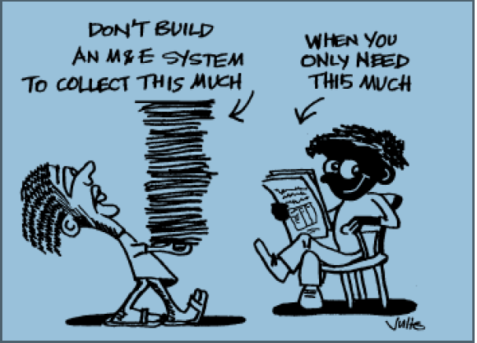
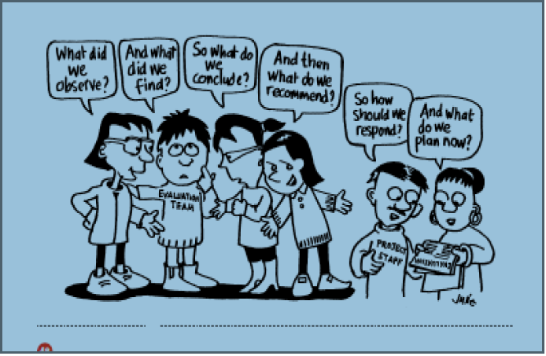
Monitoring and Evaluation

Slide 9
Outcome Indicators

Slide 10
An Indicator is…
a variable
that measures
one aspect of a program/project or health outcome
An appropriate set of indicators includes at least one indicator for each significant aspect of the program or project
Notes:
Speaker Notes
An indicator is a variable that measures one aspect of a program or project. Let’s take a moment to go over each piece of this definition. The purpose of indicators typically is to show that a program activities are carried out as planned or that a program activity has caused a change or difference in something else. Therefore an indicator of that change will be something that we reasonably expect to vary. Its value will change from a given or baseline level at the time the program begins, to another value after the program and its activities have had time to make their impact felt, when the variable, or indicator, is calculated again.
Secondly, an indicator is a measurement. It measures the value of the change in meaningful units for program management: a measurement that can be compared to past and future units and values. A metric is the calculation or formula that the indicator is based on. Calculation of the metric establishes the indicator’s objective value at a point in time. Even if the factor itself is subjective, like attitudes of a target population, the indicator metric calculates its value objectively at a given time.
Thirdly, an indicator focuses on a single aspect of a program or project. It may be an input, an output, or an overarching objective, but its related metric will be narrowly defined in a way that captures that aspect as precisely as possible.
A full, complete, and appropriate set of indicators for a given project or program in a given context with given goals and objectives will include at least one indicator for each significant aspect of program activities.

Slide 11
What makes a good indicator?
Timely
Measurable
Precise
Reliable
Valid
Relevant
Valid: Accurate measure of a behavior, practice or task
Reliable: Consistently measurable in the same way by different observers
Precise: Operationally defined in clear terms
Measurable: Quantifiable using available tools and methods
Timely: Provides a measurement over periods of time of interest
with data available for all appropriate intervals
Relevant: Linked to a public health impact or to achieving the objectives needed for impact
Notes:
Speaker Notes
What makes a good indicator? Fundamentally, good indicators must be valid and reliable measures of the result. The other desirable characteristics listed here all serve in a sense as aids that help guide the design of indicators and metrics toward this ideal or goal of valid, reliable indicators.
Valid: An indicator is valid when it dictates an accurate measurement the activity, output or outcome of the program.
Reliable: An indicator is reliable when it minimizes measurement error, that is when it is possible to measure it consistently over time, regardless of the observer or respondent.
Precise: Indicators should be operationalized with clear, well-specified definitions.
Timely: Indicators should be measured at appropriate intervals relevant in terms of program goals and activities.
Comparable: Where possible, indicators should be structured using comparable units, denominators, and in other ways that will enable increased understanding of impact or effectiveness across different population groups or program approaches.
Next, each of the characteristics of good indicators will be discussed and examples of good and problematic indicators identified.
Additional Background
These technical issues will be covered as ideals toward which to strive. Later slides will discuss a number of caveats and trade-offs often necessary in terms of the pragmatic management of programmatic M&E.

Slide 12
Common Pitfalls in Indicator Selection
Indicators not linked to program activities
Poorly defined indicators
Indicators that do not currently exist and cannot realistically be collected
Process indicators to measure outcomes & impacts
Indicators that are not very sensitive to change
Too many indicators

Slide 13
Implementation Outcomes
Notes:
A critical yet unresolved issue in the field of implementation science is how to conceptualize and evaluate success.
Studies of implementation use widely varying approaches to measure how well a new treatment, program, or service is implemented.

Slide 14
Implementation Outcomes
Implementation outcomes as the effects of deliberate and purposive actions to implement new treatments, practices, and services.
Three important functions: “serve as”
  Indicators of the implementation success
  They are proximal indicators of implementation processes
  They are key intermediate outcomes
Notes:
‘‘implementation outcomes’’ distinct from service system and clinical treatment outcomes

Slide 15
Types of implementation outcomes
Implementation outcomes
Acceptability
Service outcomes
Efficiency
Patient outcomes
Morbidity
Safety
Effectiveness
Equity
Patient-centerdness
Timeliness
Mortality
Health Status
Quality of Life
Penetration
Adoption
Appropriatenes
Costs
Feasibility
Fidelity
Penetration
Sustainability

Slide 16
Implementation Outcomes
an intervention or treatment will not be effective if it is not implemented well, implementation outcomes serve as necessary preconditions for attaining subsequent desired changes in clinical or service outcomes

Slide 17
RE-AIM Evaluation Dimensions
Dimension | Definition (Proportions) | Level
Reach | Proportion of the target population that participated in the intervention | Individual
Effectiveness | Success rate if implemented as in guidelines; defined as positive outcomes minus negative outcomes | Individual
Adoption | Proportion of settings, practices, and plans that will adopt this intervention | Organization
Implementation | Extent to which the intervention is implemented as intended in the real world | Organization
Maintenance | Extent to which a program is Individual and organization sustained over time | Individual & Organization
Impact = R x E x A x I x M
Source: Glasgow et al. Am J Pub Hlth 1999; 99:1322-7.
Notes:
Impact: .5*.5*.5*.5 = 6% benefit

Slide 18
Part Two : Impact Evaluation

Slide 19
Impact evaluation
the systematic process of assessing the causal effects of development interventions, focusing on whether observed changes in outcomes can be attributed to the program itself rather than to other factors
World Bank definition

Slide 20
Why Study?
WE ARE MAKING DECISIONS
    Continue the intervention
    Expand the intervention
Notes:
The question is why do we study causality? The reason why we look at causality is because we are going to make a decision. There are two decisions a program manager will face one a program has been put in place. The first is whether to continue the intervention. The second decision is whether to expand an intervention that has been successful. Let us take this example. We have done a study of bars and nightclubs to determine which are the most important venues where people go to meet new sexual partners. We have also mapped out condom outlets in the area and realize that there are few condom outlets around the most popular venues. So we design an intervention. The intervention will involve working with the bar managers and DJ to put colored condoms in baskets on the tables and condom balloons all over the bar/nightclub. The placement of condoms in bars and nightclubs is our program or intervention. What is the evaluation question that we need to answer: Will condom use increase among the clients if there are condoms available on site in bars and night clubs?

Slide 21
What an impact evaluation demonstrates?
Did the desired outcome occur?
Did the new intervention make a difference?
Can we attribute the change in outcome to the intervention?

Slide 22
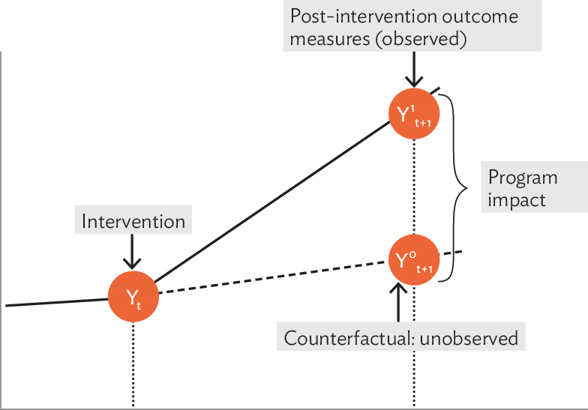
Basic impact evaluation question
What is the impact or causal effect of a program P on an outcome of interest Y?
α = (Y | P = 1) − (Y | P = 0)
How do we know Y when P=0 ?
  Control population
  Extrapolation
Notes:
This formula says that For example, if P denotes a training program and Y denotes data use, then the causal impact of the training program (α) is the difference between a person’s data use (Y) after participating in the training program (in other words, when P = 1) and the same person’s data use (Y) at the same point in time if he or she had not participated in the program (in other words, when P = 0). To put
Impact (α) of a program as the difference in outcomes (Y: person’s data use) for the same person with (P=1) and without participation (P=0) in a program at the same point in time
estimating the counterfactual
We would like to measure data use at the same point in time for the same unit of observation (a person, in this case), but in two different states of the world

Slide 23
What is Causality?
When one event produces a second event
Notes:
We have been talking about causality. Let us now define the simple concept of causality. Causality is when one event produces a second event.

Slide 24
Causality Requirements:
How do we demonstrate causality?
A precedes B
B is present only when A is present
We can rule out all other possible causes of B.
PMT and improved data use
PMT implemented to see the change in data use
Data use improvement is seen only when we have good PMT
Other cause of improved data use shall be ruled out
Notes:
How do we demonstrate causality? In the example on bars, A is our program and B is a change in condom use. The first thing we have to demonstrate is that the program came before condom use. But that is not enough. The second condition for demonstrating causality is that B is present when A is present, which means that we only get a change in condom use when the program is present. There is a third requirement. Let’s say that when we are implementing a program, the president comes on the air and says that everyone must use condoms to protect themselves against HIV. This type of occurrence is called an extraneous event, because it is not part of the planned intervention. A strong study design is needed that will help us to rule out the possibility that it is the President’s speech that caused a change in condom use. Hence, our third requirement is ruling out all other possible causes. The way we do this is by random assignment.

Slide 25
Hierarchy of impact evaluation approaches
Randomized Control Trial
Implementation Hybrid Trial
Experimental
Stepped Wedge Design
Regression Discontinuity Design
Instrumental Variable Analysis
Quasi-Experimental
Strength of evidence
Feasibility with secondary data
Difference in Differences Analysis
Time Series Analysis
Dose-Response Analysis
Observational
Pre-Post / Correlation Analysis

Slide 26
Types of impact Evaluation Designs
Experimental
  Strongest for demonstrating causality, most expensive
  Subtypes - stepped wedge, hybrid
Quasi-experimental
  Weaker for demonstrating causality, less expensive
Non-experimental
  Weakest for demonstrating causality, least expensive
Notes:
Evaluation designs that are commonly used can be classified into three groups: experimental designs, quasi-experimental designs, and non experimental designs. One may also classify these designs in terms of the extent to which they can inspire confidence that a program was responsible for causing the change in observed outcomes, experimental designs are the strongest designs for looking at program impact, followed by quasi-experimental designs. Non-experimental designs are the weakest designs for evaluating program impact but they are also the least expensive.

Slide 27
Non-experimental Design

Slide 28
Non-Experimental:
Pretest-Posttest (before-after intervention)
Time
Intervention group
O₁ X O₂
Notes:
This is a weak design for measuring causality because we only have one measurement before and one measurement after. And we know that there are always random fluctuations. We do not know the trend. Seasonality is not controlled. When can you use this design? For e.g., if we put yellow condoms in the market, will someone buy them? There was a study done in a rural area of Mali, one of the poorest countries in the world. They put a CBD program in this rural area. Then did a prevalence survey and found that contraceptive prevalence went up from 1% to 15%. Now we have to convince people that the change was due to the program. We can argue that we cannot find any observable bias (for example, there are no condom distribution points that were established by other people during the period, no health facilities, etc.). There could be unobservable bias (e.g., more people from this rural area visited the nearest urban center and became exposed to more information, etc.
This design is useful for measuring change over time. Since there is no control group, causal attribution is not possible.
In many instances, we want to observe changes in behavior but are not necessarily interested in linking those changes to a specific program. For example, we may want to measure changes in condom use in the general population of a country over a 5 year period. This can be done by using two rounds of nationally representative surveys such as the DHS surveys, which are often done over a 5 year period. This information can be very important to get an overall picture of what is happening at the national level and to determine what level of effort is needed for the future.
Although non-experimental studies are not suitable for determining the effectiveness of interventions, they are often used for program evaluation. In some cases they are the only option available for evaluating certain types of programs. For example, certain types of programs reach the entire population. A national mass media campaign to promote condom use may utilize radio and television which may have widespread reach. In such a case, it is not possible to have a control group that has not been exposed to the intervention. (A control group is only possible when program planners can direct the intervention to certain groups and not to others. Programs that are expected to reach the entire target population are referred to as full-coverage programs.)
When used for program evaluation, pretest posttest non-experimental study designs are weak because there is only have one measurement before and one measurement after the intervention. Two measurements do not constitute a trend. Besides, the lack of a control group means that history effects (extraneous events) are an important threat to validity.

Slide 29
Summary of Non-Experimental Designs
One-Group, Pre- and Post-test (before-after)
One-Group, Post-test (after intervention) Only
ASSESS TARGET GROUP BEFORE PROGRAM
ASSESS TARGET GROUP AFTER PROGRAM
IMPLEMENT PROGRAM
IMPLEMENT PROGRAM
ASSESS TARGET GROUP AFTER PROGRAM
Notes:
These are the most common type of evaluation designs. These may be used to determine the levels of outcome variables, e.g. the level of condom use in a country, or to measure changes in outcome variables over time. They are also used to evaluate the effects of full coverage programs, programs that are intended to reach everyone in the target audience. It is not possible to make causal attributions with this type of study design.
In the first design, you assess your target group both before and after program implementation. The strength of this design is that it provides baseline information that you can compare with your post-test data. For this design to work, you must administer the same instrument in the same way both before and after the program. This design can tell you whether your target group made improvements, but cannot assure you that your program was responsible for the outcomes. Alternative explanations are still possible (e.g., change occurred because participants matured over time).
In the second design, you would administer a post-test (e.g., survey) to your target group after participants have received an intervention. This design is often used if an intervention has already happened before the program thinks about doing an evaluation. This design is common and relatively inexpensive, but it does not allow you to assess how much change has occurred because you do not have a baseline. It also does not allow you to measure change in relation to other groups of people who did not take part in the program.

Slide 30
Limitations of Non-Experimental: Pretest-Posttest (before-after) Design
Don’t know what kind of results might have been obtained without the program
Causal attribution not possible
Cannot detect small but important changes, therefore
  Need to describe program in detail
  Need to assess whether program was implemented as planned

Slide 31
Non-Experimental Design: Time Series
Time
Intervention group
O₁ O₂ O₃ X O₄ O₅ O₆
Options:
  Same group of people measured many times
    (longitudinal time series)
  Successive groups of different people
    (successive group time series)
  Time series with comparison group
Notes:
This is called a time-series design. It is stronger than a pretest posttest only design that has the advantage of multiple measures before and after the program intervention. In the case of our previous example of the mass media intervention to promote condom use where the sports figure publicly admits to having HIV and promotes condoms, this is a stronger design because it enables us to measure trends over time. Non-experimental designs are the weakest designs for drawing causal inferences. A time series design is stronger than a pretest posttest only design.

Slide 32
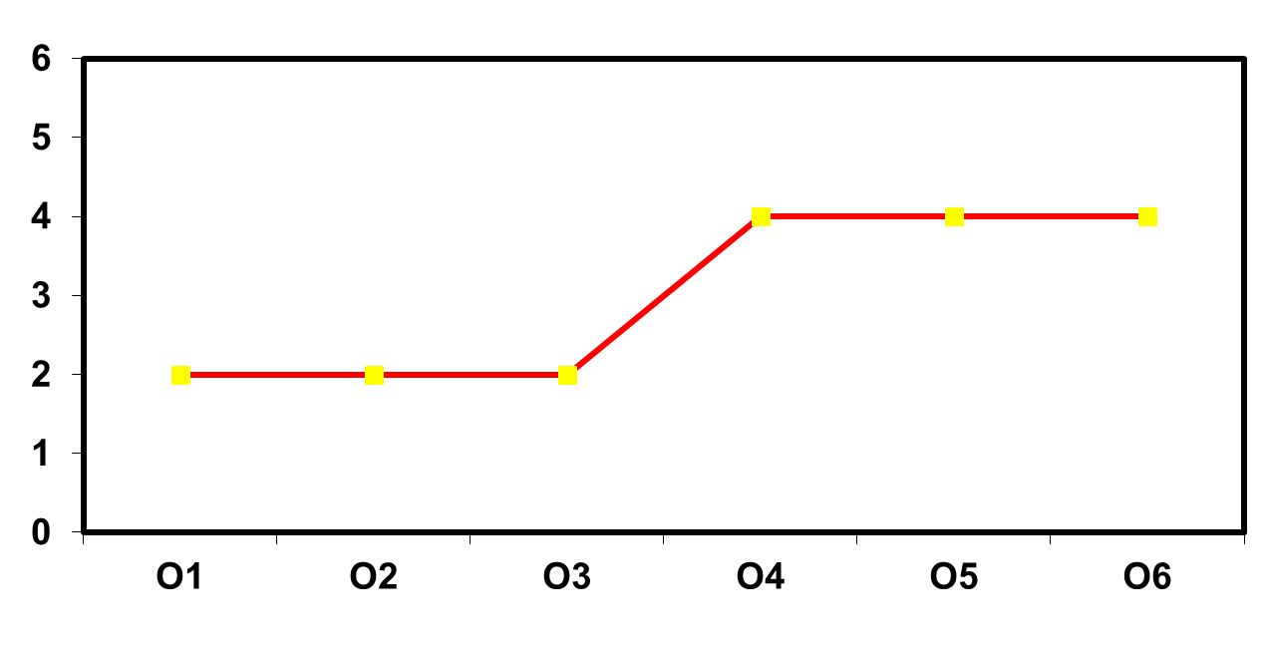
Effect of Program Intervention I
Millions of Condoms Sold
X
Notes:
The program intervention in this example is a mass media advertising campaign. Before and after the campaign, commercial retail audits are conducted in pharmacies to determine condom sales. What is the likely explanation for this change:
(Answer: The most likely explanation for the change is the campaign. But another explanation might be a history effect, such as a decrease in prices, or an instrumentation effect, such as a change in the methodology used to calculate sales by the company conducting the retail audit that happened between O3 and O4.)

Slide 33
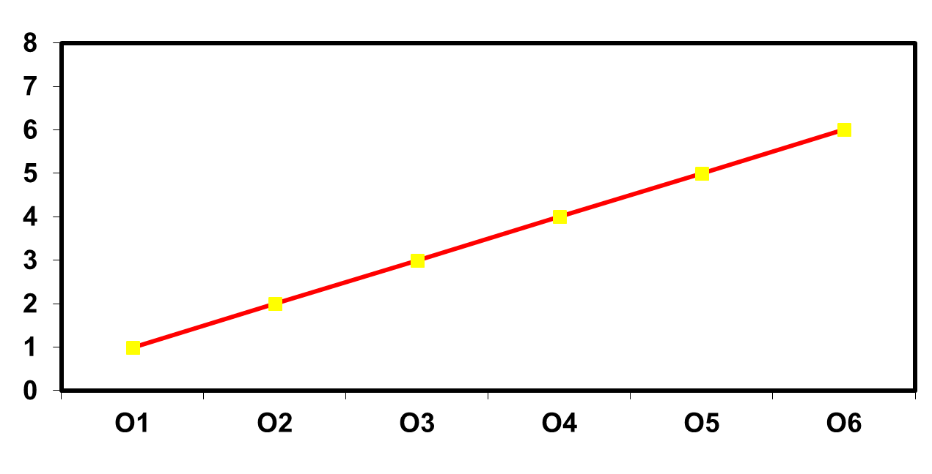
Effect of Program Intervention II
Millions of Condoms Sold
X
Notes:
What conclusion can you derive from this graph?

Slide 34
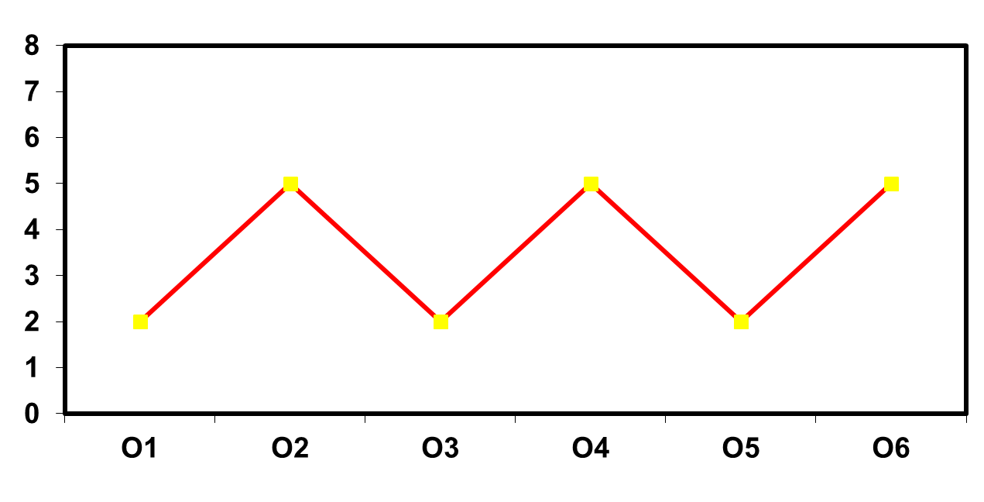
Effect of Program Intervention III
Millions of Condoms Sold
X
Notes:
What conclusion can you derive from this graph? If the evaluation had used a pre-test and post-test design, with O3 being the pretest and O4 being the post-test, what conclusion would the evaluator have derived?

Slide 35
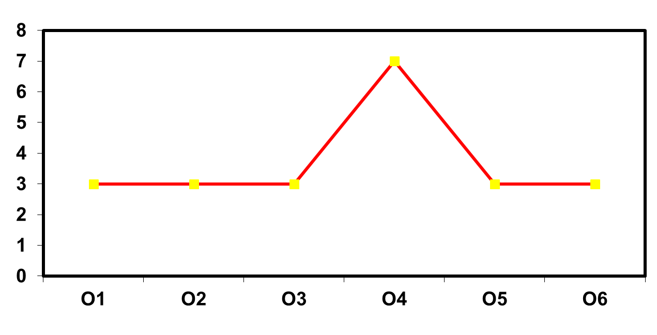
Effect of Program Intervention IV
Millions of Condoms Sold
X
Notes:
What conclusion can you derive from this graph? If the evaluation had used a pre-test and post-test design, with O3 being the pretest and O4 being the post-test, what conclusion would the evaluator have derived?

Slide 36
Number of pregnant mothers who visited health centers for ANC , SNNPR, 2015.

Slide 37
Number of pregnant mothers who delivered in health centers, SNNPR, 2015

Slide 38


An Experimental Design
No Intervention
Intervention
outcome
outcome
<
>
=

Slide 39
An Experimental Design
Time
Intervention group
O₁ X O₂
RA
Control group
O₃ O₄
Notes:
RA refers to random assignment. As we described earlier, random assignment produces two equivalent groups. One of these is the group that receives the intervention and the other is the control. We take measurements or observations on both these groups. What do we mean by measurement or observation? We mean that we collect date. Observations are denoted by O. The subscripts distinguish observations from each other. For example, O₁ and O₂ are two different observations on the group that receives the intervention. X denotes the intervention. The arrow denotes the passage of time. The fact that X is in the same row as O₁ and O₂ denotes that the a single group of subjects received the intervention. Overall, the diagram shows that two groups were created through random assignment. The experimental group received the intervention while the control group did not. Two observations or measurements were taken on each group, a pretest observation and a posttest observation. If the randomization worked as it is expected to, the pretest measures on each group, O₁ and O₃ should be the same. In other words, the level of condom use among men in experimental and control bars should be the same at pretest. Because the control group does not receive an intervention, O₃ and O₄ should also be the same. In other words, there should be no change in the control group because it did not receive the intervention. Finally, if the intervention works, O₂ should be greater than O₁. Thus, while both groups had the same level of condom use at pretest, the intervention group will have a higher level of condom use than the control group at posttest. This is known as a classic experimental study, with pretest and posttest measurements.
Researchers who design studies to make causal inferences encounter a number of threats to the validity of their designs. By validity of a design, we mean the ability of a design to measure the “true” impact of an intervention. In other words, when we observe that there is a change in the experimental group but not in the control group, we can be sure that what we observe is not a consequence of factors outside the program. We do not want to reach invalid conclusions.

Slide 40
The Basic Experimental Principle
The intervention is the only difference between two groups
This is achieved by random assignment
Notes:
The two groups that we want to use to determine the effectiveness of the intervention should be equivalent in all ways except that one received the intervention and the other doesn’t. How do we create two such groups? Through random assignment. This helps in achieving equivalence between groups and is necessary for demonstrating causality. Let us take the example where we want to test the effectiveness of condom availability in 100 bars. What should be randomly assigned? In this case, bars should be randomly assigned since we don’t know the individuals who frequent these bars. How do we randomly assign these 100 bars? We could use a coin to do this. If the coin toss produces heads, I put the first bar in one group. If the coin toss produces tails, I put the second bar in a second group. Because I am using a random process of assigning bars to groups rather than my personal opinion, there is no bias involved in assigning bars to these groups. Using this process should produce two equivalent groups of bars.
Let us look at the notation to describe an experimental study to determine the effectiveness of the bar intervention.

Slide 41
Post-test (after intervention) Only Experimental Design
Time
Intervention group
X O₂
RA
Control group
O₄
Notes:
If we think that a testing effect is likely in a population (and this could be in the case of sexual behavior in a society where it is not discussed openly), a posttest only experimental study design can be used which enables us to avoid this threat.
As before, all bars are randomly assigned to experimental and control groups but no pretest is conducted. We compare posttest measurements only. We would expect O₂ to be greater than O₄ if the intervention worked. This design helps us to get around the problem with a testing effect. However, it has two limitations. Since we do not have the pretest measurements on intervention and control groups, we cannot be sure as to how well the randomization actually worked. Moreover, it is not possible to measure the extent of change resulting from the intervention.
Class activity:
In what situations are evaluators likely to use this design? (Answer: when the program is faced with serious time or budget constraints; when baseline/pretest data are not available). How can the design be used to study the effectiveness of an HIV/AIDS prevention course in reducing risky sexual behavior among high school students? (Answer: schools will be randomly assigned to experimental and control groups. Student will not be asked to fill out a pretest questionnaire before randomization but would do so at a specific interval, say 6 months, after the course).

Slide 42
Uses of Post-test Only
Experimental Design
Post-test (after intervention) only is cheaper and quicker
Useful when pre-test (before intervention) can interfere with program effects, e.g. measuring attitudes & knowledge
Randomization ensures equivalent experimental and control groups
However, pre-test post-test (before-after) design always preferred

Slide 43
Why is it Important to Have a Pretest (before intervention test)?
Allows us to check:
  Whether program is going to people for whom it was intended
  Comparability of groups
  How much change has occurred
    You do not know how far you have come if you do not know where you were to begin with.
When should a pre-test (before intervention) not be used?
Notes:
A Pretest allows us to check if the program is going to people for whom it was intended. It also enables us to check on comparability of groups. In randomized experimental designs, a pretest allows one to ensure equivalent groups were formed if the number of units involved is small (say less than 15 per group) or if the variability is large (range of 70 to 120. More important, a pretest allows us to measure the amount of change that has occurred.
Class Activity:
Ask class when a pretest should not be used. (Answers: if taking a pretest will affect participants in some measurable way such as if stating one’s attitudes can affect those attitudes; When using a pretest would be meaningless (e.g. teaching Swahili to English Speaking children. If a program is already in place and no pretest was given. You can’t turn back the clock to interject the appropriate pretest for a program that is already underway.)

Slide 44
Experimental Design May Not Be Possible
Randomization needed before program starts
Ethics
  Solution: Use alternative program rather than no program
Political factors
Scale-up
  Solution: Start out on small scale and use delayed program strategy
Inability to generalize results
Known efficacy of intervention
Notes:
Experimental designs are often not feasible for measuring program effectiveness for several reasons. The first reason is that randomization should be done before the program starts but often the evaluator is brought in well after the program has been implemented. Second, for ethical reasons, it may not be possible to randomly assign people to experimental and control groups and some people may object to not receiving an intervention. This barrier may be overcome by using an alternative program than no program at all. The alternative program could be one you have never tried and which is similar to the intervention but one which you are unlikely to adopt. Additionally, political factors may influence the choice of where to place a new intervention. Sometimes, under political pressure, program planners may direct a program to better off communities. Even if it were possible for the evaluator to randomly allocate individuals, groups or communities to treatment and controls, many governments are scaling up. The eventual extension of the program to all communities and individuals is important for ethical reasons. But this means that the randomized designs are not appropriate for looking at effects with long-time lags after the intervention begins. In addition, if one has a randomized allocation to treatment or control as part of a pilot project, one may only be able to show that the program activities caused the results in the particular community or area. That particular community or area may represent ideal conditions that are far from the reality of other regions, communities or areas. The program may not work as well if implemented in a different region or community. Therefore, in spite of the randomization process, one may not be able to generalize the results of an intervention, which would make the results irrelevant to the decisions that need to be made. Randomization may also be of limited use in assessing large-scale programs if the interventions has proven efficacy in field trials.

Slide 45
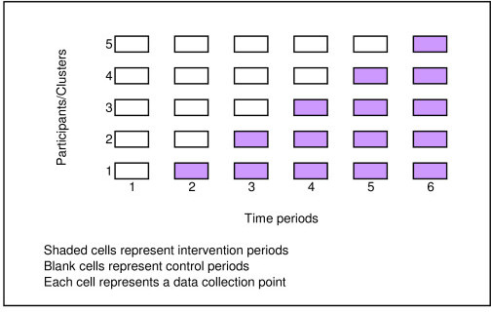
Stepped wedge design
Everyone gets the intervention
but some randomly get it earlier than others

Slide 46
Effectiveness-implementation Hybrid Designs
Type 1- Primarily testing effects of an intervention
3 hybrid types
Type 2- Dual testing of effectiveness and implementation interventions/strategies
Type 3- Primarily testing of an implementation strategy

Slide 47
A Quasi-Experimental Design
Time
Intervention group
O₁ X O₂
---------------------------------
Comparison group
O₃ O₄
Notes:
47
This is a design that can be useful for program evaluation. It is stronger than a non-experimental design. Instead of a control group (which is created by random assignment), this design has a comparison group. A comparison group is selected if its observed characteristics are similar to the observed characteristics of the experimental group. As you can see, the experimental and comparison groups are separated by a broken line. This broken line means that the groups were not been randomly assigned. This design could be useful when we want to study the effect of a program that is implemented in one area, for example, in one district, and you want to compare the effects of the program against a similar neighboring district. The comparison district can be chosen based on similar observed characteristics such as the average income level, the types of public and private health facilities etc. However, there may be other unobserved differences between experimental and comparison districts that would be a threat to validity. These differences may only be discovered when more detailed information is collected during the pretest. You can use pretests (O₁ and O₃) to assess how similar experimental and comparison groups are at baseline in terms of education, age, marital status and other important characteristics that might influence oral contraceptive use. If experimental and comparison groups are similar, and the intervention is effective, O₂ should be greater than O₄. However, if experimental and comparison groups are different on important characteristics this is a threat to validity known as selection.

Slide 48
Quasi-Experimental Design
(Before and after intervention test with Comparison Group but not randomized)
ASSESS TARGET GROUP A BEFORE PROGRAM
ASSESS TARGET GROUP A AFTER PROGRAM
IMPLEMENT PROGRAM
ASSESS COMPARISON GROUP B BEFORE PROGRAM
ASSESS COMPARISON GROUP B AFTER
PROGRAM
Notes:
The second design is the quasi-experimental design. What steps do you take to implement this methodology?
(1) Identify people who will be getting the program.
(2) Identify people who are not getting the program, but are in other ways very similar.
(3) Pre-test both groups.
(4) Deliver the intervention to TARGET GROUP A. The comparison group may receive an alternative intervention or nothing at all.
(5) Post-test both groups.
The addition of a comparison group helps you determine whether or not your target group would have improved over time even if they had not been exposed to your program. The more similar the two groups are with respect to variables that may affect program outcomes (e.g., gender, race or ethnicity, socioeconomic status, and education), the more confident you can be that your program contributed to any detected changes. Quasi-experimental designs are in-between the other two types of designs in terms of their strength and costs associated with them.
Example:
A nurse, working in an OB/GYN clinic wanted to see if her HIV education programs were increasing awareness of HIV/AIDS among pregnant women and new mothers. She asked a colleague working in another OB/GYN clinic to help her. Women in their second trimester of pregnancy in both clinics were asked to complete a pre-test. Antenatal visits by women in the experimental clinic also included regular HIV education messages, delivered during their routine clinic visits. At the post-partum visit, six weeks after the birth of their child, participants at both clinics completed the post-test. If the intervention proves successful, there would be greater improvement in HIV/AIDS awareness among women in the experimental clinic than among women in the control clinic. If the intervention is successful, the information could be used to train other nurses to deliver prevention messages during the regular course of their work.

Slide 49
What factors May Lead to Invalid Conclusions
Selection effects: Occur when people selected for a comparison group differ from the experimental group.
Notes:
The quasi-experimental design is useful when randomization is not possible. However, you need to demonstrate that the intervention and comparison group are as alike as possible except for the difference in the program. One factor that may lead to invalid conclusions is selection. For example, a training of all health providers is conducted among all providers of District A in a country. An adjacent district, District B, which is thought to be similar in terms of clinic facilities serves as a comparison district. However, when data is collected during the study, the researchers find that the providers in District A have, on average, been in service for longer than providers in District B and have been exposed to more trainings during the period of their employment. Another example is that you are testing a curriculum and the kids in the program schools did better than kids in the comparison schools. People might say that the kids in the program areas were smarter. They did better because the parents of many of the kids were professional. The control group may have started out lower than the program group so naturally, they finished lower.

Slide 50
Doing a Before-and-After Evaluation of the Training Program
 | Impact Using Before-After (Regression Analysis)
 | Pre test | Post test | Difference | t-test | Linear regression
Estimated impact of training on Knowledge

Slide 51
Thank you!

Slide 52
Supplementary slides

Slide 53
Pitfalls with Selecting Indicators
Indicator not linked to program activities
IR: Expanded access to AIDS prevention & treatment services
Activities: train providers in current clinical protocols
Inappropriate Indicator: % of facilities with adequate conditions to provide care
Better indicators: # of clinicians trained, # of facilities with a trained provider
The program is not aiming to affect facility conditions, only provider skills.
Notes:
Speaker Notes:
To summarize, here is a review of common pitfalls in selecting indicators.
One of the common pitfalls in selecting indicators is to choose one that the program activities cannot affect. This is an example of something that did occur. There was a program that planned to train health care providers in AIDS prevention and treatment services in an effort to expand access to services. The authors of this M&E plan reviewed some of the documents produced by UNAIDS and WHO and selected some indicators that seemed important. Specifically, they wanted to report the proportion of health care facilities with adequate conditions to provide care. However, many things go into that proxy indicator, including supervision, supplies and equipment availability, and the drafting of appropriate treatment protocols – several things that the program does not intend to address directly. In trying to use a global indicator, they overlooked the fact that it was not related to their program activities. A better indicator would be the # of clinicians trained or the # of facilities with a trained provider.
Ideally, indicators will provide feedback to the program so that changes can be made to activities to more effectively or efficiently reach program objectives. If an indicator is not something that is affected by program activities, not only is the indicator measuring something irrelevant, but it also is measuring something that cannot be useful for the program.

Slide 54
Pitfalls with Selecting Indicators
Indicator poorly defined
Activity: radio campaign to dispel myths about HIV transmission and prevention
Inappropriate Indicator: % of population with HIV knowledge
Better indicators: % of population with no incorrect beliefs about HIV (defined as: % correctly rejecting the two most common local misconceptions about HIV and who know that a healthy-looking person can transmit HIV)
HIV knowledge does not indicate what is desirable: knowledge that HIV exists? How is it transmitted?
Notes:
Speaker Notes:
Another common mistake is to choose a vague indicator. Although in many cases an indicator cannot be fully understood unless seeing the precise definition of how it is calculated, it is possible to have a more readily interpretable indicator. In this example, an IEC campaign to increase AIDS knowledge is to be monitored by the “AIDS knowledge” of the population. In this case, it is not clear what type of knowledge is being measured. A clearer indicator would be one that measured precisely the objective of the campaign, the proportion of the population having no incorrect beliefs. Of course, the definition provides even more information.

Slide 55
Pitfalls with Selecting Indicators
Data needed for indicator not available
Inappropriate Indicator: % of days per quarter that service delivery points have stock-out of drugs
Data issue: Information on stock-outs may not be
collected daily
Better indicators: % of service delivery points that had a stock out of drugs at some time during the last quarter
If relying on routine data, indicator definition must depend on how data are collected.
Notes:
Speaker Notes:
Another common mistake is to select an indicator that relies on routine data without verifying that the data are available as you defined it. This is another “real world” example.
A program working on drug supply selected an indicator collection information on stock outs by the number of days there were any stock outs. When checking with the information collected at the health facilities, it was found that information about the number of days that drug stock outs occurred, rather they collected information about whether there were any stock outs in each quarter. In addition, there were interpretation issues related to what the proportion of days means for more than one service delivery point. (Would it have been the average proportion of days per quarter there was a stock out?) So, this indicator was changed to account for the fact that information on stock outs is collected as a yes/no variable as well as to better represent the intended result of the program.

Slide 56
Pitfalls with Selecting Indicators
Indicator does not accurately represent desired outcome
IR: Expanded access to antiretroviral treatment (ARVs) for pregnant women to prevent mother to child transmission of HIV
Inappropriate Indicators: % of women on ARVs who are pregnant; % of people on ARVs who are pregnant women
Better indicator: % of HIV positive pregnant women who
are on ARVs
What does it mean if inappropriate indicators increase? Decrease? Do they reflect the desired program effect?
Notes:
Speaker Notes
This example also comes from a real experience. In this example, the problem with the inappropriate indicators was not readily evident to the authors of the M&E plan. The details of each indicator’s definition must be considered.
Discussion
For the first indicator labeled as inappropriate on the slide, what is the implied numerator and denominator?
In the first inappropriate indicator, the definition is:
Numerator: # of women on ARVs who are pregnant
Denominator: # of women on ARVs
In other words, this indicator tells us, of all the women on ARVs, how many are pregnant. The denominator is all women on ARVs. If the denominator increases, that is, if more non-pregnant women receive treatment for HIV but the number of pregnant women receiving treatment stays the same, the indicator decreases. If the indicator increases, it may be because more pregnant women are given treatment while other women are not. Is either of these the desired outcome of the program? Probably not.
For the second inappropriate indicator, what is the numerator and denominator?
Numerator: # of pregnant women on ARVs
Denominator: # of people on ARVs
Notice that in this indicator, the denominator was all men and women and children on ARVs, something very different than the first indicator. In other words, this indicator tells us, of all the people on ARVs, how many are pregnant women. Again, let’s consider the possible interpretations if change in this indicator is observed. If it increases over time, it might be because fewer people overall are receiving treatment, but the # of pregnant women receiving treatment has not changed. Or, it could be because there is an increase in the number of pregnant women receiving treatment, the desired effect of the program. If the indicator decreases, it might be because more people overall are receiving treatment or because fewer women are HIV positive or because there are fewer pregnant women.
In addition to the interpretation difficulties with the first two options presented above, they also do not represent the intended effect of the program. A better indicator would be the % of HIV positive pregnant women receiving ARVs. With this indicator, interpretation is not complicated by factors unrelated to this intermediate result, such as a decrease in HIV prevalence among pregnant women or the number of non-pregnant women receiving ARVs.
The definition of this indicator is:
Numerator: # of HIV positive pregnant women on ARVs
Denominator: # of HIV positive pregnant women

