Slide 1
Team 3

Slide 2
1: Making sense of implementation TMFs
Theoretical approaches used in implementation science have three overarching aims:
  Describing and/or guiding the process of translating research into practice (process models);
  Understanding and/or explaining what influences implementation outcomes (determinant frameworks, classic theories, implementation theories);
  Evaluating implementation (evaluation frameworks).

Slide 3
Five categories of theoretical approaches to achieve three overarching aims
  Process Models (describe/guide the process of translating research into practice)
  Determinant Frameworks (understand/influence implementation outcomes)
  Classic Theories (borrowed from other disciplines, e.g., psychology, sociology)
  Implementation Theories (developed within implementation science)
  Evaluation Frameworks (evaluate implementation efforts)

Slide 4
  2: Criteria for selecting Implementation TMFs
    Most Valued Selection Criteria
      Analytic Level (e.g., individual, organizational, system) – 58%
      Logical Consistency/Plausibility – 56%
      Description of a Change Process – 54%
      Empirical Support – 53%
      Generalizability – 47%
      Application to Setting/Population – 44%

Slide 5
3: Process framework: The Quality Implementation Framework
  Core Focus: A practical, "how-to" meta-framework synthesizing the critical steps for achieving quality implementation.
  Key Concepts:
    Identifies 14 critical steps grouped into 4 temporal phases:
      Initial Considerations Regarding the Host Setting
      Creating a Structure for Implementation
      Ongoing Structure Once Implementation Begins
      Improving Future Applications
    Emphasizes that most critical steps (10 of 14) occur before implementation begins.
  Provides a comprehensive, actionable blueprint for planning and executing implementation endeavors, moving beyond theory to specific steps and strategies.

Slide 6
4: Determinant frameworks: CFIR
Domain | Key Constructs | Description
1. Intervention Characteristics | - Evidence Strength & Quality - Relative Advantage - Adaptability - Complexity - Cost | The features of the intervention itself that influence its adoption. What is being implemented?
2. Outer Setting | - Patient Needs & Resources - Cosmopolitanism - Peer Pressure - External Policies & Incentives | The external economic, political, and social context. What is the external environment?
3. Inner Setting | - Structural Characteristics - Networks & Communication - Culture - Implementation Climate - Readiness for Change | The features of the implementing organization. Where is the intervention implemented?
4. Characteristics of Individuals | - Knowledge & Beliefs - Self-Efficacy - Individual Stage of Change - Other Personal Attributes | The beliefs, attitudes, and qualities of individuals involved. Who is affected?
5. Implementation Process | - Planning - Engaging - Executing - Reflecting & Evaluating | The activities and strategies used to implement the intervention. How is it done?

Slide 7
5: Classical theories/framework: The theory of diffusion
Diffusion of Innovation Theory
Core Concept
The process by which a new idea or technology spreads through a social system over time.
Key Elements
  Adopter Categories: Innovators, Early Adopters, Early Majority, Late Majority, Laggards.
  Adoption Process: Knowledge → Persuasion → Decision → Implementation → Confirmation.
  Critical Factors: Relative Advantage, Compatibility, Complexity, Trialability, Observability.
Provides a robust framework for guiding technological change, emphasizing communication and peer influence to achieve critical mass and successful adoption.

Slide 8
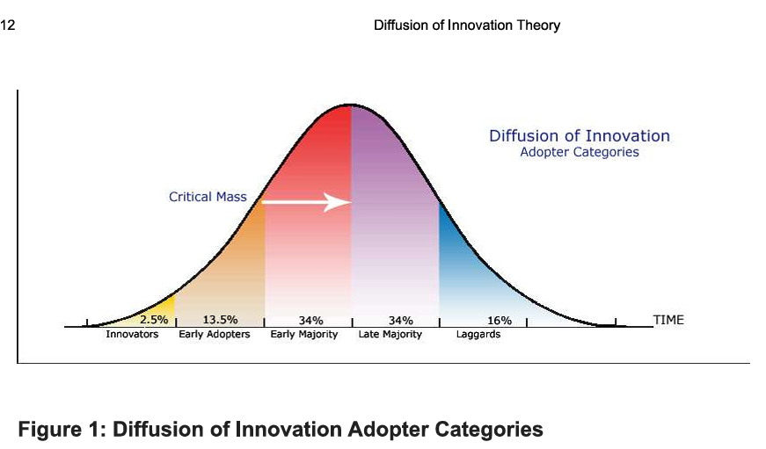

Slide 9
The Social-Ecological Model (Brief)
Core Focus: A conceptual framework for understanding the multi-level environmental and contextual factors that influence an individual's development and well-being.
Key Concepts:
  The individual is at the center, nested within interconnected systems: Family/Peers, Community, Culture/Society, and Policy/Systems.
  Each level contains distinct Risk Factors (increasing the likelihood of adverse outcomes) and Protective Factors (buffering risk and promoting positive outcomes).
  Effective interventions must address factors at multiple ecological levels, not just the individual, to be successful and sustainable.

Slide 10
6: Implementation theories/framework: The organizational change theory
Organizational readiness for change is a multi-level, multi-faceted construct.
As an organization-level construct, readiness for change refers to organizational members' shared resolve to implement a change (change commitment) and shared belief in their collective capability to do so (change efficacy).
Organizational readiness for change varies as a function of how much organizational members value the change and how favorably they appraise three key determinants of implementation capability: task demands, resource availability, and situational factors.
When organizational readiness for change is high, organizational members are more likely to initiate change, exert greater effort, exhibit greater persistence, and display more cooperative behavior.

Slide 11
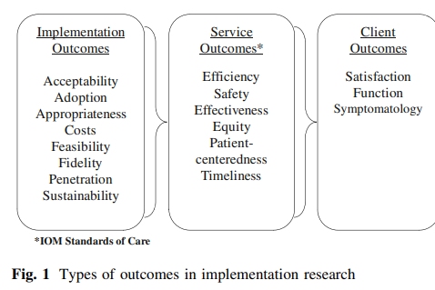
7: Evaluation framework: proctor’s outcome evaluation framework
Outcomes can help organize the key variables and frame research questions required to advance implementation science.
Their measurement and empirical test can help specify the mechanisms and causal relationships within implementation processes and advance an evidence base around successful implementation.

Slide 12
8. The Implementation Research Logic Model (IRLM)
Core Focus: A method and tool to specify and diagram the core elements and their relationships in an implementation research project.
Key Concepts:
  A semi-structured, principle-guided logic model that integrates:
    Determinants → Implementation Strategies → Mechanisms → Outcomes
  Designed to improve the rigor, reproducibility, and causal reasoning in implementation research.

