Slide 1
Implementation Theories, Models and Frameworks
By Team Two

Slide 2
What are theories, models and frameworks?
A theory may be defined as a set of analytical principles or statements designed to structure our observation, understanding and explanation of the world.
A model typically involves a deliberate simplification of a phenomenon or a specific aspect of a phenomenon.
A framework usually denotes a structure, overview, outline, system or plan consisting of various descriptive categories, e.g. concepts, constructs or variables, and the relations between them that are presumed to account for a phenomenon

Slide 3
Theories, models and frameworks in implementation science
Theoretical approaches used in implementation science have three overarching aims:
describing and/or guiding the process of translating research into practice (process models)
understanding and/or explaining what influences implementation outcomes (determinant frameworks, classic theories, implementation theories); and
evaluating implementation (evaluation frameworks).

Slide 4
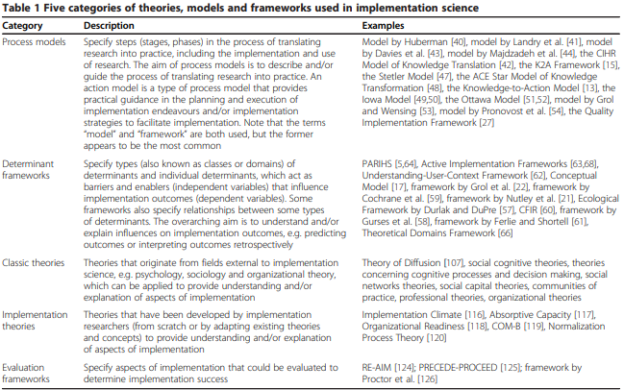

Slide 5
Criteria for selecting Implementation TMFs
Implementation scientists use a large number of criteria to select theories, but there is little consensus on which are most important.
It was found that the selection of implementation theories is often haphazard or driven by convenience or prior exposure.
It is suggested that implementation scientists may benefit from
Guidance for theory selection.
Transparent reporting of the criteria that implementation scientists use to select theories so that they can carefully consider the relevance of a selected theory instead of defaulting to theories that are convenient or familiar but are poorly suited to implementation scientists’ objectives.

Slide 6
The quality implementation framework
The Quality Implementation Framework is a practical guide that pulls together the essential steps needed to implement any program or intervention well.
It takes lessons from 25 different implementation models and organizes them into four phases:
understanding the setting and assessing readiness,
building the structures and teams needed for implementation,
supporting the process once it begins through training, supervision, and monitoring, and finally
learning from experience to improve future rounds.
In short, the QIF explains the “how-to” of high-quality implementation what to assess, what to prepare, how to support people delivering the program, and how to use feedback to make the intervention work better in real-world settings.

Slide 7
EPIS Framework – Four Phases of Implementation
Exploration
  Stakeholders recognize a public health need and assess potential Evidence-Based Practices (EBPs).
  Decision made on whether to adopt the selected intervention.
Preparation
  Detailed planning phase involving assessment of barriers and facilitators.
  Adaptation needs identified and implementation strategies developed.
Implementation
  Intervention put into action with structured support based on prior planning.
  Continuous monitoring ensures progress and informs adjustments.
Sustainment
  Systems and supports maintained to ensure ongoing delivery of the EBP.
  Adaptation continues as needed to achieve long-term public health impact.

Slide 8
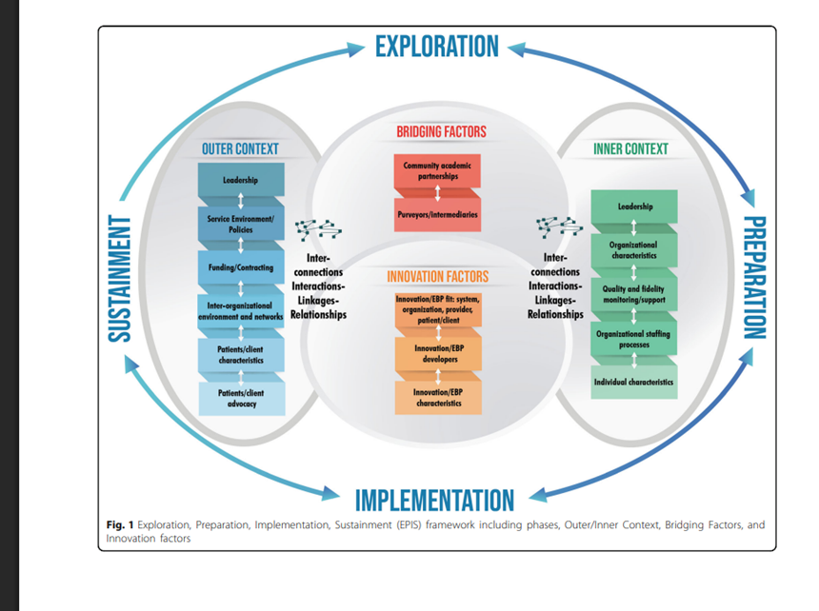

Slide 9
Consolidated Framework for Implementation Research (CFIR)
•The CFIR is intended to be used to collect data from individuals who have power and/or influence over implementation outcomes.
• CFIR includes 48 constructs and 19 subconstructs (i.e., determinants) across 5 broad domains:
1) Innovation;
2) Outer Setting;
3) Inner Setting;
4) Individuals: Roles & Characteristics; and
5) Implementation Process

Slide 10
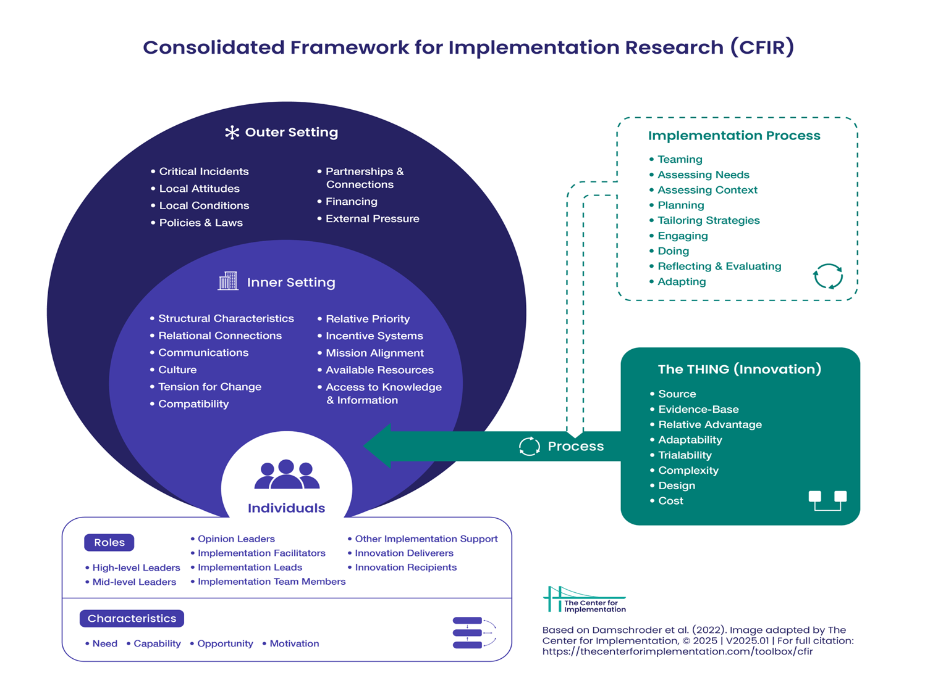

Slide 11
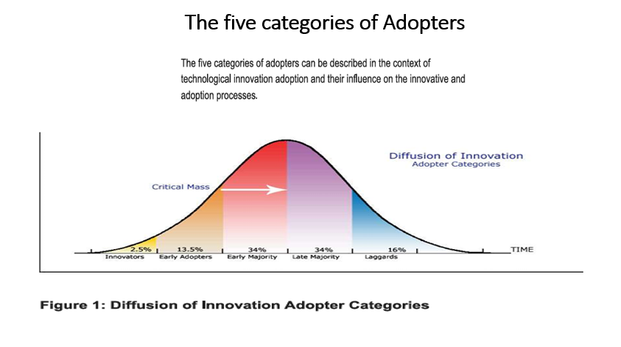
Diffusion of Innovation Theory
•In simple term the diffusion of theory is the process that occurs as people adopt a new idea, product, practice, philosophy, and so on.

Slide 12
Socio-Ecological Model
•Illustrates the importance of networks of people and structures that surround an individual
•Explains how health behaviors and outcomes are influenced by multiple levels of factors
• Individual (gender, age, socioeconomic status)
•Interpersonal/Family and peer (Parental support)
•Organizational/School level (peer to peer support, capacity of teachers, accessible physical environment and education materials)
•Community level (Cultural norms/ practices/ concepts)
•Macro-level (policy, guidelines, war)

Slide 13
Organizational change theory
Organizational readiness for change is basically about how much people in an organization want to implement a change and how confident they feel that they can do it together.
Readiness grows when staff see the change as valuable, understand what it requires, feel they have enough resources, and believe the situation allows successful implementation.
When readiness is high, people put more effort into the change, persist through challenges, and work together better, leading to stronger implementation. The theory helps clarify what truly drives successful organizational change and why some change efforts fail even when resources are available.
Notes:
It argues that readiness isn’t just about having resources—it’s a shared psychological state made up of commitment (“we believe this change is worthwhile”) and collective efficacy (“we believe we can pull this off”).

Slide 14
The Proctor Implementation Outcomes Framework
The Proctor Implementation Outcomes Framework lays out eight key outcomes that help researchers and programs understand whether an intervention is being implemented well not just whether it “works.”
These outcomes include acceptability, adoption, appropriateness, feasibility, fidelity, implementation cost, penetration, and sustainability.
The framework separates these from clinical or service outcomes, because even the best intervention won’t help people if it isn’t delivered properly.
By defining and standardizing these outcomes, the model gives researchers a clear way to measure implementation success, identify barriers, and compare different implementation strategies.

Slide 15
Implementation Research Logic Model(IRLM)
It is a method for planning, executing, reporting, and synthesizing implementation projects
Highly used model
multiple purposes :
  To improve the rigor and reproducibility of projects
  It is a road map to show how the project will be carried out
  To clearly report and specify how the project is to be conducted
  To understanding the connections between determinants, strategies, mechanisms, and outcomes of project.

Slide 16
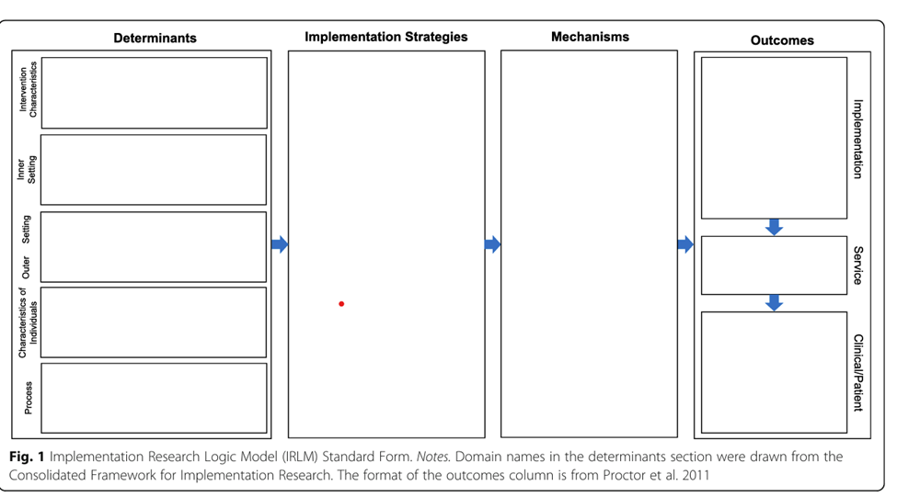
The IRLM specifies the relationships between determinants of implementation, implementation strategies, the mechanisms of action resulting from the strategies, and the implementation and clinical outcomes affected

Slide 17
Thank you!

