Slide 1
Theories, Models and Frameworks in Implementation Research
Presenter: Team 1
November, 2025
Addis Ababa, Ethiopia

Slide 2
Introduction
Theory
  A system of ideas intended to explain something.
  Description of the relationships between concepts helping to understand the world.
Model
  Schematic representations of reality to improve understanding.
  A dimensional representation of a person/thing.
Framework
  A guide for organizing information and knowledge.
  A tool help to achieve relevant and meaningful results.
TMFs are used to;
  Explain and understand why people act the way they do.
  Predict health, illness and health related behaviors.
  Justify the theoretical background.
  Generate hypotheses.
  Guide research methods.
  Develop policy and strategies.
  Guide intervention of programs.
Several review studies concluded that interventions based on theory are more effective than not using theory.

Slide 3
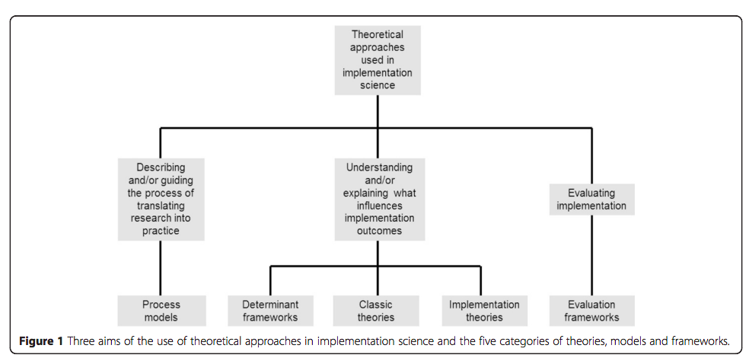

Slide 4
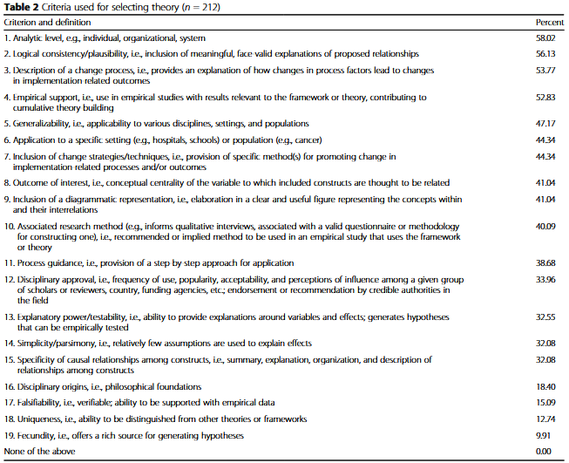
How to select appropriate TMFs?

Slide 5
Quality Implementation Framework
The QIF identifies the critical steps in the implementation process.
Synthesize insights from 25 other frameworks.
4 implementation phases and 14 critical steps
Phase One: Initial considerations regarding the host setting
  Assessment strategies
    1. Conducting a needs and resources assessment
    2. Conducting a fit assessment
    3. Conducting a capacity/readiness assessment
  Decisions about adaptation
    4. Possibility for adaptation
  Capacity-building strategies
    5. Obtaining explicit buy-in from critical stakeholders and fostering a supportive community/organizational climate
    6. Building general/organizational capacity
    7. Staff recruitment/maintenance
    8. Effective pre-innovation staff training

Slide 6
Conti....
Phase Two: Creating a structure for implementation
    9. Creating implementation teams
    10. Developing an implementation plan
Phase Three: Ongoing structure once implementation begins
    11. Technical assistance/coaching/supervision
    12. Process evaluation
    13. Supportive feedback mechanism
Phase Four: Improving future applications
    14. Learning from experience

Slide 7
Determinant Frameworks
CFIR (Consolidated framework for Implementation Research)
  Understand and evaluate factors for successful implementation of interventions.
  Help explain whether an implementation may or may not succeed.
  Includes five major domains
    Intervention characteristics
    Outer setting
    Inner setting
    Individuals characteristics of
    Process characteristics of
  It has 39 constructs and sub-constructs influencing efforts to change the practice.

Slide 8
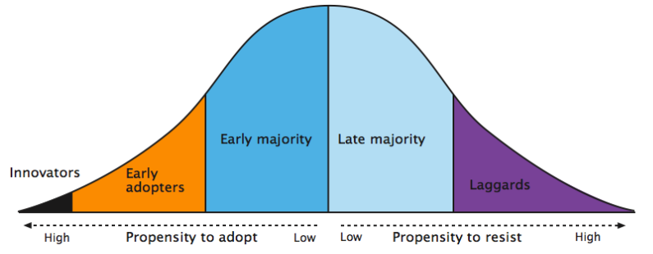
Classic Theories
Diffusion Innovation Theory
How new practices/ideas spread within society or from society to society.
Based on readiness to adapt intervention, individuals can be at different stages.

Slide 9
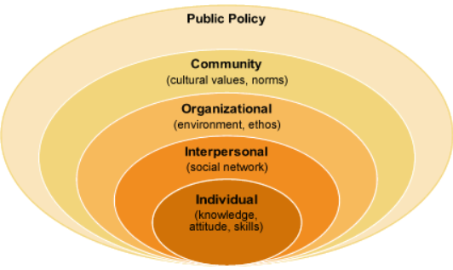
Conti....
Socio-Ecological Model
The model derived from the social-ecology system.
SEM considers health outcome is an interaction among multiple level factors within the social-ecology.
It outlines five levels of factors that influence health (McLeroy et al. 1988)
  Intrapersonal
  Interpersonal
  Institutional
  Community
  Public Policy
A number of risk and protective factors in each of level.

Slide 10
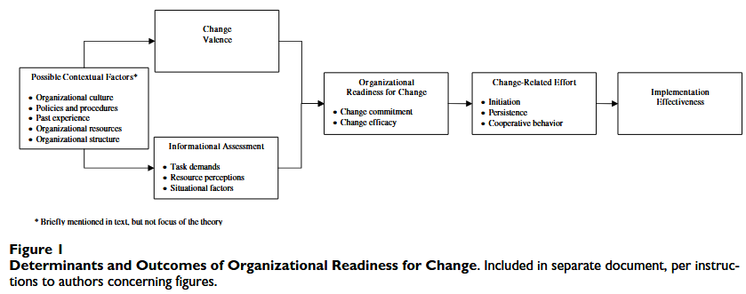
Organizational Change Theory
The theory treats organizational readiness as a shared
Psychological state in which organizational members feel committed to implementing an
Organizational change and confident in their collective abilities to do so.

Slide 11
Evaluation Frameworks
RE-AIM
  (Reach, Effectiveness, Adoption, Implementation and Maintenance)
    Address the failures and delays in translation of evidence into practice and policy.
    Improve sustainable adoptions and implementation of EBIs.

Slide 12
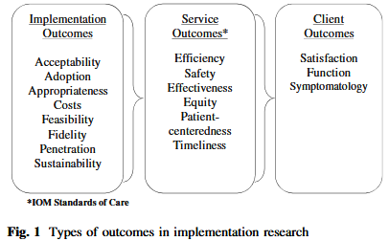
Conti....
Proctor’s Outcome Evaluation

Slide 13
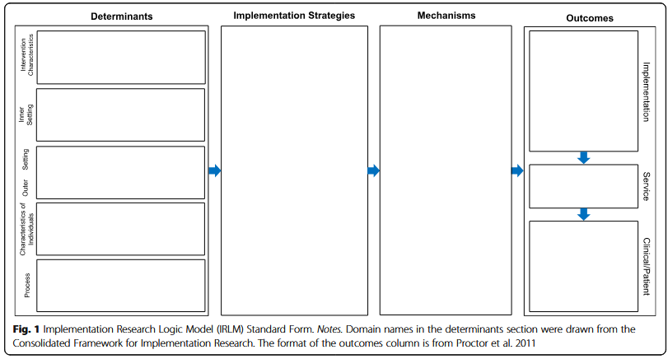
IRLM
We choose
  CFIR
  ??

Slide 14
Many Thanks

