Slide 1
Reading Reflections
Group 4

Slide 2
Making Sense of Implementation Theories, Models and Frameworks
What is the aim?
(1) describing and/or guiding the process of translating research into practice, (process model)
(2) understanding and/or explaining what influences implementation outcomes (determinant frameworks, classic theories and Implemetation theories)
(3) evaluating implementation. (Evaluation framework)

Slide 3
Cont
Five categories of theoretical approaches used in implementation science can be delineated:
Process models: Specify steps (stages, phases) in the process of translating research into practice, including the implementation and use of research. (ex: the Knowledge-to-Action Model, the Quality Implementation Framework )
Determinant frameworks: Specify types (also known as classes or domains) of determinants, which act as barriers and enablers. (Understanding-User-Context Framework)
Classic theories: Theories that originate from fields external to implementation science (social cognitive theories)
Implementation theories: Theories that have been developed by implementation researchers. (Normalization Process Theory )
Evaluation framework: Specify aspects of implementation that could be evaluated to determine implementation success. (PRECEDE-PROCEED, RE-AIM)

Slide 4
Citeria for selecting Implementation TMFs
The underuse, superficial use, and misuse of theories pose a substantial scientific challenge for implementation science and may relate to challenges in selecting from the many theories in the field.
Implementation scientists use a large number of criteria to select theories, but there is little consensus on which are most important.
Of the 19 criteria presented in the survey, the criteria used by the most respondents to select a theory included analytic level (58%), logical consistency/plausibility (56%), empirical support (53%), and description of a change process (54%). The criteria used by the fewest respondents included fecundity (10%), uniqueness (12%), and falsifiability (15%).

Slide 5
Cont
Thirty-three percent of respondents ranked empirical support as one of the three most important criteria, but only 17% ranked it number 1. Application to a specific setting/population and explanatory and power/testability were ranked second and third, respectively.

Slide 6
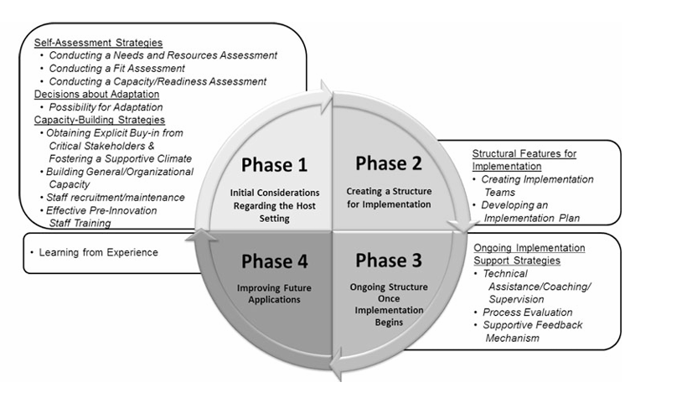
Process Frameworks: To quality Implementation Formation

Slide 7
Cont
The synthesis and translation of QIF concepts into a tool that can be used to guide the implementation process.

Slide 8
Determinant framework/ CFIR
Theories that guide the conceptualization of contextual factors are often encapsulated within determinant frameworks.
These frameworks delineate determinants (i.e., barriers or facilitators) that influence the outcome of implementation efforts.
Determinant frameworks provide a base set of concepts, terms, and definitions by which to articulate dynamic, complex contexts and develop much-needed measures of context.

Slide 9
CFIR….
The Consolidated Framework for Implementation Research (CFIR) is among the most highly cited frameworks in implementation science and has been listed in the top five most accessed articles within Implementation Science
As a determinant framework, the overarching aim of the CFIR is to predict or explain barriers and facilitators (determinants, independent variables) to implementation effectiveness (the outcome, dependent variable)

Slide 10
CFIR….
Determinant frameworks can thus be used to inform choice of implementation strategies that may best address
  Contextual determinants,
  Generate hypotheses to prospectively guide predictions of implementation outcomes,
  or retrospectively explain implementation outcomes by assessing differences in determinants across implementation settings

Slide 11
Classic theories/frameworks
Theory of diffusion
First discussed in 1903
Diffusion theory regarded as
  Valuable change model for guiding technological innovations
  Importance of communication and peer networking within the adoption process
So, it refers to a process that occurs as people adopt new ideas, product, practice, and philosophy

Slide 12
Theory of innovation…
Early innovators “spread the word” and more and more people become open to which it leads the development of critical mass
Overtime, the innovated idea/ product diffused among the population until the saturation point achieved
Rodgers Categories of adopters
  Innovator
  Early adopter
  Early majority
  Late majority
  Laggards
  Non-adopters

Slide 13
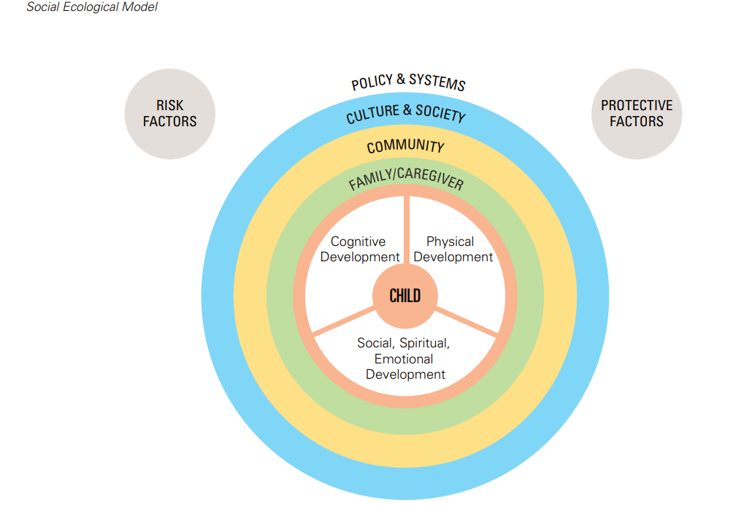
socioecological model
The social ecological model illustrates
  The importance of networks of people and structures that surround a child or adolescent,
  Safeguarding their well-being and sense of agency, and supporting their optimal development.

Slide 14
Implementation theory/frame work
Organizational change
Organizational readiness for change is a multi-level, multi-faceted construct.
As an organization-level construct, readiness for change refers to organizational members' shared resolve to implement a change (change commitment) and shared belief in their collective capability to do so (change efficacy).
Organizational readiness for change varies as a function of how much organizational members value the change and how favorably they appraise three key determinants of implementation capability:
  Task demands, resource availability, and situational factors.
When organizational readiness for change is high, organizational members are more likely to initiate change, exert greater effort, exhibit greater persistence, and display more cooperative behavior.

Slide 15
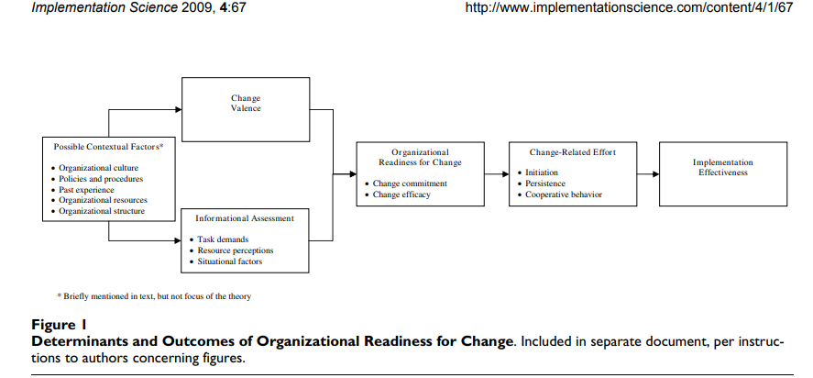
Organizational change…

Slide 16
The IRLM-Multiple frameworks within an IR projects
The IRLM is a semi-structured, principle-guided tool designed to improve the
  specification, rigor, reproducibility, and testable causal pathways involved in implementation research projects.
The IRLM provides a means of describing the complex relationships between critical elements of implementation research and practice in a way that can be used to improve the rigor and reproducibility of research and implementation practice, and the testing of theory.

Slide 17
IRLM…
The IRLM can also aid implementation researchers and implementation partners in the
  Purposes of planning, executing, reporting, and synthesizing processes and findings across the stages of implementation projects.
Adaptation and refinement of the IRLM are ongoing, as is the development of resources for use and applications to diverse projects, to address the challenges of this complex scientific field.

Slide 18
Evaluation Framework:
Proctors Outcome Evaluation Framework RE-AIM
Implementation research requires outcomes that are conceptually and empirically distinct from those of service and clinical effectiveness.
This paper proposes a heuristic, working ‘‘taxonomy’’ of eight conceptually distinct implementation outcomes—acceptability, adoption, appropriateness, feasibility, fidelity, implementation cost, penetration, and sustainability—along with their nominal definitions.

Slide 19
Choose and show your choice of frameworks using IRLM
To determine barriers, facilitators, and readiness will be assessed using CFIR framework
Implementation and evaluation of outcomes will be determined using RE-AIM framework

