Slide 1

Module.5
Chapter.9 COMPLICATION OF TL PREVENTION AND MANAGEMENT
Notes:
https://pixabay.com/en/man-reading-touchscreen-blog-791049/#_=_

Slide 2
COMPLICATION OF TL: PREVENTION AND MANAGEMENT
Learning OBJECTIVE:
Timely Identify possible complications
Properly manage/refer complications of TL procedures.

Slide 3
Course outline
Emergency management preparedness for complications of TL
Possible complications
Prevention of complications

Slide 4
Emergency management preparedness for complications of TL
A vital /absolutely necessary component of TL services.
The ability to recognize early warning signs and complications.
Client monitoring for early recognition of complications.
Availability of functional equipment, adequate supplies & appropriate drugs
Proper management of complications

Slide 5
Possible complications
Procedural complications
Anesthesia-related complications
Excessive bleeding or hemorrhage
Infection
  Wound infection
Trauma– tears or perforations to abdominal organs
  Bladder or bowel injury
  Uterine perforation
Failure – intrauterine or ectopic pregnancy

Slide 6
Anesthesia-related complications
Respiratory depression or arrest
Cardiovascular changes:
arrhythmia, hypotension, hypertension, and cardiac arrest
Convulsions
Aspiration of vomits

Slide 7
Causes of anesthesia related complications
Overdose of the analgesics, sedative or tranquilizer
Combined effect of the drugs
Delayed effect
Intravascular injection of lignocaine
Overdose of lignocaine
Preexisting cardiac disease
Severe blood loss with intravascular volume depletion

Slide 8
Prevention of complications
Anastasia related complications
Preventing is first and most important measure to follow
Ways of prevention
  Verify strength, dose and route of administration
  Check to avoid Intravascular injection of lidocaine injection

Slide 9
Prevention of complications cont..
Bladder injury
  Void and ensure bladder is empty-pre-procedure
  Carefully locate the incision site
  Check translucence of peritoneal fold
  Refer client with previous scar and adhered uterus

Slide 10
Prevention of complications cont..
Bowel injury
  Before opening peritoneum- tilt head down, deep breath
  Verify the translucency of peritoneum
  Be patient and check two to three times to verify that no visceral organ grasped under the peritoneum
  Don’t use toothed instruments in the abdominal cavity

Slide 11
Prevention of complications cont..
Uterine perforation
  Confirm the position of uterus
  Follow the uterine position, while inserting elevator
  Be gentle while manipulating the uterine elevator
Bleeding
  Secure hemostasis at every steps (skin, fascia, peritoneum, and tubes)
  Gentle manipulation of uterine elevator

Slide 12
Prevention of complication
Infection
  Use aseptic technique and universal precaution strictly
Pregnancy after procedure
  Confirm the client is not pregnant
  Avoid Failure to detect pregnancy

Slide 13
Management of complication
Signs of pregnancy
Intra uterine pregnancy management after TL
  Counsel the client on options- manage accordingly
Ectopic pregnancy:
If the pregnancy occur after tubal ligation there is significantly high chance of being an ectopic
Signs of ectopic pregnancy
  Severe lower abdominal pain
  Irregular bleeding
  Fainting or dizziness

Slide 14
Management of complication con..
Emergency management preparedness:
Vital and
Absolutely necessary component of minilaparotomy for female sterilization(tubal ligation) services

Slide 15
Emergency management preparedness for complications of minilaparotomy…
The ability to recognize and manage early warning signs and complications
Client monitoring for early recognition of complications
Availability of functional equipment, adequate supplies, and appropriate drugs
Transfer capability and a back-up referral facility

Slide 16
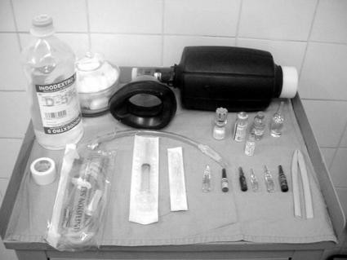
The emergency Trolley
113

Slide 17
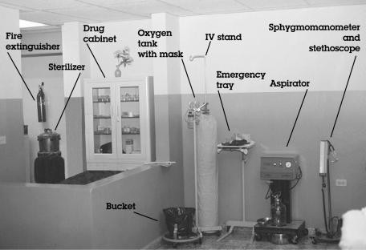
Appropriate emergency equipment for the recovery room

Slide 18
summery
Emergency management preparedness for complications of minilaparotomy is vital
Prevention and early detection of complications are very important
Case specific management ,establishing including referral system is curtail

Slide 19
Thank you!

