Slide 1

Module-5
Chapter.14 The No Scalpel Vasectomy (NSV) Procedure
MOH PPT Template
Notes:
https://pixabay.com/en/man-reading-touchscreen-blog-791049/#_=_

Slide 2
Session- 4 The No Scalpel Vasectomy (NSV) Procedure
Enabling objective
At the end of this section, participants will be able to:
Demonstrate pre-procedure tasks
Follow the standard procedures and surgical techniques for Vasectomy under LA
Perform the NSV procedure under local anesthesia per the standard.

Slide 3
The No Scalpel Vasectomy…
Outline :
Introduction
The NSV Procedure
Skills demonstrations for NSV/vasectomy in a simulated setting (by trainer)
Skills practice for vasectomy
Clinical practice of vasectomy
Perform No-scalpel vasectomy under local anesthesia

Slide 4
Introduction
Pre-procedure Tasks
Review the client’s chart and verify informed consent.
Examine to ensure that the vas deferens are mobile
Ensure that the operative site is clean.
Put the penis 12 O’clock Position on the man’s abdomen

Slide 5
Introduction
Pre-procedure Tasks
Perform a surgical scrub and put on sterile gloves.
Prepare a syringe to administer lidocaine
Prepare the operative site with antiseptic.
Isolate the operative site with sterile sheet/s or towel/s

Slide 6
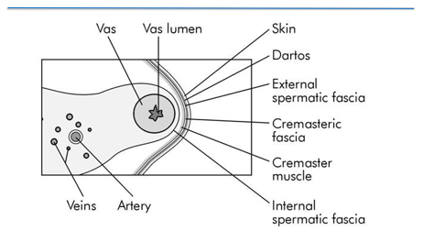
The NSV Procedure
Cross-section of the spermatic cord

Slide 7
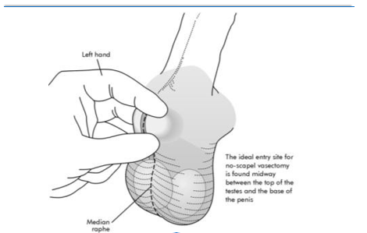
The NSV …Procedure
FIGURE . The three-finger technique: Isolating the right vas

Slide 8
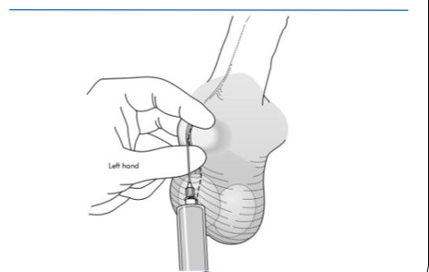
The NSV… Procedure
FIGURE. Raising the skin wheal

Slide 9
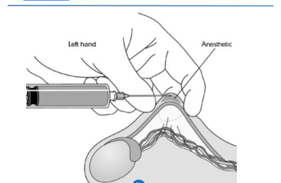
The Vasectomy… Procedure
FIGURE . Side view of the skin wheal

Slide 10
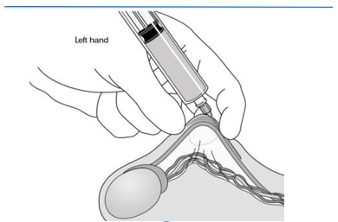
The NSV… Procedure
Figure: Advancing the needle parallel to the vas within the external spermatic fascial sheath toward the Inguinal ring

Slide 11
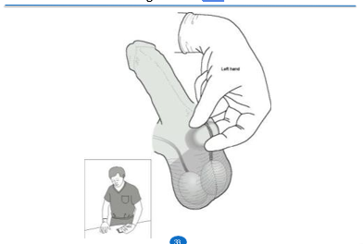
The NSV… Procedure
FIGURE . The three-finger technique: Isolating the left vas

Slide 12
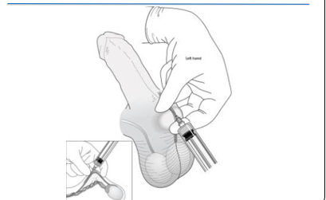
The NSV… Procedure
FIGURE . Anesthesia technique: Deep infiltration of the left vas

Slide 13
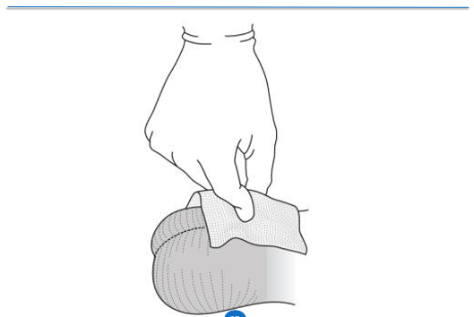
The NSV… Procedure
FIGURE. Pinching the skin wheal

Slide 14
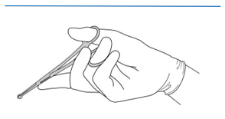
The NSV… Vasectomy
FIGURE. Holding the ringed clamp, with the palm up

Slide 15
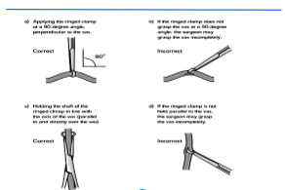
The NSV… Procedure
. Grasping the vas with the ringed clamp, extracutacutaneously (scrotal skin not shown for clarity)

Slide 16
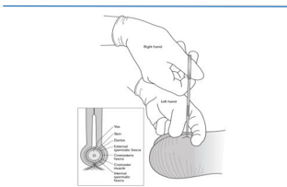
The NSV… Procedure
FIGURE. Pressing the tips of the ringed clamp onto the scrotal skin overlying the right vas

Slide 17
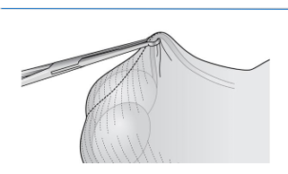
The NSV…Procedure
FIGURE. Lowering the handles of the ringed clamp to elevate the vas

Slide 18
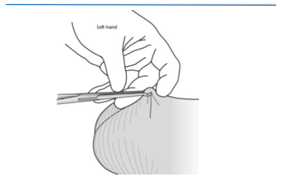
The NSV… Procedure
FIGURE Pressing the index finger lightly downward to
Tighten the scrotal skin just ahead of the tips of
The ringed clamp and over the anesthetized area

Slide 19
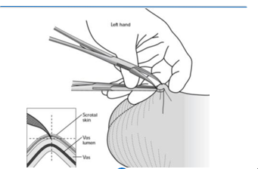
The NSV… Procedure
FIGURE: Piercing the skin with the medical
blade of the dissecting forceps

Slide 20
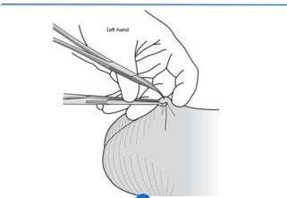
The NSV… Procedure
FIGURE. Inserting both tips of the dissecting
forceps into the puncture site

Slide 21
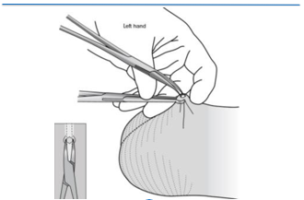
The NSV …Procedure
FIGURE. Spreading the tissues to make a skin opening twice the diameter of the vas

Slide 22
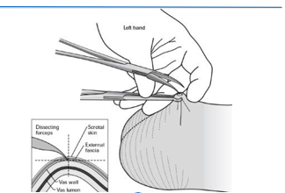
The NSV … Procedure
FIGURE . Piercing the wall of the vas with the tip of the lateral
blade of the dissecting forceps

Slide 23
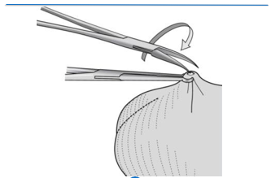
The NSV…Procedure
FIGURE. Rotation of the dissecting forceps, Part 1

Slide 24
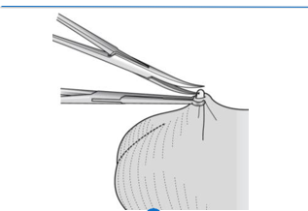
The NSV … Procedure
FIGURE. Rotation of the dissecting forceps, Part 2

Slide 25
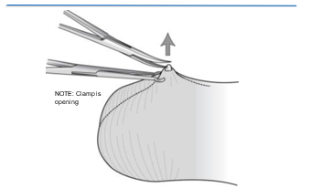
The NSV…Procedure
FIGURE. Releasing the ringed clamp before elevating the vas with the dissecting forceps
ringed clamp open, but still in place

Slide 26
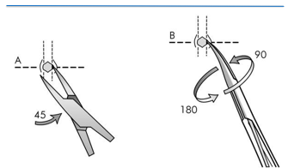
The NSV… procedure
Alternative way to deliver and elevate the vas;
skewer the vas with the dissecting forceps,
use the forceps to grasp the bare vas directly.

Slide 27
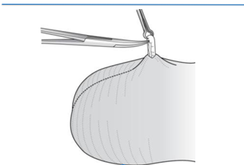
The NSV…Procedure
FIGURE. Grasping a partial thickness of the elevated vas

Slide 28
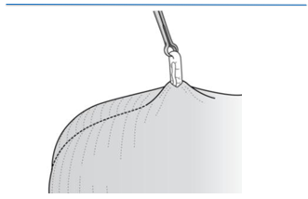
The NSV…Procedure
FIGURE. Grasping a partial thickness of the elevated vas;
grasp at the crest of the loop,
use only the ringed clamp attached

Slide 29
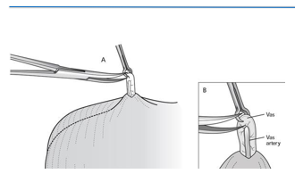
The NSV… Procedure
FIGURE. Puncturing the sheath with one tip of the dissecting forceps

Slide 30
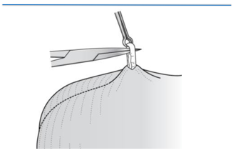
The NSV… Procedure
FIGURE. Inserting both tips of the dissecting forceps into the punctured sheath (tips facing to the side)

Slide 31
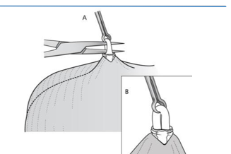
The NSV… Procedure
FIGURE. Opening the dissecting forceps to strip the sheath

Slide 32
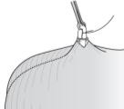
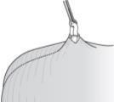
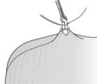
The NSV… Procedure
Ligating the vas with excision
FIGURE. Steps in performing vasectomy by ligation with excision
a) Sheath and vasal vessels are
stripped away from the part of
the vas being occluded
(b) The prostatic end of the vas is ligated,
and one end of the ligature is cut
(c) The testicular end of the vas is ligated
54

Slide 33
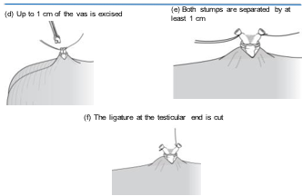
Steps in Ligating the vas with excision
Figure: Steps in performing vasectomy by ligation with excision (cont’d.)

Slide 34
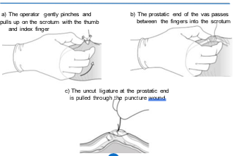
Steps in Ligating the Vas with excision
FIGURE . Steps in completing vasectomy by fascial interposition

Slide 35
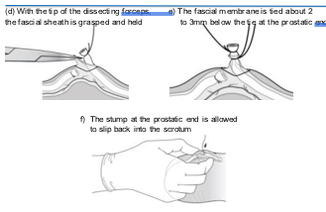
Steps in Ligating the Vas with excision…
Figure . Steps in completing vasectomy by fascial interposition (cont’d.)

Slide 36
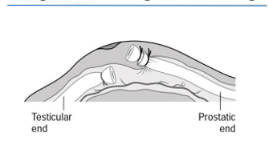
Steps in Ligating the Vas with excision…
Figure The completed fascial interposition, with the stump
of the prostatic end outside the fascial sheath and
the stump of the testicular end inside the fascial sheath

Slide 37
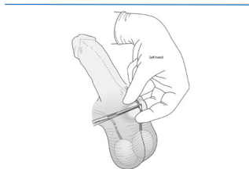
The NSV… Procedure
FIGURE Isolating the left vas before occlusion

Slide 38
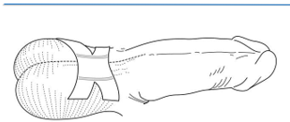
Dressing the wound
FIGURE. Dressing the wound

Slide 39
Summary
Review the client’s chart and verify informed consent just before the procedure
Examine the client properly before the procedure
Preform the NSV procedure as per the standard

Slide 40
Thank you!

