Slide 1

Module:5
Chapter.11 Facilities, NSV/LA team, equipment, instruments and supplies
Notes:
https://pixabay.com/en/man-reading-touchscreen-blog-791049/#_=_

Slide 2
Learning Objectives
Identify facilities requirements,
Identify the vasectomy surgical teams,
Describe equipment, instruments and supplies needed for vasectomy service.

Slide 3
Session outline
Facilities. the vasectomy team
Instruments, equipment and supplies

Slide 4
Facilities and the vasectomy team
Vasectomy can be performed in almost any facility
Requirements to providing high-quality services:
  A waiting area with a toilet
  A private space for counseling
  An examination room for the Pre procedure assessment and follow-up
  A clean equipped procedure room with good light source

Slide 5
Facilities and the vasectomy team…
Vasectomy can be performed by trained provider
The temperature of the room should be warm:
relax scrotum,
eases manipulation of the vas using the three finger technique

Slide 6
Vasectomy equipment ,instrument and supplies
The no-scalpel technique requires two instruments specially designed by Dr. Li Shunqiang.
The extra cutaneous ringed forceps
The dissecting forceps

Slide 7
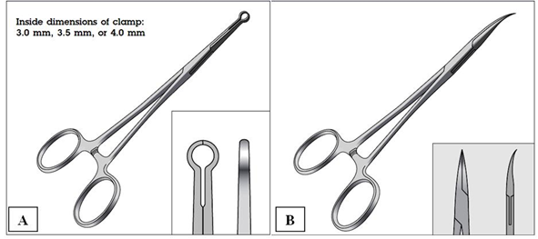
Vasectomy equipment…

Slide 8
supplies
Adhesive tape and gauze-positioning the penis
Scissors for clipping any scrotal hair
Soap and water or antiseptic agents for the surgical scrub,
Sterile gloves
Iodine antiseptic solution
Sterile gauze
10-cc syringe with1% lidocaine without epinephrine

Slide 9
Supplies…
Sterile drapes (fenestrated 1X 1.5 meter)
Scrotal support for the man to wear after the procedure
Surgical gowns, caps, masks, goggle, shoes for both surgeon and assistant
Instrument tray, with stands
Supply that helps to practice appropriate Infection prevention

Slide 10
summery
Vasectomy can be done at any facility
Needs trained surgical team
Specific instruments (ringed clamp and dissecting forceps) for vasectomy
Equipment, instruments and supplies needed for Vasectomy

Slide 11
Thank you!

