Slide 1

Responding to Peer Reviewers and Editors
Tigist Workneh Leulseged (MD, MPH)
July 2026

Slide 2
Why Peer Review Matters
Improves the quality of your research
Ensures scientific rigor
Identifies gaps and weaknesses
Increases chances of publication

Slide 3
Types of Reviewer Comments
Major comments → methods, analysis, interpretation
  Requests for additional analysis
Minor comments → grammar, clarity
Conflicting comments between reviewers

Slide 4
First Reaction to Reviews
Stay calm and professional
Do NOT take comments personally
Read all comments carefully
Take time before responding

Slide 5
Golden Rules
Be polite and respectful
Respond to EVERY comment
Be clear and specific
Revise the manuscript, not just respond

Slide 6
Structure of Response Document
Start with thank you note
Copy each reviewer comment
Respond point-by-point
Indicate where changes were made (page/line)

Slide 7
Example Response Format
Reviewer Comment: “Please clarify your sampling method.”
Author Response: “Thank you for this comment. We have clarified the sampling method in the Methods section (Page 5, Lines 10–15).”

Slide 8
How to Handle Disagreement
It is okay to disagree
Provide evidence-based justification
Be respectful, not defensive
Offer balanced explanation
Respectful disagreement is acceptable; ignoring is not.

Slide 9
Common Mistakes to Avoid
Ignoring comments
Emotional or defensive tone
Vague responses
  Bad Response: “We have corrected this.”
  Good Response: “Thank you for this comment. We have revised the definition of unintended pregnancy in the Methods section (Page 4, Lines 12–18) using the DHS standard.”
Not revising the manuscript

Slide 10
Final Checks Before Resubmission
All comments addressed
Changes clearly indicated
Manuscript proofread again
Journal instructions followed

Slide 11
Take-Home Message
Responding to reviewers is part of the process.
Responding to reviewers is not about defending your work, it is about improving it.
Address every comment clearly, respectfully, and with evidence.
A good response can turn rejection into publication.

Slide 12
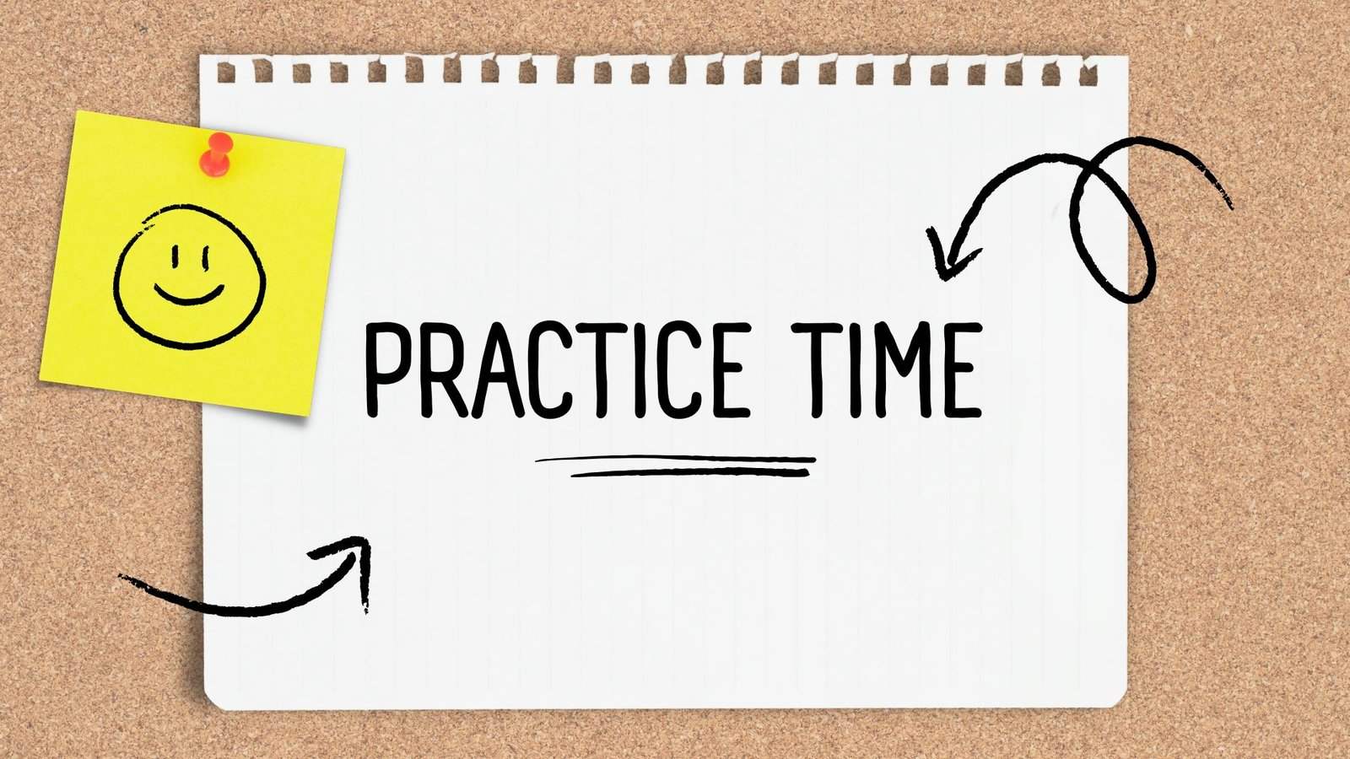

Slide 13
End

