Slide 1

Data analysis: Making meaning out of the raw data: Part 3
Tigist Workneh Leulseged (MD, MPH)
July 2026

Slide 2
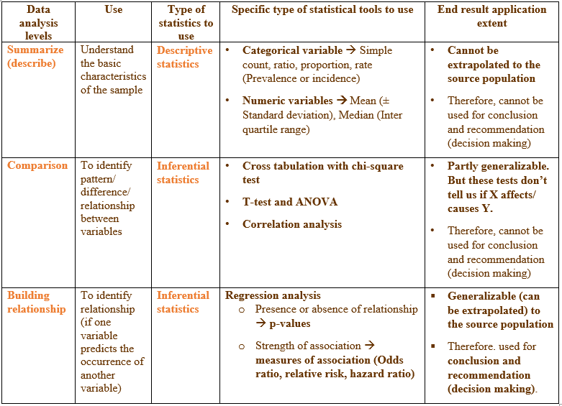
Data analysis:
Statistical tools for each analysis level

Slide 3
Building/Assessing Relationships

Slide 4
Use
Identifies independent factors/determinants/predictors
Controls for confounders
Answers: What factors are independently associated with the outcome?

Slide 5
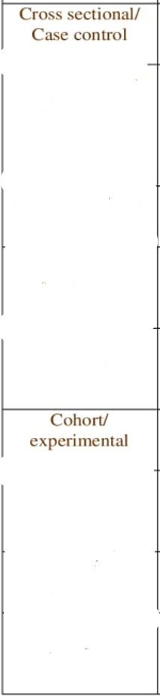
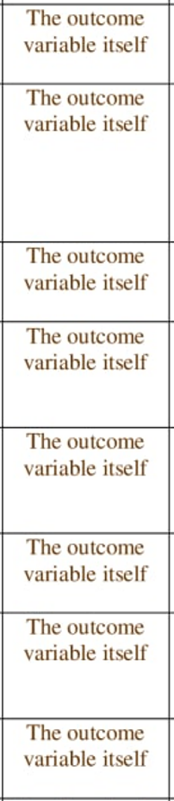
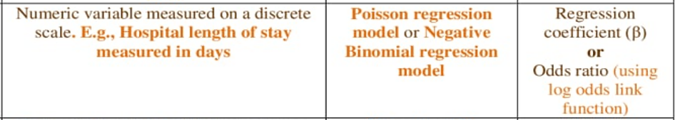
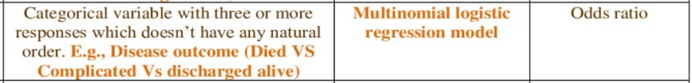
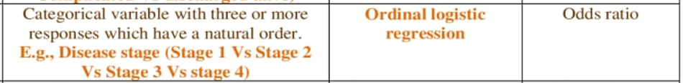
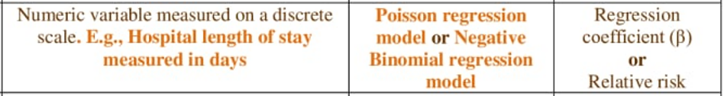
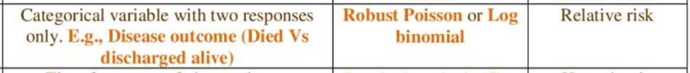
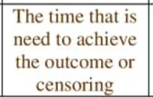
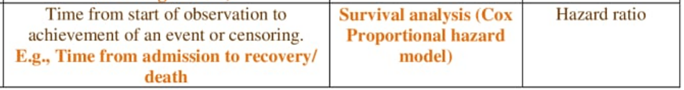
Steps to run regression model
Steps
1. Select the appropriate regression model.
Study design
Outcome Vs time to outcome
Outcome’s scale of measurement
2. Check the assumptions of the selected model
Does the selected model fit the data?
3. Which variable should be included in our analysis?
Run univariate/ bivariate analysis using the selected regression model (p-value of 25 % (or 20%))
Clinical decision
4. Which factor caused the outcome?
Run Multivariable analysis using the selected regression model (P-value of 0.05 (or 0.1, 0.01))
5. Interpret the results of the regression model

Slide 6
Presenting regression results: Text
Focus on significant factors only
Example: Women with secondary education were twice as likely to use contraceptives compared to those with no education (ARR = 2.1, 95% CI: 1.3–3.4).
Always include: MOA (AOR/ARR/AHR/B) with 95% CI
Keep interpretation simple

Slide 7
Presenting regression results: Tables
This is the MOST IMPORTANT TABLE
Typical Columns: Variable, 2x2 table, COR with 95% CI, AOR with 95% CI, p-value of AOR
Highlight significant variables
Keep formatting consistent
Example Title:
  Table 3: Multivariable logistic regression analysis of factors associated with contraceptive use in Addis Ababa, 2024

Slide 8
Presenting regression results: Figures
Not required in most cases, Tables are the standard and usually sufficient
Forest plots (advanced, optional)

Slide 9
Presenting Regression Results: Common Mistakes
Reporting all variables instead of key ones
Missing confidence intervals
Misinterpreting odds ratios
Overcomplicated tables

Slide 10
Choosing presentation mode: Key Takeaways
Always ask:
  What is the best way to present this result?
Use:
  Text → highlight main findings
  Tables → detail reporting
  Figures → simplify complex data
Avoid duplication
Keep it clear and concise
Analysis Level | Text | Tables | Figures
Descriptive | Key summaries | Main characteristics table | Optional
Comparative | Significant associations | Cross-tabulation table | Optional
Regression | Key predictors | Regression table | Rare

Slide 11


Slide 12
End

