Slide 1

Data analysis: Making meaning out of the raw data: Part 2
Tigist Workneh Leulseged (MD, MPH)
July 2026

Slide 2
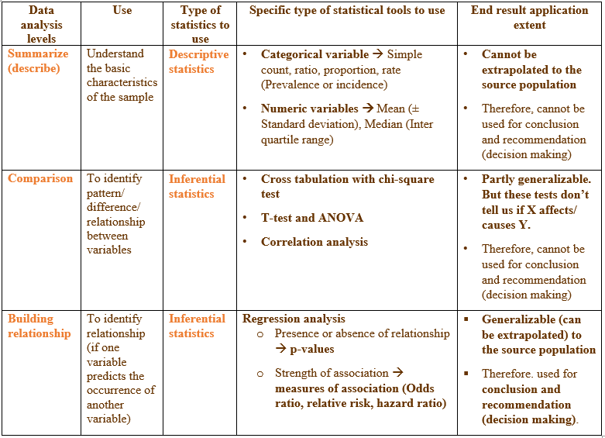
Data analysis:
Statistical tools for each analysis level

Slide 3
Comparing groups

Slide 4
Use
Compares groups to assess differences (not associations)
Based on:
  Outcome status (Diseased vs Non-diseased) → cohort or experimental studies
  Exposure groups (e.g., urban vs rural) → comparative cross sectional or case control studies
Answers:
  “Is there a statistically significant difference between groups?”

Slide 5
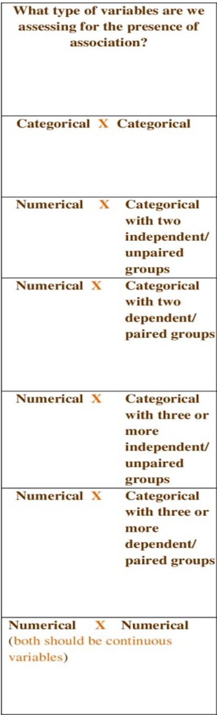
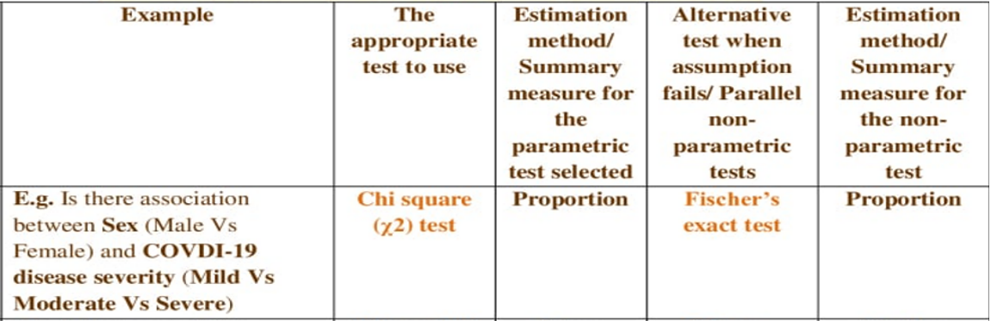
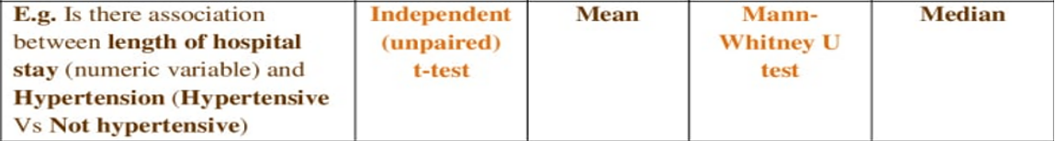
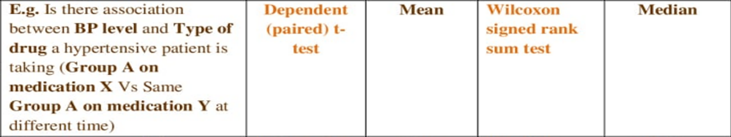
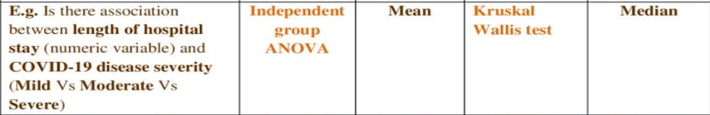
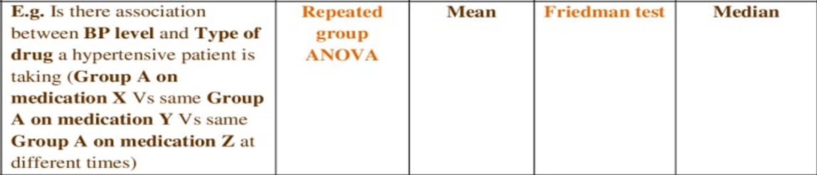
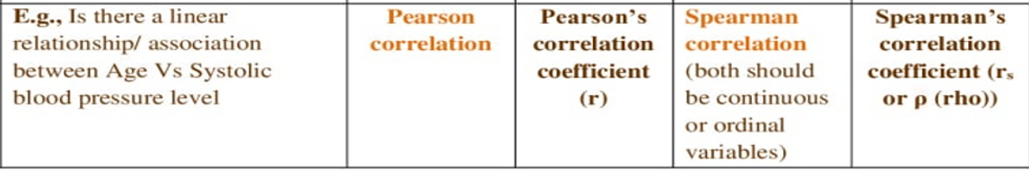
Selecting the comparison test
Steps
Identify the variables scale of measurement
Select the test
Test assumptions
If it fails use the parallel non-parametric test
Two types
Parametric tests
Make assumption about data distribution
Always test assumptions
Greater statistical power
Non-parametric tests
Distribution free tests

Slide 6
Presenting Comparative Results: Text
Report only variables that showed significant difference.
Always report: The variable, the comparator groups within the variable, and the proportions of both groups, and the p-value.
Example (Case-Control Study): Cases were significantly more likely to be older than controls (p = 0.01). A higher proportion of cases had comorbidities compared to controls (45% vs 28%, p < 0.05).

Slide 7
Presenting Comparative Results: Tables
Most important presentation format for comparative analysis
Always include: Both groups, n (%), and p-value
One row per variable (categories nested)
Keep formatting clean
Usually presented in Table 1 (along with descriptive data)
Variable | Category | Cases n (%) | Controls n (%) | p-value
Age group | <25 | 30 (25%) | 50 (40%) | 0.02*
 | ≥25 | 90 (75%) | 75 (60%)

Slide 8
Presenting Comparative Results: Figures
Usually NOT required
Tables are preferred
Use only if a clear visual comparison is needed
Examples:
  Bar chart: % exposed in cases vs controls
  Group comparison visualization

Slide 9
Presenting Comparative Results: Common Mistakes
Not showing both groups
Missing p-values
Reporting only “significant” without data
Overcrowded tables
Using wrong statistical test

Slide 10


Slide 11

End

