Slide 1

Data analysis: Making meaning out of the raw data: Part 1
Tigist Workneh Leulseged (MD, MPH)
July 2026

Slide 2
Data analysis: Definition
It is a systematic process of applying statistical techniques and logic (scientific knowledge) to a well managed data to answer our research question.
OR
Making a meaning out of a raw data.
  How do we make a meaning???
    Data analysis levels/steps

Slide 3
Data analysis: levels/ Steps
Describing the data
  Characterizing the study population based on all the studied variables (exposures and outcome/s).
    All research types (Qualitative and Quantitative)
    Descriptive analysis
Comparing groups
  Comparing the characteristics of the study population based on their outcome status or particular exposure of interest.
    Mostly in analytic comparative research designs
    Inferential analysis (Comparison analysis)
Building relationships
  Identifying significant exposures that affect the outcome.
    Only in analytic research designs
    Inferential analysis (regression analysis)

Slide 4
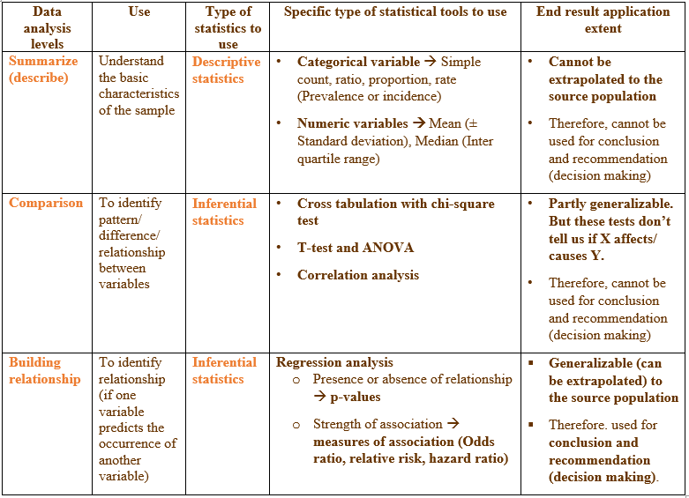
Data analysis:
Statistical tools for each analysis level

Slide 5
Data analysis: Basic principles
Have a good research question
Have a clear study objective
Select a proper study design
List out all study variables with their scale of measurement (measurement to be used for data analysis not to be used for data collection)
Identify the level/s of analysis we have to conduct
Select the proper statistical analysis method/tool

Slide 6
Describing the data

Slide 7
Use
Summarizes characteristics of participants and key variables
Answers: “What does the data look like?”
Includes:
  Socio-demographic characteristics
  Clinical characteristics
  SRH indicators

Slide 8
Summarizing a categorical variable
E.g., Disease outcome (Recovery/complication) of participants in 400 study population
  250 recovered and 150 complicated → Simple count
  The ratio of recovered to complicated is 1.7 → Ratio
  62.5% of the patients recovered→ Proportion
  The prevalence/incidence of recovery was 62.5% during the 02 months follow up period → Rate
N.B. A single summary measure will not be a representative result of the studied population unless it is accompanied by a range of values.
  Confidence interval (90%, 95%, 99%)
Outcome variable → Rate (prevalence or incidence rate)
E.g., The prevalence of recovery was 62.5% during the 02 months follow up period.
The prevalence of recovery was 62.5% (95% CI= 54.2% - 69.5%) during the 02 months follow up period.
Exposure variable → Simple count (proportion)
E.g., Among the study participants 250 (62.5%) were females.

Slide 9

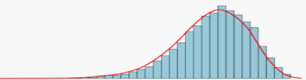
Summarizing a numerical variable
E.g., Length of hospital stay
  Methods to find the central value → Mean, median, mode
  Methods to assess dispersion → Standard deviation (SD), interquartile range (IQR), variance …
N.B. A single summary measure will not be a representative result of the studied population unless it is accompanied by a range of values.
Mean (SD)
  When the variable has a normal distribution
Median (IQR)
  When the variable has a skewed distribution
How to check distribution???
Using plots (subjective method)
Using tests of normality with p-values (objective method)
  tests of Kolmogorov-Smirnov test or Shapiro-Wilk test

Slide 10
Presenting descriptive results: Text
Use text to report key findings only
Do NOT list all variables in text
Keep it short and focused
Avoid repeating full table data
Example: The mean age of participants was 27.4 years (SD ±5.6). The majority (62%) were married, and 48% had secondary education or above.

Slide 11
Presenting descriptive results: Tables
Best option for presenting study population character
One main descriptive table is usually enough
Table Components:
  Clear title
  Variables in rows
  Frequencies (n) and percentages (%)
  Total sample size indicated
Example Table Title:
  Table 1: Socio-demographic characteristics of women attending family planning services in Addis Ababa, 2024 (N=400)

Slide 12
Presenting descriptive results: Figures
Use figures ONLY when they add clarity
Best for: proportions in multiple category variable (e.g., contraceptive methods) and Trends
Examples:
  Pie chart → contraceptive methods
  Bar chart → distribution by category
Avoid:
  Too many figures
  Repeating table data

Slide 13
Presenting descriptive results: Common mistakes
Repeating all table data in text
Too many tables/figures
Missing percentages
Unclear table/figure titles

Slide 14


Slide 15

End

