Slide 1

Sample size determination principles
Tigist Workneh Leulseged (MD, MPH)
July 2026

Slide 2
Content
Why sample size determination?
When to calculate sample size?
Key principles in sample size determination

Slide 3
Why sample size determination?
Research: Sample → Population
Representative sample is key
    We should have an Adequate (appropriate) sample size
      Prior determination
      Post hoc determination
    We should use a fair (unbiased) sample selection technique
      Use proper sampling technique

Slide 4
When to determine sample size?
Two points
Prior calculation
  Determine/calculate adequate sample size
Post-hoc calculation (power analysis)
  Determine if the already available sample size is adequate
    Through calculating the achieved power

Slide 5
Prior Sample size determination principles
Adequate (appropriate) sample size should be calculated using the following:
      Correct formula
      Appropriate/ logical statistical assumptions
      Adding all statistical considerations
      Proportional allocation in multicenter study

Slide 6
Using the correct formula
Depends on:
  Study design
    Different design, different formula
  Study objective
    Descriptive Vs Inferential objective
      Cross sectional (single population Vs double population)
  Dependent variable type (categorical or numerical)
    Proportion Vs mean
  Type of regression analysis model
    Survival analysis

Slide 7
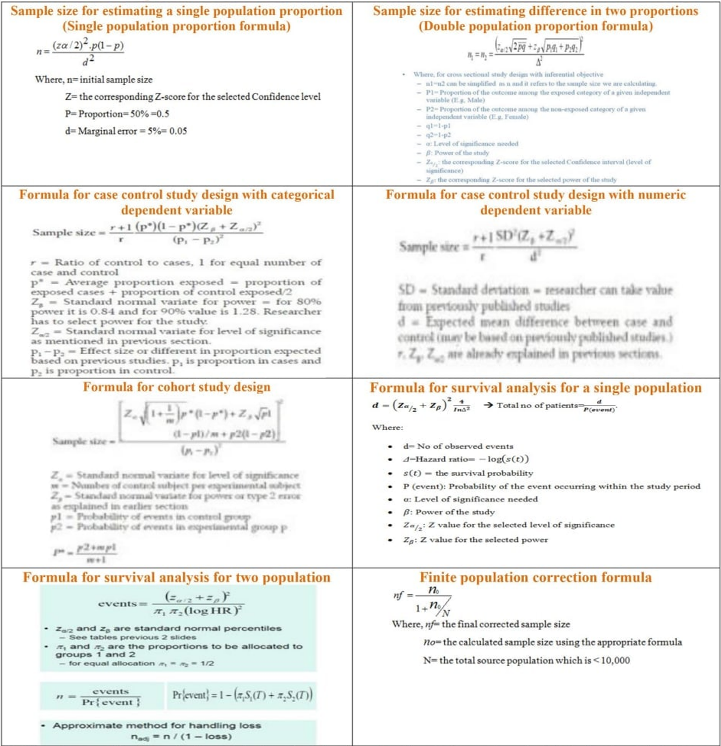

Slide 8
Appropriate/ logical statistical assumptions
Proportion (P1, P2) or mean (standard deviations)
Level of significance (α) = 5%
  Confidence level (90%, 95%, 99%)
Power (1- ẞ) = 80%

Slide 9
Statistical considerations to be added
Add the following to the final sample size obtained from the correct formula as necessary:
  Non-response
    10-30%
  Design effect in multistage sampling
    1.5-3x
  Finite population correction
    < 10,000 total population
  Proportional allocation in multicenter study
    Proportional to the size of the population

Slide 10


Slide 11
End

