Slide 1

Study Designs in Health Research
Tigist Workneh Leulseged (MD, MPH)
July 2026

Slide 2
Content
Introduction to Epidemiology
Descriptive Vs Analytic Study designs
Prospective Vs Retrospective Cohort
Strength of evidence
Common mistakes
Considerations in follow-up studies

Slide 3
Epidemiology
The study of the frequency, distribution and determinants of a given condition (diseases or health related conditions) in specified human populations and the application of this study to the promotion of health and to the prevention and control of major health problems.
Two broad categories of epidemiology
  Frequency and distribution → Descriptive epidemiology
    E.g., Prevalence of unintended pregnancy among women of reproductive age by age (person), residence (place), and year (time).
  Determinants → Analytic epidemiology
    E.g., Factors associated with unintended pregnancy, including use of modern contraceptive, age, education, and residence.

Slide 4
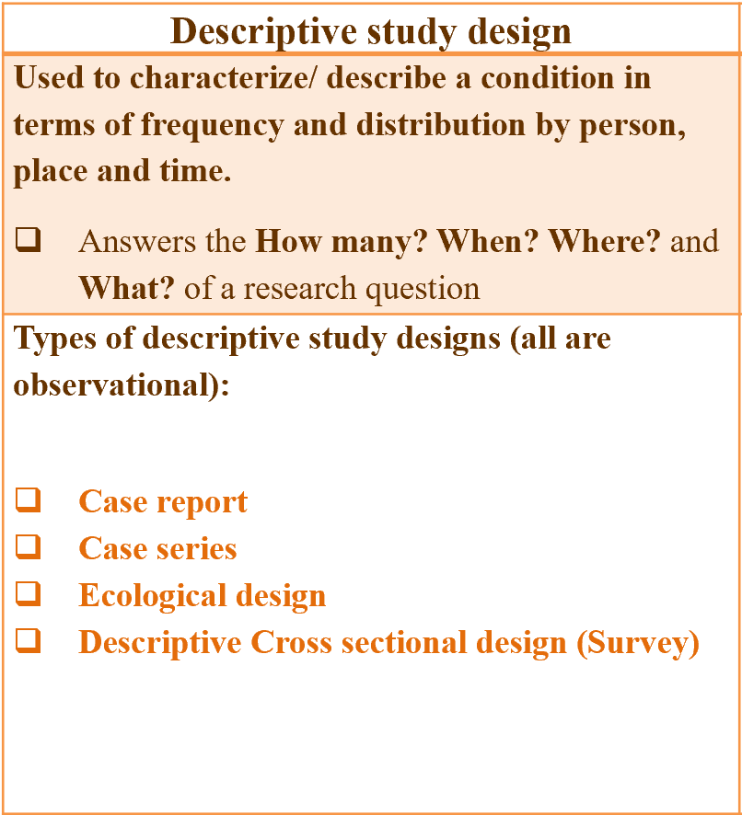
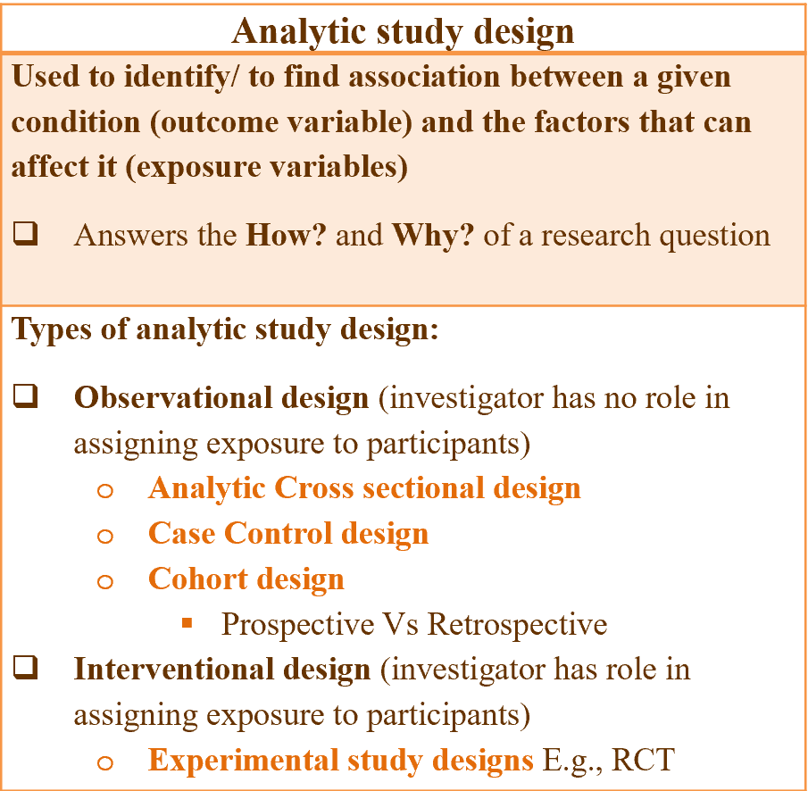
Descriptive vs. Analytic Study designs
What exactly are we studying in epidemiology?
  Frequency and distribution of a condition and/or determinants of a given condition
What do we need to study the condition?
  A designed approach (methodology)→ Credible and repeatable result → Study design

Slide 5
Descriptive study designs
Case report → Unusual finding, a single patient.
  E.g., A 28-year-old woman developed venous thromboembolism after initiating combined oral contraceptives.
Case series → Unusual finding, 2 or more patents.
  E.g., Five women attending an SRH clinic developed contraceptive implant failure leading to unintended pregnancy within one year of insertion.
Ecological (correlational study) → Comparison between population groups.
  E.g., Comparison of modern contraceptive prevalence rate and unintended pregnancy rates across different regions.
Descriptive Cross-sectional study (survey)

Slide 6
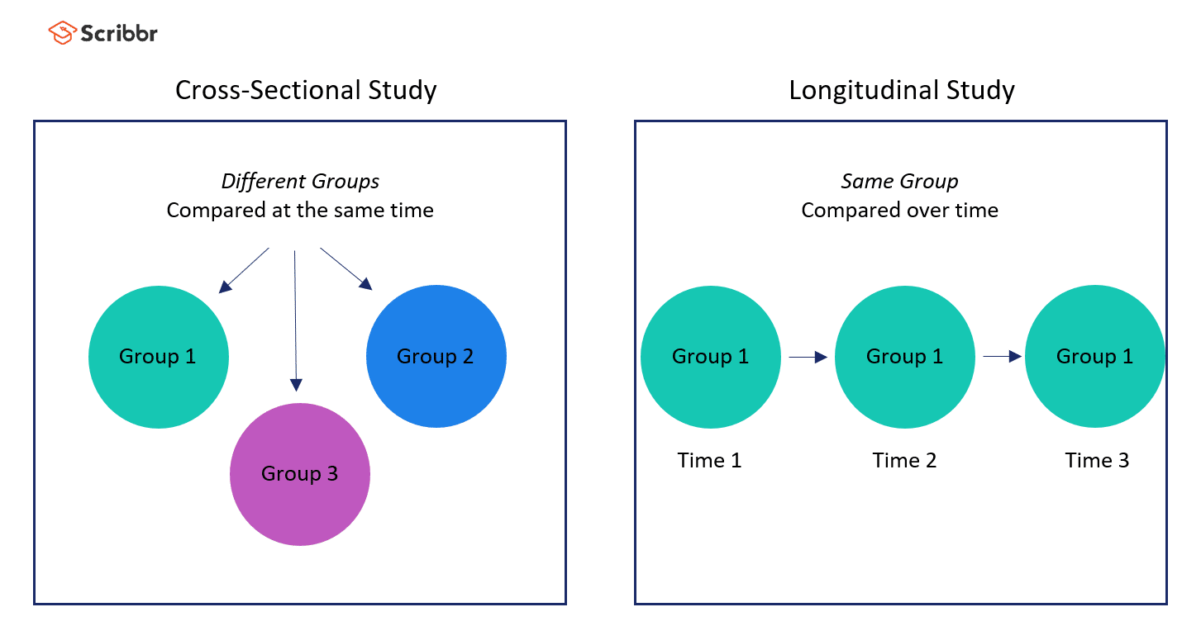
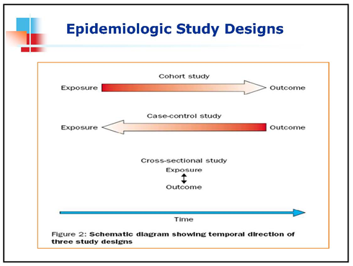
Analytic study designs
Analytic cross sectional, case control, cohort and experimental
Population studies where individuals are the study units.
Difference comes in the time data on Exposure and outcome is collected.
Information about the status of an individual with respect to the presence or absence of exposure and outcome can be assessed in two ways;
  At a point in time → Cross sectional
    It is difficult to know which occurred first, the exposure or the outcome. This is known as "chicken or egg dilemma".
      No causality
  At different times → Case control, cohort and experimental
    Causality

Slide 7
Example
Research question: Is modern contraceptive use associated with unintended pregnancy?
Study participant: 400 women on follow up at SRH clinic.
Cross sectional: Select 400 women attending an SRH clinic. Assess current contraceptive use and history of unintended pregnancy at the same time.
  We have no knowledge of the exposure or outcome status of any of the 400
Case control: Select 200 women with unintended pregnancy (cases) and 200 without (controls), then assess prior contraceptive use.
  We have knowledge of outcome status of all the 400. (But not the exposure status)
Cohort: Select 200 contraceptive users and 200 non-users, then follow them over time to observe occurrence of unintended pregnancy.
  We have knowledge of the exposure status of all the 400. (But not the outcome status)

Slide 8
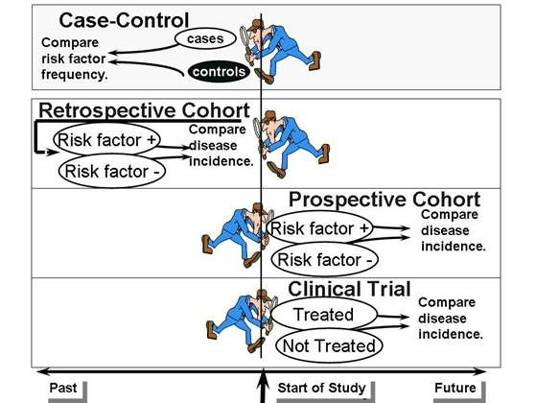
Prospective Vs Retrospective Cohort
Research question: Is modern contraceptive use associated with unintended pregnancy?
Study participant: 400 women on follow up at SRH clinic.
Investigator reviews records of 400 women (200 with unintended pregnancy and 200 without) and checks prior contraceptive use.
  Case control
Recruit 400 women (200 users, 200 non-users) and follow them forward to observe unintended pregnancy.
  Prospective cohort
Review existing records of 400 women (200 users vs 200 non-users) and look follow up data to see who developed unintended pregnancy.
  Retrospective cohort
Recruit women and provide modern contraceptive vs placebo, then follow to compare unintended pregnancy rates.
  Experimental

Slide 9
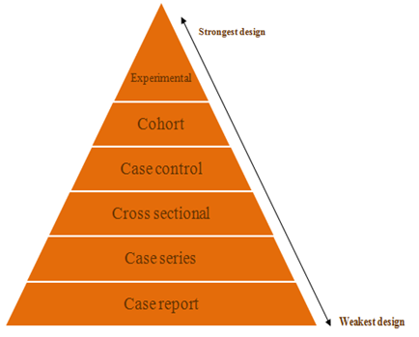
Strength of evidence
Study design | Measure of association | Proper word for relationship between exposure and outcome
Cross sectional | Odds ratio (OR) | Associated factors
Case control
Cohort | Relative risk (RR) | Determinants Predictors Prognostic factors Effect Impact
Experimental

Slide 10
Common mistakes and
special considerations
Common mistakes in stating study design
  Cross sectional design → Prospective or Retrospective
  Case control design → Prospective or Retrospective
  Retrospective study → What type?
  Prospective study → What type?
Considerations in follow-up studies
  Retrospective Cohort vs. Prospective Cohort
  Retrospective Cohort vs. Retrospective chart review
    Retrospective cross sectional → Retrospective chart review
  Prospective Cohort vs. Prospective observational

Slide 11


Slide 12
End

