Slide 1

Variables
Tigist Workneh Leulseged (MD, MPH)
July 2026

Slide 2
Content
Definition
Types
Scale of measurement
Study variables

Slide 3
Definition
A variable is a characteristic of a person, an object or a phenomenon that can take on different values.
  For a characteristic/factor to be called a variable, it should assume different values.
E.g., Age, gender, place of residence, weight, blood pressure, exercise, ANC follow up, contraceptive use, smoking, radiologic features, length of hospital stay, pregnancy outcome, hematocrit level ….

Slide 4

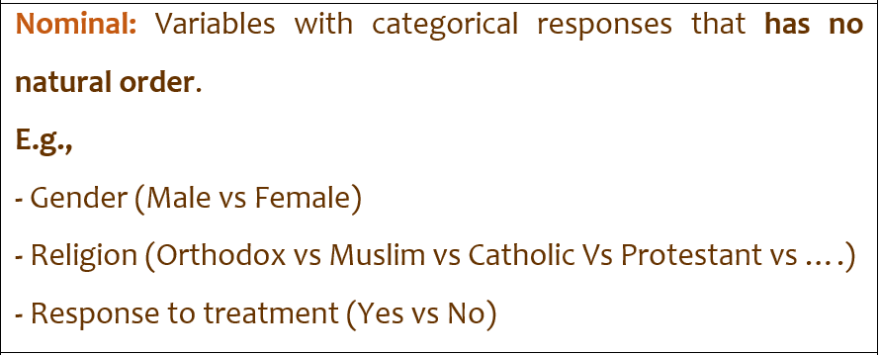
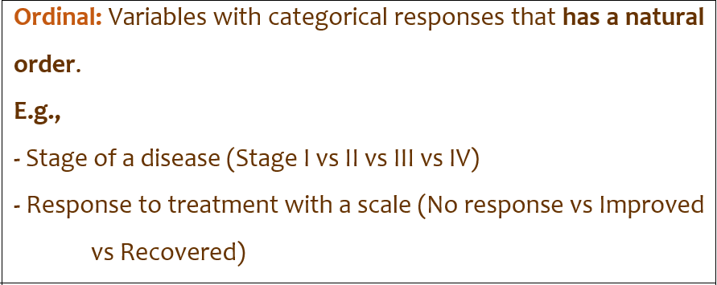
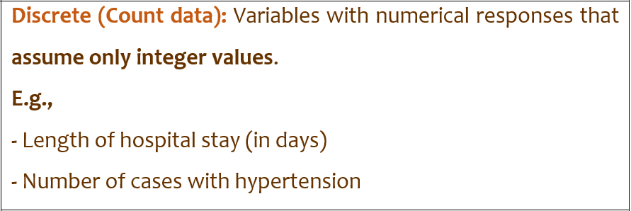
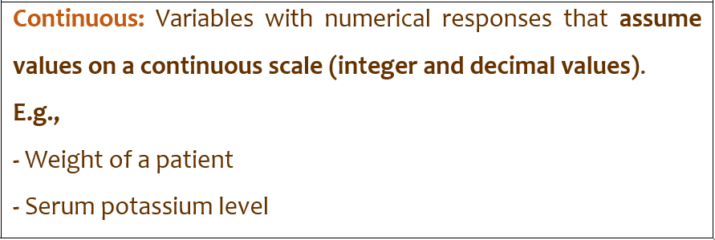
Type and scale of measurement
The value a variable can take can be expressed in two ways, categories or numbers.
These categories and numbers can further be measured differently.
Measurement decision points
Data collection → Always measure in the original scale. E.g.,
  - Age → How old are you?
  Disease stage → I, II, III, IV
  BMI → 23.4, 31.6 …
  Income → 9,700 ETB
Analysis → Change it to fit purpose. E.g.,
  - Age Category (e.g., 20-29, 30-39, …..)
  Disease stage → I & II, III & IV
  BMI → Underweight, Normal, overweight …
  - Income → <5000, 5001 – 10,0000,…

Slide 5
Study variables
Study variables are variables that are included in our study and for which we collect data to answer our research question.
Two types :
Outcome variable
  This is the main variable that is used to measure the problem under study.
  Primary Vs secondary outcomes
  Also called dependent/ response variable.
  Types:
    End outcomes → E.g., Birth, death and quality of life
    Intermediate outcomes → E.g., Complications, hospitalization …..
Exposure variable
  This is a variable that is assumed to cause the problem/outcome under study.
  Main Vs Other exposures
  Also called independent/ explanatory/predictor variable.

Slide 6


Slide 7
Research Question: Does modern contraceptive use among women of reproductive age (15–49 years) reduce the incidence of unintended pregnancy over a one-year follow-up period compared to non-use?
Outcome Variable
  Primary outcome: Unintended pregnancy (Yes/No)
  Secondary outcome: Number of pregnancies / time to pregnancy (optional)
Exposure Variable
  Main exposure: Modern contraceptive use (Yes/No)
  Other exposure / explanatory variables may include: -------
Scale of Measurement of Variables

Slide 8
End

