Slide 1
SCIENTIFIC WRITING AND EFFECTIVE COMMUNICATION
A Training on the tool, Strategy, IMRaD Macro-Structure, and the Micro-level of the paper
Melsew Getnet (GMPH, MPH-Epi, PhD)

Slide 2
Training Objectives
After completion of the training, you will be able to:
Describe components of a scientific paper
Apply writing principles of each component, including the Title, Abstract and IMRAD
Construct a scientific paper publishable in reputable journals

Slide 3
Scientific writing….
‘’What is written without effort is in general read without pleasure’’
Samuel Johnson (1709–1784)

Slide 4
What is scientific writing?
Scientific writing is a specialized, formal mode of technical communication that uses precise, unambiguous language and a standardized structure (e.g., IMRaD) to report original research, review existing knowledge, or propose a hypothesis.

Slide 5

What is Scientific Writing?
Defining the specialized, formal mode of technical communication.
A formal method designed specifically for conveying technical information to professional audiences.
Utilizes precise, unambiguous language to minimize misinterpretation and ensure accuracy.
Adheres to conventions like IMRaD (Introduction, Methods, Results, and Discussion) to maintain consistency.
Used to report original research, review existing knowledge, or propose new scientific hypotheses.

Slide 6
The Importance of Scientific Writing
Science is not complete until it is published and understood.
Advancing Knowledge: Drives broader scientific progress by allowing peers to build upon your findings.
Professional Reputation: Serves as the primary currency for career advancement, funding, and institutional recognition.
Public Trust & Policy: Ensures research is accessible, minimizing misinterpretation and informing evidence-based decisions.
Reproducibility: Clear writing allows other researchers to verify, replicate, and validate your work.

Slide 7
The Importance of Scientific Writing
Why Excellent Writing Matters: Science is not complete until it is published and understood.
Drives broader scientific progress by allowing peers to build upon your findings.
Serves as the primary currency for career advancement, funding, and institutional recognition.
Ensures research is accessible, minimizing misinterpretation and informing evidence-based decisions.
Clear writing allows other researchers to verify, replicate, and validate your work.

Slide 8
True ease in writing comes from art, not chance, As those who move easiest have learnt to dance.
Alexander Pope (1688–1744)

Slide 9
Why should we Publish?
It is unethical to conduct a study and not report the findings
You have some results that are worth reporting
You want to progress scientific thought or improve health outcomes
You want to give credibility to your research team
You want your work to reach a broad audience
Your track record will improve
You will add credibility to your reputation
You will improve your chance of promotion
You are more likely to obtain research grants

Slide 10
PRINCIPLES OF SCIENTIFIC WRITING (CRAFT)
SW is all about ensuring that your research manuscript is clear, precise, logical, and ethically sound.
The Golden rule: The best scientific writing is completely invisible; the reader should be so absorbed by the science that they do not notice the writing itself. Overall, the five elements of SW are:
Clarity and Conciseness (The Golden Rules)
Precision and Accuracy (Defeating Ambiguity)
Logic and Flow (Building the Narrative)
Objectivity and Evidence-Based Claims
Ethical Integrity (The Foundation of Trust)

Slide 11
Clarity and Conciseness: The Golden Rules
The goal is to communicate complex ideas in the simplest possible way
Be Direct: Use active voice over passive voice.
  Weak: It was observed that the temperature decreased.
  Strong: The temperature decreased.
Cut Unnecessary Words: Remove jargon, filler phrases, and redundancy; every word must serve a purpose.
Define Terms: Define technical terms, abbreviations, and acronyms clearly upon their first use (e.g., Ventricular Tachycardia (VT)...).

Slide 12
Clarity and Conciseness….
Avoid Ambiguity: Use clear antecedents for pronouns to ensure clarity.
  Example: Replace The sample was heated. It turned black with
  The sample was heated. The sample turned black.
Use Simple Sentence Structure: Short, declarative sentences are easier to follow than long, complex ones

Slide 13
Precision and Accuracy: (Defeating Ambiguity)
Ambiguity is the enemy of science. Your writing must mean exactly what you intend.
Choose the Right Word: Avoid using "significant" to imply "important" if the term has a specific statistical meaning in your context. Instead, use more precise alternatives like "substantial" or "considerable".
Quantify When Possible: Replace vague descriptors such as "many," "often," or "a few" with concrete numbers or ratios. Examples include using percentages (e.g., "78%"), specific counts (e.g., "in 12 of 15 cases"), or precise sample sizes (e.g., "the majority (n=45)

Slide 14
Precision and Accuracy…
Be Specific: Always provide essential experimental details to avoid ambiguity. For example, instead of stating "The cells were treated with a drug," specify the cell line, the exact drug, the concentration, and the duration (e.g., HEK-293 cells were treated with 10 µg ibuprofen for 24 hours).
Use Standard Units and Notation: Strictly adhere to the SI system (meters, kilograms, seconds). Maintain consistency and never mix different abbreviations for the same unit (e.g., do not alternate between "sec" and "s").

Slide 15
Logic and Flow: The Narrative
Treat scientific writing as a story with a clear beginning, middle, and end.
Most research papers follow the IMRaD Structure as a standardized order:
  Introduction: Define the problem, explain its importance, and state your hypothesis.
  Methods: Describe how you tested the hypothesis with enough detail to ensure reproducibility.
  Results: Present your objective, data-driven findings without interpretation.
  Discussion: Interpret your results, compare them to prior work, and address limitations and implications.
Use Transition Words: Employ words like "therefore," "however," "furthermore," "in contrast," or "consequently" to guide the reader through your argument.

Slide 16
Logic and Flow….
One Idea per Paragraph: Begin every paragraph with a topic sentence and focus on developing a single point.
Tense Matters:
Past Tense (Used for your specific methods and results):
The treatment significantly reduced blood pressure in the patient group.
Present Tense (Used for established facts or general truths):
Hypertension increases the long-term risk of cardiovascular disease.
Future Tense (Used for implications or planned research):
These findings will guide upcoming modifications to the institutional review system.

Slide 17
Objectivity and Evidence-Based Claims:
Your opinion is irrelevant: only the evidence matters.
Avoid Emotional Language: Refrain from using subjective terms like "surprisingly," "interestingly," or "importantly". Instead, allow the data to demonstrate its own significance by explaining the context (e.g., this result is crucial because it contradicts the prevailing model...).
Cite Everything: Provide a reference for every claim that is not considered common knowledge or part of your original data.

Slide 18
Objectivity….
Report Negative Results: Present all findings, even those that do not support your initial hypothesis. A null result remains a valid scientific contribution (e.g., No significant difference was found between Group A and Group B (p > 0.05).
Acknowledge Limitations: Address study weaknesses transparently within the Discussion section. This demonstrates intellectual rigor and helps build trust with your audience

Slide 19
ETHICAL INTEGRITY: THE FOUNDATION
Never Plagiarize: Always cite other people's words, ideas, designs, and data. Use direct quotes exceptionally rarely.
Paraphrase source concepts completely into your own structural voice while providing proper citations.
Zero Data Falsification: Never fabricate data or manipulate results to force alignment with a desired conclusion.
Avoid Salami Slicing: Do not split a single, comprehensive study into multiple fragmented pieces to artificially inflate your publication count.

Slide 20
ETHICAL INTEGRITY: DISCLOSURE & CAUTIOUS CLAIMS
Disclose Conflicts of Interest: If you or your primary funding body has any financial, professional, or institutional stake, disclose it.
Honesty About Uncertainty: Deploy deliberate hedging language to carefully reflect scientific uncertainties without overstating data.
Utilize precise hedging verbs: "suggests," "indicates," "may," "likely."
Overstating conclusions leaves a manuscript highly vulnerable to immediate peer-review rejection.

Slide 21
EFFECTIVE SCIENTIFIC COMMUNICATION
In science, the credit goes to the man who convinces the world, not to the man to whom the idea first occurs.
Sir Francis Darwin
‘A paper is not judged on what you know. It is judged on how the reader see it’

Slide 22
Writing vs. Communication
Scientific writing focuses entirely on the technical craft of the text itself (clarity, precision, layout).
The Strategy: Scientific Communication is the broad strategy of delivering that message to the right audience, at the right level, via the right medium.
Writing is merely one tactical tool ad Communication is the complete strategic mission.

Slide 23
Principle in scientific communication.
Audience Segmentation (The Cardinal Rule)
Defining the Core Message (The Elevator Pitch)
Matching the Medium and Format
Translating the Complex (The Art of Analogy)
Two-Way Engagement and Feedback Loops

Slide 24
Know Your Audience :The Cardinal Rule
Single most important principle in scientific communication.
While the science remains the same, the communication style must be entirely different depending on the target audience.
Audience Categories
The Expert (e.g., Peer-Reviewed Paper, Conference Talks)
  Jargon is acceptable.
  You may assume deep background knowledge.
  Focus on novelty, rigorous methodology, and narrow details.
  The goal is to convince peers.

Slide 25
Audience Categories…
The Informed Non-Specialist (e.g., Grant Reviewer, Science Journalist)
  Explain the "big picture" first.
  Define all key terms.
  Avoid deep technical rabbit holes.
  The goal is to show why the work matters and what was done at a high level.

Slide 26
Audience Categories…
The General Public (e.g., Blog Post, News Interview)
  Eliminate all jargon.
  Use analogies to explain concepts.
  Tell a human story.
  Focus on the impact and relevance to their lives rather than methodology.
  The goal is to inspire interest and build trust.
Exercise
Before you write or speak a single word, write down the answer to: Who is your audience, and what is their current level of knowledge?

Slide 27
Define Your Core Message
Most scientific communication fails because it tries to say everything.
The So What? Test: After hearing your message, the listener should be able to answer: Why should I care?
Structuring: Start with the conclusion or the headline, then provide the supporting evidence, not the other way around (Journalism's inverted pyramid).

Slide 28
Define Your Core Message…
Example (which one of those is bad?/who is the Audience?):
  We investigated the longitudinal impact of multi-drug resistant bacterial colonization on post-operative cytokine profiles and systemic inflammatory response markers in orthopedic surgical cohorts.
  We identified a simple screening test that helps surgeons predict which patients are at high risk for dangerous infections before their surgery begins.
Exercise?
Write a single sentence that your grandmother could understand, summarizing the most important thing you want your audience to know.

Slide 29
CHOOSE THE RIGHT MEDIUM & FORMAT
Format Constraints:
Journal Article
Conference Slide
Conference Poster
Social Media (LinkedIn/X)

Slide 30
NON-TECHNICAL TRANSLATION…
Additional Strategies
Define Before You Dive In: Never introduce a technical medical or scientific term without first explaining it in plain language.
Visualize the Abstract: Use diagrams, flowcharts, or infographics to illustrate relationships that are difficult to describe using words alone.

Slide 31
LISTEN AND ENGAGE
Two-Way Loop: Science communication must never be a lecture or a monologue.
At Technical Conferences: Listen intensely to questions during Q&A. Avoid defensive posturing. Clarify points of confusion.
With the Public Media: Do not just talk at a journalist. Actively ask what their specific audience cares about; let them help shape the angle.

Slide 32
TECHNICAL WRITING VS. STRATEGIC COMMUNICATION
Feature | Scientific Writing (Craft) | Scientific Communication (Strategy)
Primary Focus | The text itself (clarity, structural precision, units) | The human audience and the ultimate behavioral goal
Target Audience | Typically specialized domain experts and reviewers | Highly variable (ranging from experts to the public)
Core Goal | Record methodology, convince peers, enable replication | Inform, engage, inspire public trust, catalyze impact
Tone & Style | Formal, neutral, objective, strictly controlled | Adaptive and fluid (ranging from formal to casual)
Core Structure | Rigidly adheres to standard IMRaD scaffolding | Uses the inverted pyramid or engaging narrative arcs
Key Skillset | Grammar, logic, database citation, precise data mapping | Translation, analogy design, storytelling, deep empathy
The Metaphor | Building a flawless, high-spec technical engine | Knowing how to mount that engine in a racecar

Slide 33
Anatomy of a research paper
Melsew

Slide 34
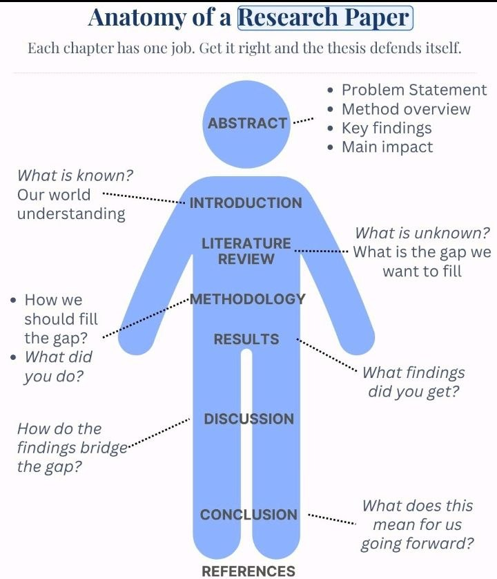

Slide 35
Structure of a scientific paper
The Macro-Structure: IMRaD (The Standard Research Paper)
The most foundational and universal structure for scientific writing is IMRaD. Mastering this structure is the key to successfully publishing research papers.
Introduction: Defines the question being asked and explains why it matters.
Methods: Describes how the question was answered.
Results: Details what was found through the investigation.
Discussion: Explains what the results mean and why the findings are significant ("So what?").

Slide 36
The Logic of IMRaD
This structure is not arbitrary; it mirrors the scientific method itself, providing a logical flow from the initial inquiry to the final interpretation.
1. Introduction: What question did you ask? (Why?)
2. Methods: How did you answer it? (How?)
3. Results: What did you find? (What?)
4. Discussion: What does it mean? (So what?)

Slide 37
Scientific Paper/Manuscript structure
Structural Overview (The IMRaD Blueprint)
A standard scientific paper follows a predictable, highly structured framework designed to guide the reader logically from the big picture to the specific details, and back out again.
Title & Abstract - Broadest view
Introduction - Context & Gap
Methods - Narrow & Specific
Results - The Core Findings
Discussion - Contextualized Meaning
Conclusion - Big-picture Impact
References - Foundation

Slide 38
Manuscript Section | Operational Function | Dominant Verb Tense | Key Question Answered
Introduction | The Funnel: Guides the reader from broad context to the specific gap. | Present Tense (facts) Past Tense (prior literature) | Why did you do this study?
Methods | The Recipe: Provides complete details for exact experimental replication. | Past Tense (Passive Voice focus) | How did you perform it?
Results | The Data: Objective, neutral presentation of findings without interpretation. | Past Tense (Objective reporting) | What exactly did you find?
Discussion | The Inverted Funnel: Interprets findings and scales back out to broad impact. | Present Tense (your findings) Future Tense (implications) | So what? Why does it matter?

Slide 39
Discussion Points
What sections of the manuscript do you find most challenging to draft?
Are there specific writing habits you want to improve during this workshop?

