Slide 1
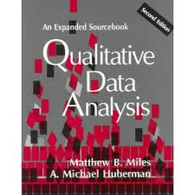
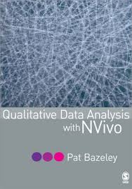
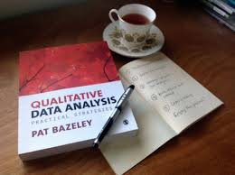
Qualitative data analysis

Slide 2
Common feelings when starting QDA
The moment you cease your DC, pack and leave the field,
  you will get a remarkably clear insight about that one critical activity you should have done
After you close your tape and say goodbye to your informants,
  it would be clear immediately what a perfect question that you should have asked to tie every thing together
The moment you start analysis
  it will become clear to you that you are missing the most important pieces of information and
  without those pieces of information there absolutely no hope of making any sense out of what you have

Slide 3
Cont…
Know then this: The complete analysis isn’t
  Analysis finally makes it clear what would have been most important to study if only we had known beforehand
Analysis brings moments of terror, that nothing sensible will emerge and or times of exhalation from certainty of having discovered ultimate truth.
In between are long periods of hard work, deep thinking and weight lifting voluminous work
From Halcolm’s Iron laws of evaluation research

Slide 4
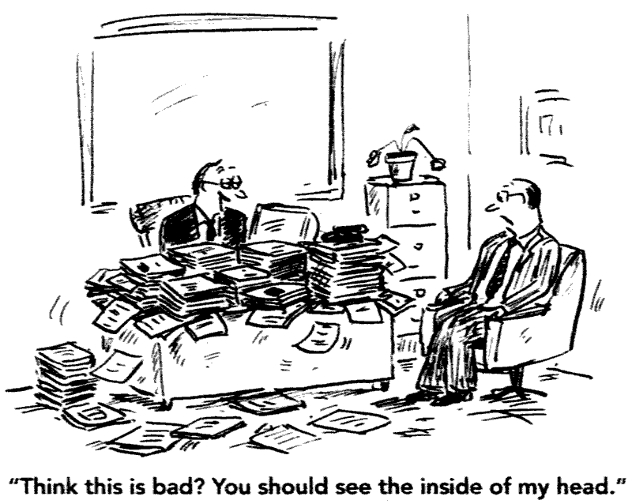

Slide 5
Features of Qualitative Data Analysis
The distinctive features of qualitative data collection methods are also reflected in the methods used to analyze QUAL data.
It is inductive and used the systems view (The whole is always understood to be greater than the sum of its parts)
“social context of events, thoughts, and actions becomes essential for interpretation..” (Miller and Crabtree (1999b)
The focus on text…

Slide 6
Cont...
Qualitative data analysis is an iterative and reflexive process that begins at data collection
Basic guidelines for data analysis: (Miller & Crabtree 1999b:142–143):
  Know yourself, your biases, and preconceptions.
  Know your question.
  Consult others and keep looking for alternative interpretations.
  Be flexible.
  Exhaust the data.

Slide 7
Cont..
Celebrate anomalies. They are the windows to insight.
Get critical feedback. The solo analyst is a great danger to self and others.
Be explicit.
Share the details with yourself, your team members, and your audiences.

Slide 8
Qualitative Data Analysis as an Art
“.Interpretation is a complex and dynamic craft, with as much creative artistry as technical exacti­tude, and it requires an abundance of patient plodding, fortitude, and discipline. There are many changing rhythms; multiple steps; moments of jubilation, revelation, and exasperation. . . “
…The dance of interpretation is a dance for two, but those two are often multiple and frequently changing, and there is always an audience, even if it is not always visible. Two dancers are the interpreters and the texts. William Miller and Benjamin Crabtree:1999b;138–139

Slide 9
Cont...
Miller and Crabtree (1999b) identify three different modes of reading the text within the dance of qualitative data analysis:
When the researcher reads the text literally, she/he is focused on its literal content and form, so the text “leads” the dance.
2. When the researcher reads the text reflexively, she/he focuses on how her own orientation shapes her interpretations and focus. Now, the researcher leads the dance.
3. When the researcher reads the text interpretively, she/he tries to construct her own interpretation of what the text means.

Slide 10
What does qualitative analysis do?

Slide 11

What it does
Qualitative data analysis transforms data into findings
No formula exists for the transformation
Gives guidance but no recipe
It gives direction
Road map that leads the traveler to a destination
It does not give answers to your question
It is up to the researcher to choose the best way to ones destination

Slide 12
Cont..
The challenge in qualitative analysis lies in making sense of massive amount of data
This involves reducing the volume of raw information,
  sifting trivial from significance,
  identifying significant patterns and constructing a framework for communicating the essence of the what the data reveal.
We have few agreed cannons for qualitative data analysis, in the sense of shared ground rules for drawing conclusions and verifying their rigor.

Slide 13
Cont..
There are no formulas for determining significance;
There is no way of replicating the researchers thought process
No straight forward test for assuring validity and reliability
“In short, no absolute rules exist except perhaps this: do your very best with your full intellect to fairly represent the data and communicate what the data revel given the purpose of the study “ Patton MQ
Guidelines for analysis of qualitative data can be found in abundance;

Slide 14
Cont…
But guidelines, procedural suggestions and examples are not rules;
Applying guidelines requires judgment and creativity
Because each qualitative study is unique .
Because qualitative inquiry depends at every stage, on the skills, training, insights and capabilities of the inquirer.
Qualitative analysis ultimately depends on the analytical intellect and style of the analyst
The human factor is the greatest strength and the fundamental weakness of the qualitative inquiry and analysis –A scientific two aged sword

Slide 15
Steps in data analysis
Documentation of the data and the process of data collection
Organization/categorization of the data into concepts
Connection of the data to show how one concept may influence another
Corroboration/confirm by evaluating alternative explanations, disconfirming evidence, and searching for negative cases
Representing the account (reporting the findings) in thick description

Slide 16
Coding in qualitative research
Codes are the building blocks for theory or model building and the foundation on which the analyst’s arguments rest. (Kathleen M. MacQueen)
Coding is the process of labelling and organizing a qualitative data to identify different themes and the relationships between them.
Coding qualitative data makes it easier to interpret findings
Coding helps to storing data analysis processes to help them make data-driven decisions based on customer feedback.
Coding helps to compare perspectives of different researchers or/coderes

Slide 17
Cont…
Codes are assigned to segments of the text as per the decision of the researcher
You may assign codes to a whole paragraph or to a sentence
Code should not contain blanks, commas or parentheses
If your code consists of more than one code, then you need to connect it with a hyphen
The maximum length of a code is 50charachters

Slide 18
How do you determine what codes to use?
Your research objective or questions
Themes and patterns you recognized while conducting the initial interviews
The theory or framework that’s the basis for your study

Slide 19
Codebook
A codebook for qualitative research contains a list of the codes that you will use in your qualitative analysis research
A Codebook is useful when different coders are involved
A code book should include the following:
  Code definition
  Examples of what to include with this code
  Theme
  Parent code
  Child code
  (Marsha E. Fonteyn, et al Developing a codebook to guide content analysis of expressive writing transcripts)

Slide 20
Sample code book
Theme | Parent code | Child code | Inclusion | Exclusion | Description
I remember telling God that He had finally found my breaking point | Spirit | Belief Desperation | All taks about spirit | All others | Statements about sources of ultimate meaning in one’s life that are connected to a higher power
Women who had neonatal losses are neglected blamed | stigmatized | Un accepted Less valued Blamed | All talking abut stigma | All others | Statements that put women with neonatal loss down

Slide 21
Advantages of using software
Many types of software are in use elsewhere
The key advantages:
Thorough and systematic analysis
If all data is coded, search will produce all relevant data than those noticed by the researcher
Facilitate transfer of data in case of large scale data files, emerging coding schemes and research memos
Allows participation of all team members and transparency

Slide 22
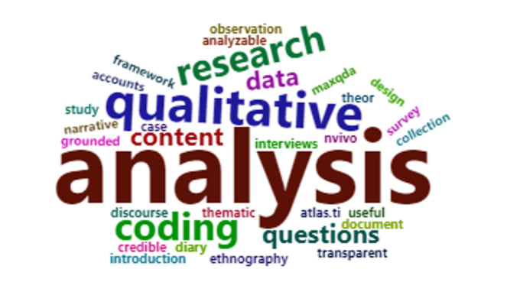
OpenCode
Is a software for classifying and sorting any kind of qualitative information.
It can also be used a means of systematically storing qualitative data in text form
Data could be generated using different methods of data collection
    In-depth-interviews
    Observations or field notes and FGDs

Slide 23

Steps in Open Code
Preliminary/common:
Transcribe the interviews using a word processing program
Save the transcripts in text format
Assign codes to segments of the text
Produce lists showing frequency of use
Search single cods or combined codes in the documents
Produce lists of search results
Print the results from any of the functions

Slide 24
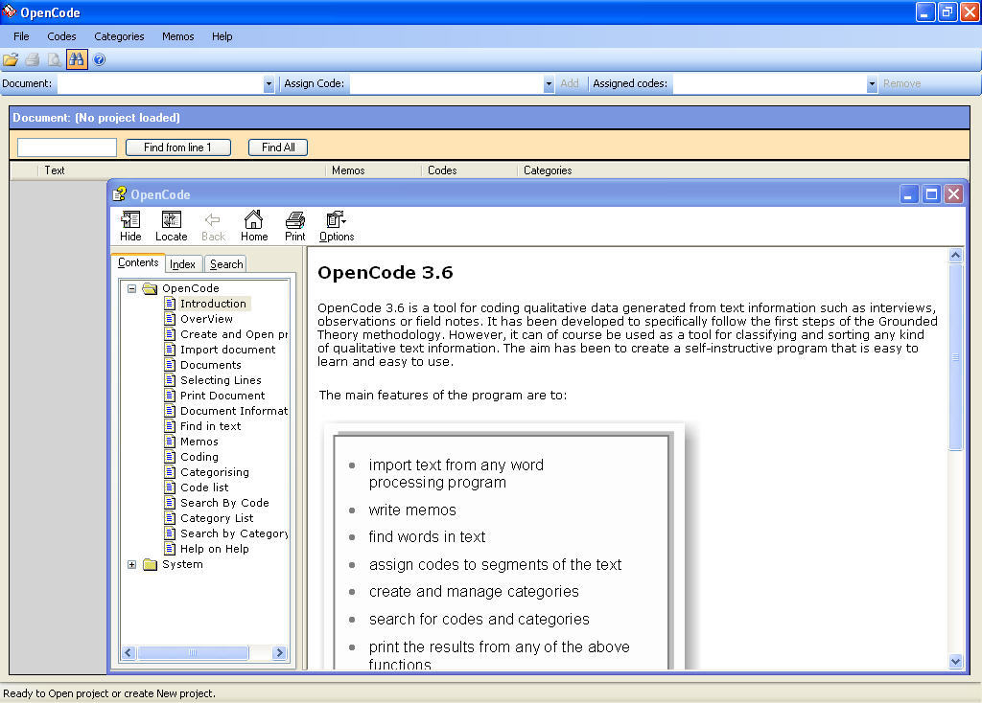
Steps in Open Code
Create a project:
  Define your project with a level no more than 8 characters.
  An empty database will be created for each project
  All your documents belonging to the project will be stored with max. Size of one GB

Slide 25
Cont…
Import documents:
  OpenCode imports only documents of text files.
  The document should not be more than 1000 lines if more better to divide it
  Documents shall be edited and arranged in paragraphs before importing
  There is no possibility of changing once it is imported
Example of text file
E001 ETHIOPIA 28TH FEB 2011
Key: Interviewer (Helen)
Interviewer (Male)
Interviewer (Female)
Interviewee
HB: If I talk, can you just clarify a bit about your role, what you do here in your organisation?

Slide 26
Steps in Open Code analysis
III. Coding :
Codes are assigned to segments of the text as per the decision of the researcher
You may assign codes to a whole paragraph or to a sentence
Code should not contain blanks, commas or parentheses
If your code consists of more than one code, then you need to connect it with a hyphen
The maximum length of a code is 50charachters
Feeling
Depression
Happiness
Willingness
Compassion
Good-standing
…..

Slide 27
Cont...
IV Categories/ synthesis
Create new category
A category should be meaningful
Once you create the category, you can move codes that represent the category
A code can go to more than one category/ but not common
Several categories can be created but limiting to less than 10 is practical

Slide 28
Steps in OpenCode
V. The code list
OpenCode allows
  A list of all codes used in a document can be seen
  Frequencies can be calculated from the list
  This list makes the researcher to get an overall idea about the codes and the connectedness of the codes
  Can also give you an overview of your findings and helps to make decisions on changing or retaining the codes

Slide 29
Steps in OpenCode
VI. Document information
Here you can include identifiers for the document
Take additional information or notes from other projects
This is the place for summarizing , methodological and analytical notes that can accompany all documents

Slide 30
Steps in OpenCode
VIII. Memos
Help to assign any reminder for later analysis and interpretation
Go to memos
Assign number may be starting from 3 digits
You can retrieve it later
VII. Search:
The possibility of quick search of your data is the main advantage of coding
You can search the codes and the texts related to it
Can be done for specific documents or for all

Slide 31
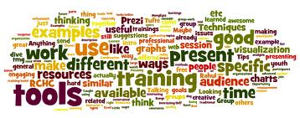
Approaches to analysis
Analysis of qualitative data relies on both rigour and imagination
In health research, the method of analysis shall be transparent
However, many of the classical studies that have an impact on health, lacks information about how data were analysed

Slide 32
Cont…
Most works were also theoretical with few empirical findings
Even those with empirical works, the process of analysis is rarely described
Currently, with the growing market of peer reviewed journals, as outlets for qualitative research findings, there has been a substantial increase in attention to the practice of analysis

Slide 33
Cont...
For readers who are less familiar with social science writing, researchers had to be more explicit in what they do with the data
And also how their conclusion is built up from their interpretation
This also prove the rigour, validity and comprehensiveness of the work

Slide 34
Cont….
However, it is impossible to reduce the task of analysing qualitative data to a set of tools that can be applied in a mechanistic way
Good analysis needs to draw knowledge from the social sciences
Locate a the particular findings form one study to the broader context

Slide 35
Cont…
This is described as sociological imagination i.e.,
  An ability to shift from one perspective to another and make the links between them(Wright Mills 1959)
  Thus it is rarely sufficient to focus purely on data collected when doing analysis

Slide 36
Cont….
Understanding of the ‘meaning’ of data properly involves a broader perspective on
  history, social structures and comparative cases and
  an in-depth grasp of the particularities of the dataset
Integrating the more contextual and theoretical insights constitutes:
  The art of qualitative analysis, utilizing imagination (the ability to make links) as well as a very broad knowledge base to draw upon
  Norman Denzin , 1994 argues that this art can only be learned by doing

Slide 37
Cont...
Is imagination same us that qualitative study is just ‘made up’?
  Qualitative study should be rigorous as well as imaginative
  The requirement of thoroughness, reliability, and attention to validity provide a necessary if not sufficient condition for conducting good and useful work in health research.
  The interpretation made by the researcher have to be credible, and the links between the empirical data and the claims made about them clear

Slide 38
Cont...
  Outlining guidelines for the creative aspects of the analysis is more difficult
  Creativity is intuitive which can be developed by experience, but it is one that can be developed with experience and the cultivation of inquiring approach

Slide 39
Relating analysis to the aims of studies
One influence on the kind of analysis would be what the findings are intended to do with :
  Developing conceptual definitions eg. stigma
  Developing typologies and definitions eg. accepting and denial
  Exploring associations between attitudes, behaviours and experiences
  Developing explanations of phenomenon
  Generating new ideas and theories

Slide 40
Principles of different approaches
In practice most researchers use pragmatic mixture of approaches to analysis within a particular study
Common approaches for analysing health research
Thematic analysis:
Most basic type of analysis that examines the content of the data to categorize the recurrent or common themes
Good for novice researchers
It is a useful approach for identifying typical responses
It is a comparative process of identifying recurrent themes
The best way to do this is using computer software or
You use cut and past similar items

Slide 41
Cont…
Content analysis
A basic issue in conducting content analysis is to decide whether the analysis should focus on the manifest content or latent content of the text
An analysis of what the test says deals with the content aspect which is obvious components referred to as the manifest content
In contrast, analysis of what the text talks about deals with the relationship aspect and involves an interpretation of underlying meaning of the text, referred to as the latent content
..\content analysis.pdf

Slide 42
Principles of different approaches
II. Framework analysis
Is developed by the National Centre for Social Research (http:/www.scpr.ac.uk) is explicitly geared towards generating policy- and practice oriented findings, and is popular with many health and social researchers
A key difference between this and grounded theory is that ‘framework analysis’ maintains the integrity of individual respondent accounts is preserved throughout the analysis
While a deliberate attempt to fracture the data in order to open up new avenue for analysis is done in GT ..\framework analysis (1).pdf

Slide 43
Principles of different approaches
The firs step in FA is familiarization with the data
  listening to the tapes and re-reading the field notes or transcripts until the researchers are familiar with its entirety
Second step is thematic analysis to develop a coding scheme
  The themes in the data became the labels for the codes
The third step is indexing (the process of applying codes to the whole data set in a systematic way)
  Like TA, comparison is involved in framework analysis both between and with in cases

Slide 44
Principles of different approaches
The forth step is charting, which involves the rearrangement of data according to thematic content either case by case or by theme
These charts contain only summarized data and hence enable the researcher to see cases across and under themes
The final stage is looking at relationships between the codes
This is called ‘Mapping and Interpretation’
A key tactic to use diagrams and tables to explore the relationships between the concepts typologies developed from them and the associations between the concepts

Slide 45
Principles of different approaches
III. Grounded theory (GT)
Grounded theory is a research method that seeks to develop theory that is grounded in data systematically gathered and analysed.
It is a qualitative research method that uses a systematic set of procedures to develop an inductively derived grounded theory about a phenomenon.
It was first introduced by two US Sociologists Barney Glaser and Anselm Strauss (1967).

Slide 46
Principles of different approaches
Building grounded theory requires an iterative process of data collection, coding, analysis, and planning what to study next.
It allows for the emergence of original and rich findings that are closely tied to the data.
A researcher does not begin with a pre-conceived theory in mind; rather the researcher begins with an area of study and allows the theory to emerge from the data.

Slide 47
Principles of different approaches
Glaser and Strauss argue that the strength of grounded theory approaches lies in this cyclical process of:
    Collecting data,
    Analyzing them,
    Developing a provisional coding scheme,
    Using this to suggest further sampling,
    More analysis
    Checking out emerging theory, and so on, until a point of saturation is reached

Slide 48
Cont
IV. Narrative / journalistic: in a more humanistic traditions the researcher may be conceptualized more as a conducted than an analyst through which other voices can be heard
If the aim of the study is to indicate what others said, then the effort of the researcher editing than analysis
Most approaches into analysing qualitative data attempt draw meanings that are hidden in the narratives

Slide 49
Cont...
Description of data is the basic building block of all analysis styles, but in some, a more holistic description is more central in others which focus more in unpacking the data to reveal the underlying patterns
However, the approach adopted for managing and analysing data from an empirical study related to the aim of the study

