Slide 1
Qualitative data collection methods
Simegnew H.(BSc, MPH, Ass. Prof.)
simegnew.handebo@sphmmc.edu.et

Slide 2
Disclaimer Statement
This training is a collective learning journey, built on shared experiences and insights. I am not here to deliver absolute knowledge, but to guide participants in structuring and deepening their understanding of qualitative research methods.
The session is neither exhaustive nor definitive; it is designed to spark further growth for those with genuine interest and commitment.
All examples are strictly academic and scientific, with no negative intent or motives.

Slide 3
Learning objectives
By the end of the session, participants will be able to:
Describe different types of data collection techniques
Explain how to choose appropriate data collection tools for different qualitative studies
Apply the most important data collection methods in qualitative research

Slide 4
Discussion
What does qualitative data constitute?
Experience in qualitative data collection?
What are challenges in qualitative data collection process?
Notes:
Where the information is and who has it?

Slide 5
Overview of qualitative data
Qualitative data are data representing information and concepts that are not represented by numbers.
Qualitative data can be observed and recorded.
This data type is non-numerical.
Words, images, or observations
Collected through observations, interviews, and document
Notes:
Experiences, perceptions, and behavior

Slide 6
Overview of qualitative data
Textual data: Written materials documents, transcripts, field notes and reflections from engagement in the context.
Audio data: evidences in the form of recordings of interviews or discussions
Visual data: evidences in the forms of photographs, videos, or drawings that is amenable to seeing to shed light on the contexts
Notes:
Experiences, perceptions, and behavior

Slide 7
Qualitative data collection
Data collection techniques allow us to systematically collect information about objects of study (people, objects, phenomena) and about the settings in which they occur.
If data are collected haphazardly, it will be difficult to answer our research questions in a conclusive way.

Slide 8
Qualitative data collection…
Qualitative researchers may combine more than one method
The selection of data collection method depend on
  The type of data sought
  The subject area, and
  The nature of the study group

Slide 9
Procedural steps
Establishing rapport – the most important step that opens up for a smooth data collection or that jeopardize the process.
  You never had a second chance to create a first impression
Warming up: Begin with simple, general, and non-personal questions
  Help participants feel comfortable and ease into the discussion.
-
Notes:
Experiences, perceptions, and behavior

Slide 10
Procedural steps…
Asking and probing: actively probe responses with clarifying and follow-up
  Generate rich, detailed evidence
  Avoiding shallow or superficial data that weakens analysis.
  When participants become emotional, allow space for reflection and venting,
  Gently guiding them back to the topic
Notes:
Experiences, perceptions, and behavior

Slide 11
Procedural steps…
Cooling off: After main questions, ease participants back to normalcy with general and non-specific questions
  Ensuring they leave the session feeling comfortable and not burdened.
Thanking and offering space: Thank participants for their time and provide space for any unresolved or research-related questions
  Maintain ethical and respectful engagement

Slide 12
Data collection methods
Common qualitative data collection techniques are:
  Document Analysis
  Photographs and Videos
  Individuals interview
  Focused group interview
  Observation

Slide 13
Document analysis
Examination of records
  Newsletters, news releases
  Student records
  Minutes from meetings
  Code of ethics
  Philosophy statements
  Diaries, letters
Depending on the research question, the researcher might utilize:
  Rating scale
  Checklist
  Content analysis
  Matrix analysis

Slide 14
  Photographs and Videos
Use to gain insight into how people view and interpret their world
It's benefits are as an aid to recall, multiple interpretation, and reaching a wider audience.
E.g. Film on homeless to mobilize community action

Slide 15
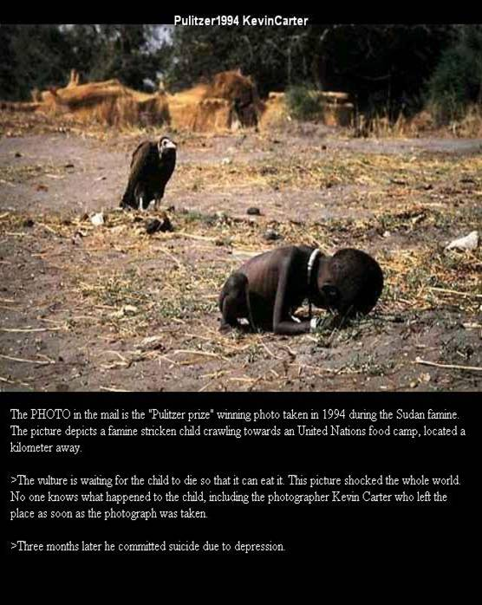
Photographs

Slide 16
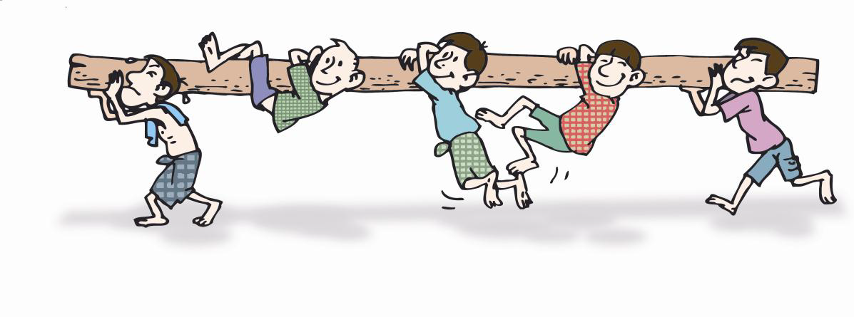
Pictures/photographs

Slide 17

  Individuals interview
An interview is a purposeful interaction in which one person obtains information from another.
Interviewing techniques;
    1. Unstructured interviews
    2. Semi-structured interviews
    3. Structured interviews

Slide 18
Guidelines for interviewing
Listen more, talk less.
Do not interrupt.
Avoid leading questions.
Keep participants focused and ask for concrete details.
Follow up on what they say.
Do not be judgmental about their views.
Do not debate with them over their responses.

Slide 19
Guidelines for…
Do record everything the interviewee says and note impressions of interviewee’s nonverbal behavior
Do allow the interviewee time to think

Slide 20
Interviewer Issues
Non Talker
Rambler unrelated topics
Uncomfortable with the issue
Contradicting Statements his/her self
Feel confused
Questioning you

Slide 21
In-depth interview
Semi-structured interview
Face to face conversation to explore issues in more detail
Last for 30-60 minutes
Minimum sample size 20-30 individuals
Use of open ended questions; power of probing
Know your interview guide and potential probes

Slide 22
In-depth interview…
Used
  When the subject matter is highly sensitive.
    E.g. opinion of abortion cases about FP
  Geographically dispersed respondents.

Slide 23
In-depth interview…
Participants will speak candidly only if they:
  Feel comfortable in the space
  Trust the interviewer
  Feel secure about confidentiality
  Believe interviewer is genuinely interested in what they have to say
  Do not feel judged
Establish good rapport!

Slide 24
Probing skill
Silent – Nod slowly, tilt head
Echo – Repeat the last statement and ask respondent to continue
Neutral – Encouraging; "I see", "uh-huh", minimal nonverbal signals
Direct – "Tell me more", "What do you do then?“
Phased assertion – Imply you already know something and encourage respondent to speak up
Detail – who, where, what, when, how
Clarifying – "You said X, please describe what you meant by that"

Slide 25
Focused Group Discussion (FGD)
A research technique that collects data through group interaction on a topic determined by the researcher
It is a discussion of 6-12 persons guided by a facilitator, members talk freely & spontaneously about a certain topic.
The most widely used technique
Time: lasts for 1-1:30hrs/group
A minimum of 4 groups

Slide 26
Focused Group…
Group interviews can be used when:
Limited resources
It is possible to identify individuals who share a common factor
It is desirable to collect the views of several people within that population sub group.
Group interaction stimulate reach response and greater insights
When subject matter is not so sensitive.

Slide 27
Skills of FGD moderators
Ability to put others at ease
Ability to listen to other people
Ability to encourage people
Awareness of non-verbal reactions
Knows when to probe
Does not lead the participants
Discourage dominant group members
Stimulates group interaction
Is relaxed and friendly
Responsive to the situation

Slide 28
FGD…
Composed of homogeneous members who share characteristics but usually do not know each other
Pre-determined criteria for selecting participants
Use of discussion guide )
2 FGD per type of respondent
Moderator and note taker

Slide 29
FGD guide
No more than 10-12 questions
Always use open ended questions
Avoid questions that can be answered yes or no.
Flow from general to specific
Avoid using “why” questions – instead use what or how

Slide 30
Flow of questions
Type of Question | Purpose
Opening questions | To identify the characteristics that the participants have in common.
Introductory questions | Introduce the general topic of the discussion, stimulate the conversation, and improve interaction in the group.
Transition questions | To move the participants into the focus of the discussion
Key questions | Concern about the focus of the interview
Ending questions | Give the participants an opportunity to make final statement.
Final questions | Ask the participants to add things they think have not been considered during the discussion

Slide 31
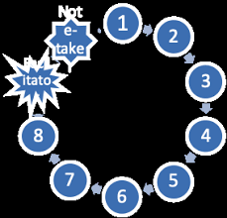
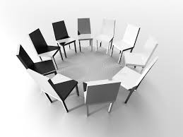
Seating arrangements

Slide 32
Sociodemographic of participants FGD
Code | Age | Occupation | Educational status | Age of the child/month | Total no of kids | Marital status | Distance from facility
P1 | 20 | No job | 4th | 12 | 1 | Marred | 15 min.
P2 | 25 | No Job | 8th | 47 | 1 | Marred | 15min.
P3 | 23 | Government | 3 | 31 | 1 | Marred | 15min.
P4 | 30 | No Job | 8th | 24 | 3 | Marred | 15min,
P5 | 45 | No Job | Illiterate | 15 | 1 | Divorced | 10min.
P6 | 24 | No Job | 10th | 20 | 4 | Marred | 10min.
P7 | 23 | No Job | 4th | 20 | 2 | Married | 10min
P8 | 25 | No Job | 5th | 17 | 3 | Married | 10 min

Slide 33
Observation
It involves systematically selecting, watching and recording behavior and characteristics of living beings, objects or phenomena.
  Gathering data from natural situation
  Obtaining data by watching participant

Slide 34
Type of Observation
Observation of human behavior
Participant observation
  The observer takes part in the situation he or she observes
Non-participant observation:
  The observer watches the situation, openly or concealed, but does not participate

Slide 35
Dimensions of Observation
Space (physical places)
Actors (people involved)
Activities (the set of related acts people do)
Object (the physical things that are present)
Time (the sequencing that takes place over time)
Goal (the things people are trying to accomplish)
Feeling (the emotions felt and expressed)

Slide 36
Steps for Observation
Determine the purpose of the observation activity.
Determine the population(s) to be observed.
Consider the accessibility of the population(s) and the venues in which you would like to observe them.
Investigate possible sites for participant observation.

Slide 37
Preparing…
Select the site(s), time(s) of day, and date(s), and anticipate how long you will collect observation data on each occasion.
Decide how field staff will divide up or pair off to cover all sites most effectively.
Consider how you will present yourself, both in terms of appearance and how you will explain your purpose to others if necessary.
Plan how and if you will take notes during the participant observation activity.

Slide 38
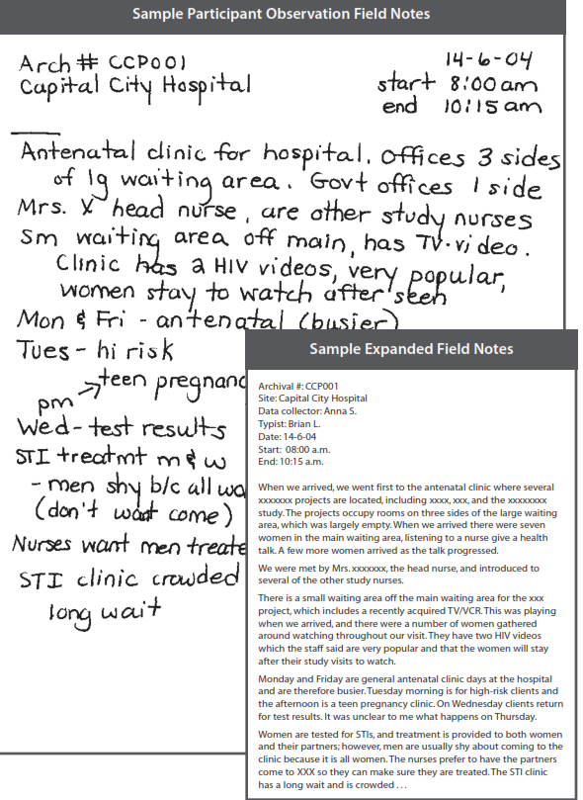

Slide 39
Transcriptions and translation
Transcribing is producing a written version of the interview or discussion.
It is a full "script" of the interview or discussion.
Transcribe audiotapes as soon as possible after the interview or discussion
No tempt to cut corners by summarizing the discussion/interview
The estimated ratio of time required for transcribing interviews is about 5:1 hour.

Slide 40
Types of transcription
Verbatim transcription
  It captures all of the spoken words, including fillers like “ah”, “uh” and “om”, throat clearing and incomplete sentences
  It also includes pauses, laughter and other sounds
Intelligent verbatim transcription
  Omits all “ums”, “oms”, laughter and pauses throughout the conversation.
Edited transcription
  A full and accurate script is formalized and edited for readability and clarity.

Slide 41
Translation
Transcribe in original language and then translate
Transcriber, trying to stay as close as possible to the original meaning
Translator should give literal-sentence-by-sentence translation
Some words simply have no translation or difficult to find equivalent; difference in culture.
Use the word or phrase that comes closest and include the original word in parentheses

Slide 42
Field Notes
Qualitative research material gathered, recorded, and compiled (usually on site) during the course of the study
It describes accurately and comprehensively as possible
It should be extensive, clear, and detailed as possible.
Have two sections
  Descriptive Information
  Reflective Information

Slide 43
Memo
With prolonged engagement and immersion in contexts and data, the researcher may realize from self-reflexivity that useful insight but not directly related to the data crops up.
Memo could be taken at different levels of the research process starting from definition of research problems and continuing through data collection, data reduction, data display, analysis, and interpretation.
The memos are useful espcially during data analysis and interpretation of the result.

Slide 44
Any question?

Slide 45
References
Immy Holloway and Stephanie Wheeler (2002). Qualitative Research in Nursing. Second edition. Blackwell publication. ISBN-10: 0632052848 | ISBN- 13: 978-0632052844
Priscilla R. Ulin, Elizabeth T. Robinson and Elizabeth E. Tolley (2004). Qualitative Methods in Public Health: A Field Guide for Applied Research. Jossey-Bass Wiley Imprint. ISBN-10: 0787976342 | ISBN-13: 978- 0787976347

