Slide 1
Qualitative Research Designs
Simegnew H.(BSc, MPH, Ass. Prof.)
simegnew.handebo@sphmmc.edu.et

Slide 2
Disclaimer Statement
This training is a collective learning journey, built on shared experiences and insights. I am not here to deliver absolute knowledge, but to guide participants in structuring and deepening their understanding of qualitative research methods.
The session is neither exhaustive nor definitive; it is designed to spark further growth for those with genuine interest and commitment.
All examples are strictly academic and scientific, with no negative intent or motives.

Slide 3
Learning objectives
By the end of the session, participants will be able to:
Elucidate research design in qualitative inquiry
Appreciate the unique features of qualitative research design
Select tailored qualitative research designs to specific questions, contexts, and epistemological positions.

Slide 4
Discussion
Qualitative research is characteristically exploratory, fluid and flexible, data-driven and context-sensitive.
Is it necessary, or possible, to design qualitative research at all? (Mason, 2002, PP 24).
What form of a priori design, if any, can appropriately guide such inquiry??
Notes:
Qualitative research is “loose” or “unstructured.”???
Mason, design is both necessary and possible in qualitative inquiry, but it looks different from quantitative design.
Unlike quantitative “blueprints,” qualitative design is adaptive.
Design is dynamic: it evolves as the researcher engages with participants and contexts.

Slide 5
Qualitative research design
A research design is a logical model that guides the investigator through the research process.
It links data to be collected and conclusions to be drawn to the initial questions of the study.
The process of designing qualitative research is rarely linear.
Have interdependent and overlapping steps

Slide 6
“The design of a naturalistic inquiry (whether research, evaluation, or policy analysis) cannot be given in advance; it must emerge, develop, unfold.”
(Lincoln and Guba 1985, p. 225)
Notes:
Decisions about design and strategy are ongoing and are grounded in the practice, process and context of the research itself.

Slide 7
QR design …
A well formed question is key to good qualitative research design
“To ask the right question is more important than receiving answers. The solution lies in understanding the problem; the answer is within it."
(J. Krishinamurti, 1971)

Slide 8
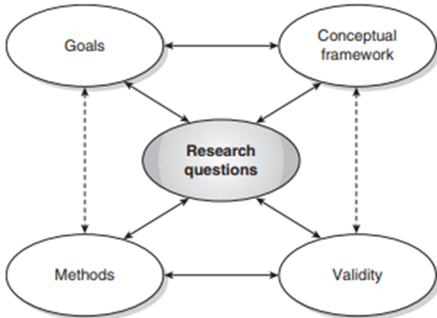
QR design …
No consensus on whether we need a design at the beginning or as an iterative process
“Do not put me into a box let me try myself”
“…interactive approach, whereby a qualitative study’s purpose, research questions, conceptual context, methods and concerns for validity all continually interact”
(Maxwell, 2012)

Slide 9
Characteristic of QR design
Naturalistic - studying real-world situations as they unfold naturally
Non-manipulative and non-controlling
There is a lack of predetermined constraints on findings
Emergent - adapting inquiry as understanding deepens and situations change
Avoids rigid designs to allow opportunities to pursue new paths of discovery as they emerge.
Let the landscape (the understanding) reveal the true journey.
Notes:
This approach is not "unstructured" or "unscientific." yet different kind of rigor suited to understanding complex human phenomena.
Fidelity to the Phenomenon: The findings genuinely reflect the reality of the participants' world, not the researcher's preconceived notions.
Answers are not limited by the questions.
Constrained (Hypothesis-testing) Approach: “Higher class sizes correlate with lower teacher morale.“
Naturalistic (Unconstrained) Approach: Would start with a question: "What is the experience of teaching at this school, and what factors affect teacher morale?"

Slide 10
Characteristic of QR design
Purposeful - cases for study are selected because they are “information rich” and illuminative.
Sampling is aimed at insight about the phenomenon, not empirical generalization
Holism- the whole is more than the sum of individual parts
Understanding contextual meaning requires a holistic approach- considering a multiple contextual factors (social, historical, physical, etc.)

Slide 11
Human as Research Instrument
Fundamental, defining characteristic of qualitative inquiry
Major decisions about study design are often emergent
The researcher is not an external observer using neutral tools, but a primary tool for data collection, analysis, and interpretation.
Need to cope with the circumstances: Responsive, flexible, adaptive and a good listener
Example: Studying community grief after a disaster

Slide 12
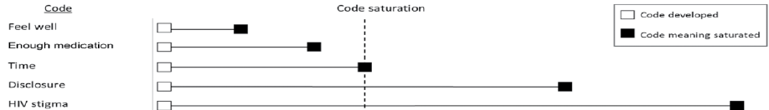
Saturation or Redundancy
A stage when additional interview or observation is not believed to add new information, themes, or insights
A point at which the research circle is discontinued
Data recurrence and conceptual density
Notes:
Not About Quantity, But About Information Depth
An Emergent Benchmark, Not a Predetermined Number

Slide 13
Discussion
Can qualitative research be both deeply subjective and systematically rigorous? How?
What practical challenges arise when a study’s direction can change unexpectedly—and how might a researcher prepare for or navigate them?
Notes:
Risks: bias, subjectivity.
Managed through reflexivity, transparency, and methodical documentation.
Requires researcher skill in balancing openness with focus.
Staying systematic while being flexible.

Slide 14
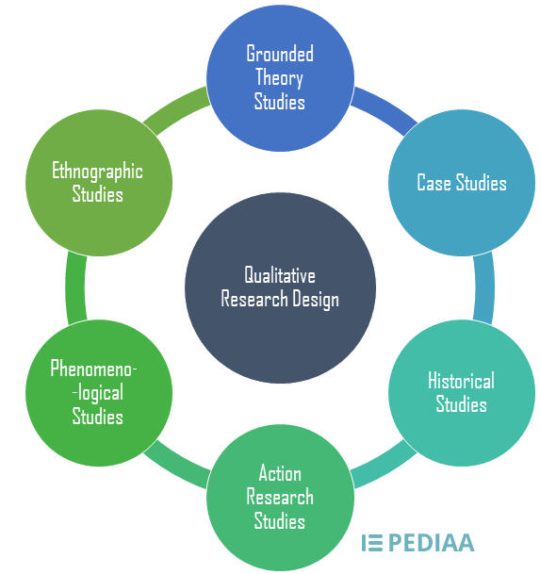
Qualitative research designs
Grounded theory
Phenomenology
Ethnography
Narrative
Case study

Slide 15
Grounded theory

Slide 16
Grounded theory
Developed by Glaser and Strauss (1967)
Interactions between health care professionals and dying patients-- “dying in a California hospital.”
Explored the social processes
Explanation of grief process which progressed through a series of stages: denial, anger, acceptance and resolution.
Notes:
Inductive reasoning and systematic data collection to generate theories grounded in the data.
Theoretical Sensitivity
Introduced a more structured approach to coding and analysis

Slide 17
Grounded theory…
It is a systematic, qualitative procedure used to generate a theory that explains conceptual level, process, an action, or an interaction about a substantive topic (Creswell, 2008).
The aim is to generate or discover a theory
Theory is derived from data acquired
The researcher does not use an existing theory

Slide 18
Grounded theory…
Use constant comparative analysis - simultaneous collection and analysis of data
Categories are developed from the data are constantly compared with data obtained earlier
Data collection and sampling are based on emerging concepts; stop when theoretical saturation is achieved

Slide 19
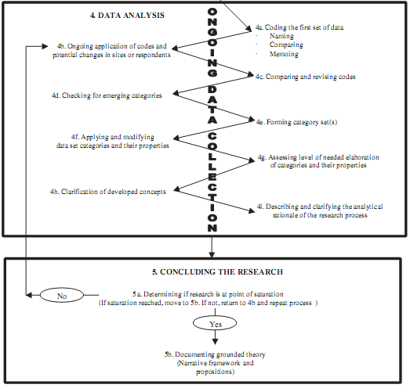
Zigzag approach to data collection and analysis

Slide 20
Grounded theory…
Theoretical sensitivity
Ability to give meaning to data, understand what the data says, and being able to separate out what is relevant and what is not

Slide 21
Literature review in GT
Where is the place of the literature review in grounded theory research???
Glaser and Strauss explicitly advised against conducting a literature review until the analysis completed

Slide 22
Delaying literature review
Not to be biased with existing framework, theories
May ‘contaminate’ the data collection, analysis and theory development
Lead the researcher to impose existing frameworks, hypotheses or theoretical ideas upon the data
Undermine the focus, validity and quality of the grounded theory

Slide 23
Undertaking early review
It can provide a cogent rationale for a study, including a justification for a specific research approach
It can help contextualize the study and orient the researcher
It can help the researcher develop ‘sensitizing concepts’ , gain theoretical sensitivity
Promote clarity in thinking about concepts
The open-mindedness should not be mistaken for the empty mindedness

Slide 24
Phenomenology; The Lived Experience

Slide 25
Phenomenology
Phenomenology is the study of the structures of experience and consciousness.
Phenomenology means the study of phenomena; may be events, situations, experiences or concepts.
Aimed to understand the subjective, lived experiences and perspectives of participants.
Construct the universal meaning of the phenomena.

Slide 26
Phenomenology…
Example of Phenomenological research questions;
What is experience of people with back pain?
What is the feelings and experience of teenagers who faced unsafe abortion?

Slide 27

Phenomenology…
It is based on the principle that a single experience can be interpreted in multiple ways
Objective study of subjective things
Data is collected: Observation and interview
Phenomenology: Pictorial Representation

Slide 28
Features of Phenomenology
Starts free from hypothesis: "begins with the phenomena themselves.“
Descriptive: time, space, and context
Interpretive: what the experience means to involved people and beyond
Focuses on four aspects of a lived experience: lived spaced, lived body, lived time, and lived human relations.

Slide 29
Ethnography

Slide 30
Ethnography
“The attempt to understand another life world using the self … as the instrument of knowing”
Sherry Ortner

Slide 31
Ethnography
Ethnography from the Greek word stands for ethnos (people) and graphy (to write).
Ethnography aims to provide rich and holistic insights into people’s worldviews and actions, as well as the contexts.
Detailed and systematic study of people and cultures
Has its foundation in naturalism and relativism: natural setting with active involvement in the usual contexts

Slide 32
Ethnography…
Researcher embeds/immerse within the community/setting for extended time
Moves beyond surface explanations; to grasp underlying meanings, norms, and cultural logic
Knowledge as co-constructed and situated

Slide 33
Ethnography…
Ethnographers participate in the daily lives of the people being studied
24 hours per day, 7 days per a week and different seasons of the year for extended period of time
Watch what happens,
Listen to what’s being said and
Ask questions.
Study from an insider’s point of view.

Slide 34
Ethnography...
Focuses on the culture of a group of people
Cultural behaviour (what they do)
Cultural artifacts (what they make and use)
Cultural speech (what they say)
Multiple data collection methods
Observations,
Depth inter-views, FGDs,
Documentary, photographs.

Slide 35
Ethnography...
Ethnography study cultural system holistically through
Emic perspective
The way the members of the culture envision their world, insiders’ view
Etic perspective
The outsider's interpretation of the experiences of that culture; Researcher view

Slide 36
Features of Ethnography
Immersion in the context
Focus given to cultures and how it works
Emic perspective given prominence
Understanding of the different parts together
Language as an important element in the study
Maximum variation

Slide 37
Narrative inquiry

Slide 38
Narrative
Narrative research design is a relatively recent
Focuses on the ways in which personal story is constructed, and how individuals account for and give meaning to their life stories
The role of a researcher is to collect and narrate stories about people’s lives in the way people narrated them.
Shares broader contexts with ethnography; implication of time, space and context with phenomenology; and exploration of depth with case study.

Slide 39
Narrative…
Narrative inquiry can reveal unique perspectives and deeper understanding of a situation.
Research design to explore the perceptions and personal stories
Focuses on chronology, context, and personal meaning rather than general themes
Prioritizes the participant's voice and the "micro picture" of lived experience

Slide 40
Elements of narrative inquiry
Temporality – the time of the experiences and how the experiences could influence the future
Sociality – cultural and personal influences of the experiences
Spatiality – the environmental surroundings during the experiences and their influence on the experiences.
Chronology - allows participants to recall specific places, situations, or changes within their life history

Slide 41
Case study

Slide 42
Case study
Case study is an in-depth and detailed investigation of the development of a single event, situation, or an individual over a period of time.
“A case study is an empirical study that investigates a contemporary phenomenon in depth and with its real-life context” (Yin, 2009)
Develop holistic and meaningful characteristics of real life event

Slide 43
Case study…
Case studies are often used to explore and unearth complex issues such as social issues, medical conditions, etc.
Rely on multiple data sources
A successful case study is always context-sensitive, holistic, systematic, layered and comprehensive.

Slide 44
Case study…
Main methods
Observation
Interview
Document review
Data analysis will be
Pattern-matching
Explanation-building
Time-series analysis

Slide 45
Types of case study
Intrinsic
The case itself is of interest
Instrumental case study
A particular case is studied to provide insight into an issue or to refine a theory
Collective case study
A number of cases are studied jointly in order to investigate a phenomenon (instrumental study extended to several cases)

Slide 46
Discussion
What would be the most appropriate qualitative research design. If you think that more than one method would be appropriate, explain why.
How it feels to be a drug addict?
Foods taboo for pregnant women and related contexts
Evaluation of the PHU reform in AA

Slide 48
Mixed methods research

Slide 49
Mixed methods research
Mixed methods research is the type of research which focuses on collecting and analyzing both quantitative and qualitative data in a single study or series of studies.
Its central premise is the use of combination of both approaches, provides a better understanding of research problems than either approach alone.

Slide 50
Mixed methods…
Advantage Mixed methods
Offset the weaknesses of both quantitative and qualitative research
Provides complete and comprehensive understanding of the research problem
For developing better, more context specific instruments
Explain findings or how causal processes work

Slide 51
Mixed methods…
Disadvantage Mixed methods
Research design can be very complex.
Takes much more time and resources to plan and implement
It is difficult to plan and implement method by drawing on the findings of another.
It may be unclear how to resolve discrepancies that arise in the interpretation of the findings.

Slide 52
When to Mix
A need exists because one data source may be insufficient
A need exists to explain initial results-quantitative results require an explanation
A need exists to generalize exploratory findings
A need exists to enhance a study with a second method

Slide 53
Types of mixed methods design
Sequential : Analysis of the data from the first method precedes execution of data collection in the second method
Exploratory mixed methods design
Explanatory mixed methods design
Concurrent: Quantitative and qualitative data are gathered at the same time period, from the same participants.
Convergent mixed methods design
Embedded or nested mixed methods design

Slide 54
Types of mixed…
Finally, a series of sequential and/or concurrent designs can be combined to form what is commonly referred to as:
Multiphase or iterative mixed methods design

Slide 55
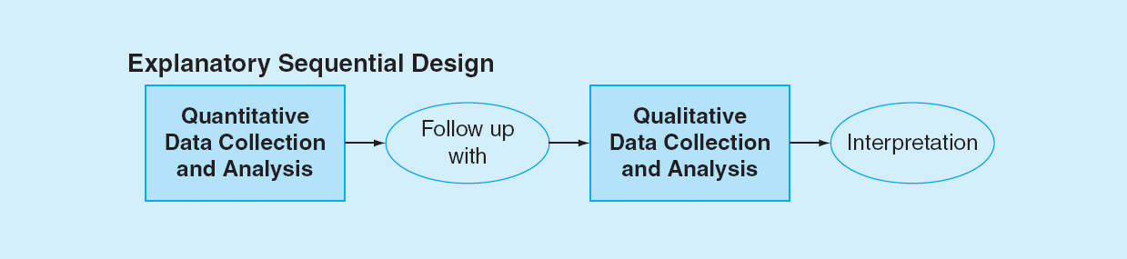
Explanatory design
This design use qualitative methods to explain earlier quantitative findings.
Quantitative data are collected and analyzed prior to the collection and analysis of qualitative data.

Slide 56
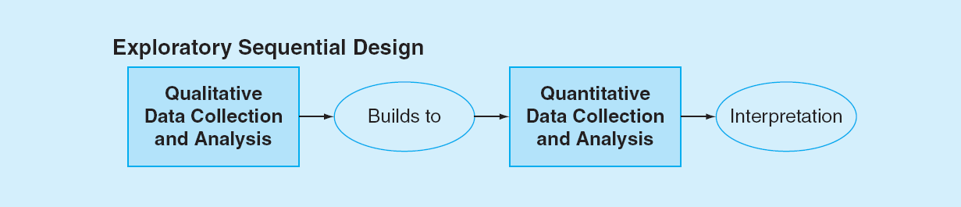
Exploratory Design
Design in which qualitative methods are used to inform a subsequent quantitative study.
Qualitative data are to inform the content and design of the quantitative survey or intervention.

Slide 57
Convergent Designs
Quantitative and qualitative data collection and analysis are conducted separately yet concurrently.
The findings are integrated during the interpretation of the study.
Equal priority is given to both types of research.
If the results from two methods agree: two sets of findings serves to validate both the qualitative and quantitative findings

Slide 58
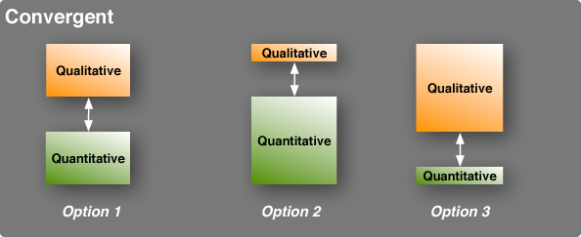
Convergent…
If the results from two methods disagree: generate insights in need of further research.
Three type of convergent mixed methods:

Slide 59

Embedded Design
Predominant method embeds the other less priority method.
The embedded method addresses a different question than the dominant method.
The data collected from the two methods are mixed during the analysis

Slide 60
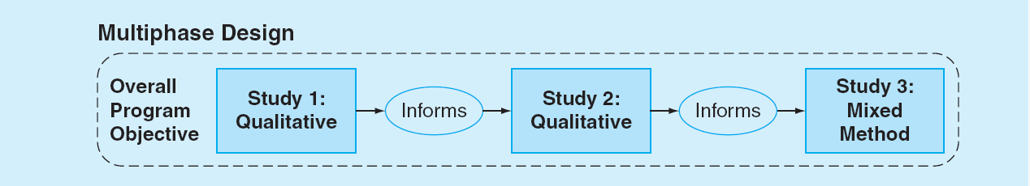
Multiphase Designs
This designs incorporate a series of qualitative and quantitative studies comprising multiple sequential or concurrent designs.

Slide 61
Any question?

