Slide 1
Overview of Qualitative Research Methods

Slide 2
Introduction
What is Qualitative Research?

Slide 3
Qualitative research defined
  It is a type of research that focuses on exploring and understanding the meaning individuals or groups ascribe to social or human experiences.
Based on distinct methodological traditions of inquiry
  it uses specialized techniques for obtaining in-depth understanding of what people think and how they feel

Slide 4
Cont…
It enables to gain insight into
  attitudes,
  beliefs,
  motives and
  behaviour of the target population

Slide 5
Cont…
It is not just small scale, subjective quantitative research
Requires us to examine how we understand science
It is thinking beyond numbers

Slide 6
Cont…
‘Qualitative Research…involves finding out what people think, and how they feel - or at any rate, what they say they think and how they say they feel. This kind of information is subjective. It involves feelings and impressions, rather than numbers’

Slide 7
Cont…
Qualitative research involves the use and collection of a variety of empirical materials including:
  Personal experience, case study, observational, historical, and visual texts-that describe routine and problematic
  moments in individual and group lives.
Deploys a wide range of interconnected methods, hoping always to get a better fix on the subject matter at hand.

Slide 8
Cont...
Albert Einstein stated that;
“Not everything that can be counted counts, and not everything that counts can be counted”

Slide 9
History of qualitative research

Slide 10
History of qualitative research
Qualitative research have been concerned in understanding of society
Tries to see this world’s objectivity
Qualitative research ( like any other research) have always been judged on the standards whether the work communicates or says something to us
Based on how we conceptualize our reality and our images of the world

Slide 11
History of qualitative research
History of qualitative research have some overlapping stages
Early ethnography (17th century)
Colonial ethnography (17th, 19th and 20th century)
The ethnography of American Indians (19th and 20th century)
Community studies and ethnographies of American immigrants early 20th century throughout the 1960s
Studies of ethnicity and assimilation (mid century to the 1980 and) and the current which we call the eighth moment

Slide 12
History of qualitative research
In each of these eras, researchers were influenced by their political hopes and ideologies and discover findings in their research that confirmed their prior theories or believes
Post modernism and post structuralism shifted the researcher than observing history to be part of history

Slide 13
Approaches in qualitative research

Slide 14
Approaches in qualitative research
Qualitative research is a complex, contested and a site of many research methodologies
It has no theory or paradigm that is distinctly its own
Multiple theoretical paradigms claim use of qualitative research methods and strategies
  From Constructivist to Cultural studies, Feminism, Marxism, and ethnic models of study
Three approaches are presented:
      positivist,
      interpretative,
      and feminism

Slide 15
The positivist approach
A positivist philosophy assumes that there is a stable reality;
A phenomena exist whether we are looking at them or not,
That they exist in exactly the same way whether we understand them or not.
A basic assumption of this paradigm is that the goal of science is to develop the most objective methods possible to get the closest approximation of reality.
Stress on studying only observable phenomena

Slide 16
Interpretative appraoch
  A paradigm that sees the world as constructed, interpreted, and experienced by people in their interactions with each other and with wider social systems.
  The view that there is one stable, pre-existing reality ‘out there’ waiting to be discovered is questioned that reality is held to be socially constructed.

Slide 17
Approaches: Feminist
Underlying this perspective is a notion of difference, whether it was to claim that men and women are essentially different or that men and women occupy different social positions and therefore have very different world-views and experiences.
All knowledge is produced by social subjects, and knowledge that is being produced predominantly by men about a world that is predicated on male experiences and views cannot be held to be objective.

Slide 18
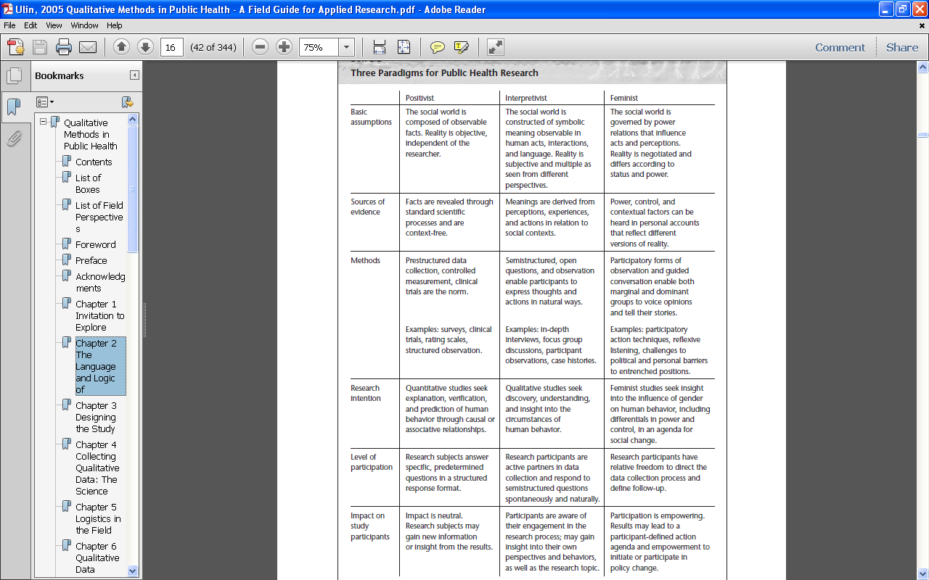

Slide 19
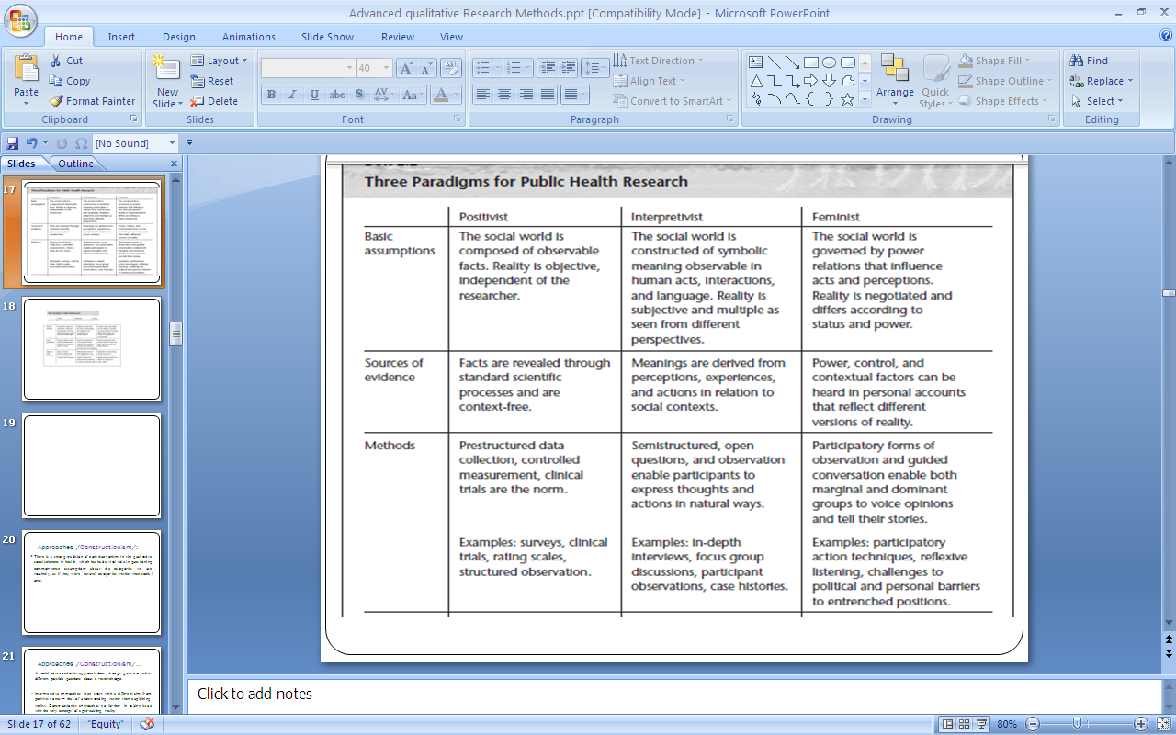
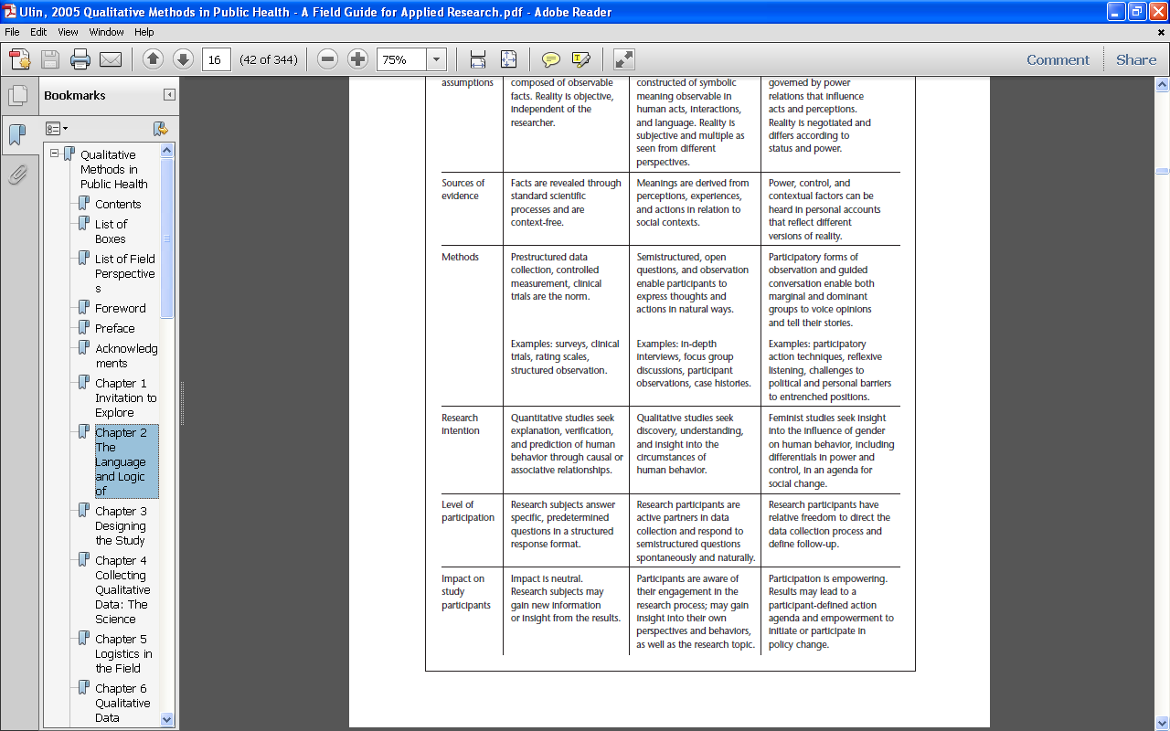
Ulin et al, 2005: p 16

Slide 20
Building blocks of qualitative research

Slide 21
Ontological assumtions
Relates to the nature of reality and its characteristics.
What concepts do we understand to underpin being, reality and substance?
What is the nature of being?
  Realities are subjective and multiple
  Realities are socially constructed
  Report on these multiple realities by exploring multiple forms of evidence from different individuals’ perspectives and experiences

Slide 22
Epistemological assumptions
  Is a view on how knowledge is generated (How researchers know what they know), this emphasizes the interaction between the informant and the researcher as inseparable
  How do you go about examining the world?
  What are the appropriate forms of investigation
  Researchers try to get as close as possible to participants being studied.
  Subjective evidence is assembled based on individual views from research conducted in the field.

Slide 23
Axiological assumptions
The role of values in research:
  Researchers make their values known in the study and actively reports their values and biases as well as the value-laden nature of information gathered from the field.

Slide 24
Methodological assumption
The process of research
  Qualitative research is inductive,
  Time and context-bound
  Follows an emerging design.

Slide 25
Why do we need to use qualitative research

Slide 26
“If the researcher cannot articulate, at least to herself, the reasons for using qualitative methods in a research project, it is likely that she will be unable to defend the project as a rigorous and valued piece of scholarship.”
(Maykut and Morehouse, 1996)

Slide 27
Cont…
There are both conceptual and practical reasons to use qualitative studies
  Conceptually:
    It provides greater depth of response and greater consequent understanding of the informant

Slide 28
Cont....
“The choice between quantitative and qualitative research methods should be determined by the research question, not be the preference of the researcher.”
(Marshall, 1996)

Slide 29
Cont…
  Practical reasons to use qualitative research
  Low cost
  Timing-short time
  Flexibility- the study design can be modified while it is in progress
  Direct link with the target population
  Not affected by lack of technical facilities

Slide 30
Difference b/n qualitative and quantitative methods
In qualitative research the point of departure is the point of view of the informants
Qualitative research is an act of interpretation
Qualitative researchers work with small number of informants, but try to gain an in-depth understanding.
In quantitative research the point of departure is the idea of the researchers
Quantitative research is an act of proof
Quantitative researchers need representative sample size

Slide 31
Less is more and more is more…
Qualitative research prioritizes detailed data from smaller number of cases
“Making the facts understandable” – why do we see the patterns that we do?
Mechanisms and processes are often key
Embraces context, rather than trying to control for it, or exclude it

Slide 32
Cont…
Qualitative
Quantitative
Lots of probing
Data collection needs skilled researcher
Exploratory nature
Limited probing
Not necessary
Descriptive or analytical/causal

Slide 33
Cont…
The data processing in qualitative research is systematic yet flexible
Unlike quantitative analysis, qualitative analysis does not entail reducing information to numbers and applying statistical methods.
Rather, the aim of qualitative analysis is to conceptualize the meaning of phenomena and human action

Slide 34
How is qualitative research used

Slide 35
How is qualitative research used
As an idea generation tool
2. A preliminary step to aid in the development of a
quantitative study
As a follow-up to aid in understanding of the results of a quantitative study
The primary data collection method

Slide 36
Designing a qualitative research

Slide 37
Central concepts in designing qualitative research
Natural setting/Context:
People ascribe different meanings to activities, events or phenomenon in different contexts familiar to the informants
Environment which is familiar,
Holistic: taking a multitude of contextual factors.
“ the whole is more than the individual parts”
The human research instrument: The researcher as a human research instrument is very important in qualitative research
Open ended questions

Slide 38
Cont….
There is no a priori hypothesis and the research method is flexible, hence the researcher should be involved from data collection to write up.
The epistemological aspect of qualitative research indicates that knowledge is created by interaction between people (knower and known)

Slide 39
Cont…
Emerging design:
Aim to learn from every step of our data collection, openness to adopt inquiry
Avoids getting locked into rigid designs
That eliminate responsiveness and peruses new paths of discovery as they emerge

Slide 40
Thanks
Q and A

