Slide 1
Quality in RCTs
Dawit A. Ejigu (MD, MSc)
Associate Professor,
Department of Pharmacology
SPHMMC

Slide 2
Outline
Background
Quality by Design
Audit & Inspection
SOPs

Slide 3
Background
Quality: absence of errors that matter to decision making
  Errors which have a meaningful impact on the safety of trial participants or credibility of the results
Quality must be integrated into the entire clinical study process
  To ensure subject protection and to deliver high quality data
A shared responsibility
  Sponsor, investigator, IRB, RAs…

Slide 4
Quality by Design (QbD)
Focuses resources on errors that matter to decision making during a trial
Prospectively examining the objectives of a trial and defining factors critical to these objectives
  Taking action to prevent important risks to these critical factors
  Understand which data & processes underpin a successful trial
  Identify and manage important and likely risks

Slide 5
Quality by Design (QbD): Steps
STEP 1: Identify “critical to quality” factors (CTQs) for your specific trial
    Protocol design
    Feasibility
    Study conduct
    Study reporting
    Third party engagement
    Patient safety

Slide 6
Quality by Design (QbD): Steps
STEP 2: Discuss potential risks related to each CTQ identified that impact study quality
STEP3:
Mitigate those risks that will likely lead to errors that matter
Determine how to rapidly identify and react when there is an issue

Slide 7
Quality by Design (QbD)…
Prospectively and fully aware throughout the trial lifecycle important errors that could jeopardize
  Patient safety
  Credible data

Slide 8
Audit and Inspection
Part of the quality system
Independent of the routine monitoring and quality control system
Evaluates adherence to GCP, Protocol, SOPs, local regulations…

Slide 9
Audit and Inspection…
The sponsor is responsible for implementing and maintaining quality assurance and quality control systems with written SOPs to ensure that trials are conducted ….. in compliance with the protocol, GCP, and the applicable regulatory requirement(s)
ICH GCP E6

Slide 10
Audit and Inspection…
QA
All those planned and systematic actions that are established to ensure that the trial is performed…in compliance with GCP and the applicable regulatory requirements
ICH GCP

Slide 11
Audit and Inspection…
QC
The operational techniques and activities undertaken within the quality system to verify that the requirements for quality of the trial related activities have been fulfilled
ICH GCP

Slide 12
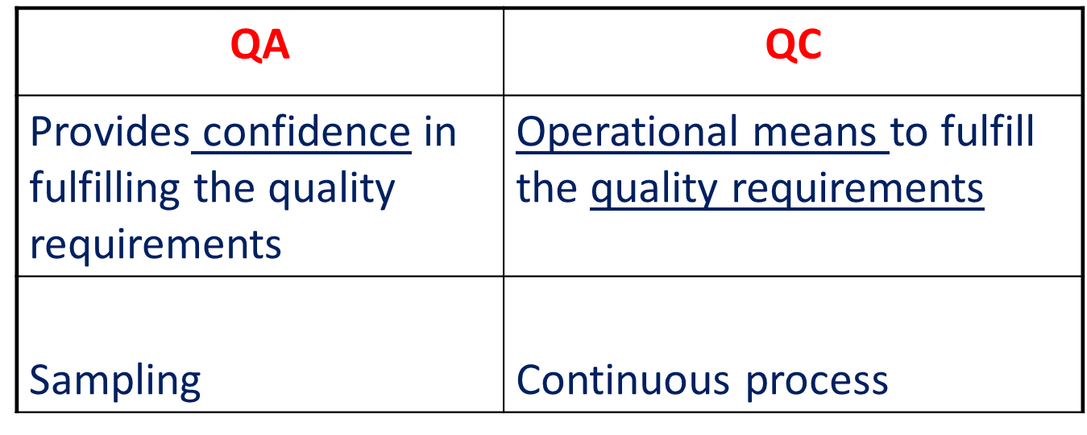
QA vs QC

Slide 13
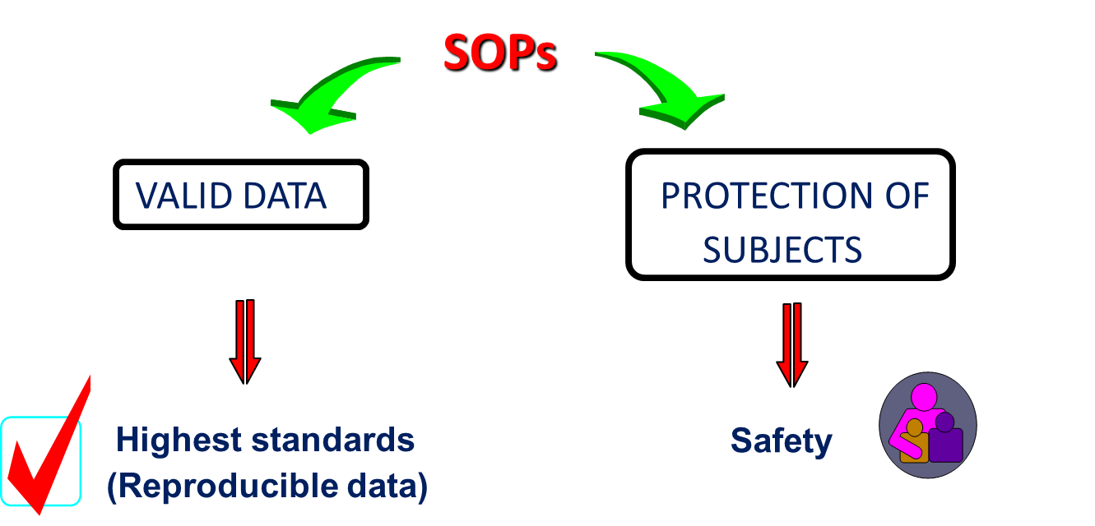
Quality

Slide 14
Audit
A systematic and independent examination of trial related activities and documents to determine whether the evaluated trial related activities were conducted...according to the protocol, sponsor’s SOPs, GCP and the applicable regulatory requirement(s).”

Slide 15
Audit…
Assesses the process and the QC
Checks for compliance with regulations, SOPs, protocol (study specific audits), and guidelines
Identifies serious and systematic problems
Gives an assurance of the quality of trials
Only a small sample of work is audited
Benefits need to be spread across all areas

Slide 16
Inspection
The act by a regulatory authority(ies) of conducting an official review of documents, facilities, records, and any other resources that are deemed by the authority(ies) to be related to the clinical trial and that may be located at the site of the trial, at the sponsor’s and/or CROs facilities, or at other establishments deemed appropriate by the regulatory authority(ies)

Slide 17
Preparation for Auidt/Inspection
Try to identify potential areas of concern before the inspection
Don't try to cover it up
Show improvements and plans
Don't offer adverse information unless requested to do so
Aim to be consistent with team members

Slide 18
Preparation for Inspection…
        Know what you do
        Say what you do
        Do what you say
        Prove what you did

Slide 19
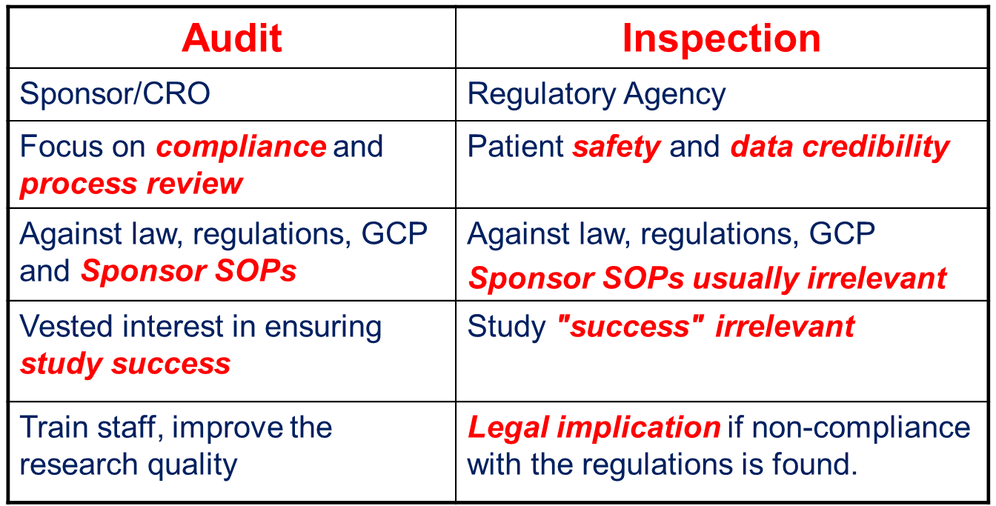
Audit vs Inspection

Slide 20

Standard Operating Procedures (SOPs)
“Detailed WRITTEN instructions to achieve uniformity of performance of a specific function”
SOPs simplify organisation & documentation of operation while maintaining high standards

Slide 21
Characteristics of SOPs
Written in a clear and unambiguous manner
Language understandable by the users
Easy to follow instructions
Should be reviewed regularly (maximum 3 years according to ICH-GCP)
Updated for changes or as a result of events
  Audit finding
  Policy changes…

Slide 22
SOPs should be:
An effective and efficient way of documenting/ communicating procedures
A tool for staff training programmes
An invaluable asset to your organization

Slide 23
SOPs should NOT be:
Documents which exist only for the sake of regulatory authority, sponsors, monitors, auditors !
A set of documents for mere existence!

Slide 24
Importance of SOPs
Proficiency – training tool
Accountability – who is to do what
Efficiency – timeliness
Consistency – uniformity
Continuity – in case of personnel turnover
Transparency – audit trail, + documentation
Study reconstruction over time
Prerequisite for GCP and GCLP

Slide 25
SOPs should answer:
  WHAT has to be done
  WHO has to do what
  WHEN has it to be done
  HOW has it to be done
  WHY has it to be done
  WHAT evidence shows that it was carried out

Slide 26
Maximizing compliance with SOPs
Design for Compliance
Writing SOPs and guidelines that can be followed
Tight timeframes
  Allow time for natural and appropriate workﬂow
  Signature in one day ?
  Signature on all edit checks before testing DB; probably better before production

Slide 27
Maximizing compliance with SOPs…
Design for Compliance…
Too many signatures
Over specified details
Notations in green ink or is any pen color other than black
Batch transmittal form initialed by clinical assistant or
can it just be whoever opens the mail?

Slide 28
Maximizing compliance with SOPs…
Design for Compliance…
Documentation produced after fact
  Burdensome documentation after a task is completed
  Especially after the study is locked
  E.g. Manually creating list & signing list of subjects locked for interim analysis

Slide 29
Maximizing compliance with SOPs…
Design for Compliance…
‘Require’ vs ‘Include’
  Something required by an SOP, it must be there during audit
  If something not always required, recommend, may include
  Should or may vs MUST

Slide 30
Maximizing compliance with SOPs…
Training and Access
SOP training before working on production studies
  Different modes including read and acknowledge
  Including contractors & temporary employees
Document training
Despite intensive training not points remembered
  Ensure access to the SOPs
  Revisions of SOPs undergo the same process

Slide 31
Proving Compliance with SOPs
“NO SOP, NO GCP”…. “If it is not documented, it was not done”
If SOP compliance not documented, SOP not followed
  There is often intrinsic evidence that procedures were followed
When developing SOP think of evidence to show compliance
  Critical tasks such as SAE reconciliation & database locking

Slide 32
Proving Compliance with SOPs: Best Evidence
Used in carrying out the procedure specified in the SOP
Naturally produced as output in carrying out the procedure
Should also be helping you carry out the procedure
Task with many steps & time lag in between
  Signed checklists could be both helpful and evidence
E.g. natural output annotated CRF as evidence that DB designer followed SOP
  Not extra documentation

Slide 33
Proving Compliance with SOPs: Acceptable Evi.
Sign off forms associated with SOPs
  E.g. Study Lock Approvals” followed by a list of people, who sign off to approve a process in advance or to attest that procedure was done
Not really tools, but evidence
We have to rely on the idea that the signers were diligent in making sure necessary steps were carried out

Slide 34
Thank You !

