Slide 1
Good Documentation Practice
(ALCOA)
Dawit A. Ejigu (MD, MSc)
Associate Professor,
Department of Pharmacology
SPHMMC

Slide 2
Source Document
One of the essence of GCP is credible data
An essential part of the quality assurance system
Correct, complete, current, and consistent info meets regulatory requirements
Helps to reduce observations raised as a result of inadequate documentation practices

Slide 3
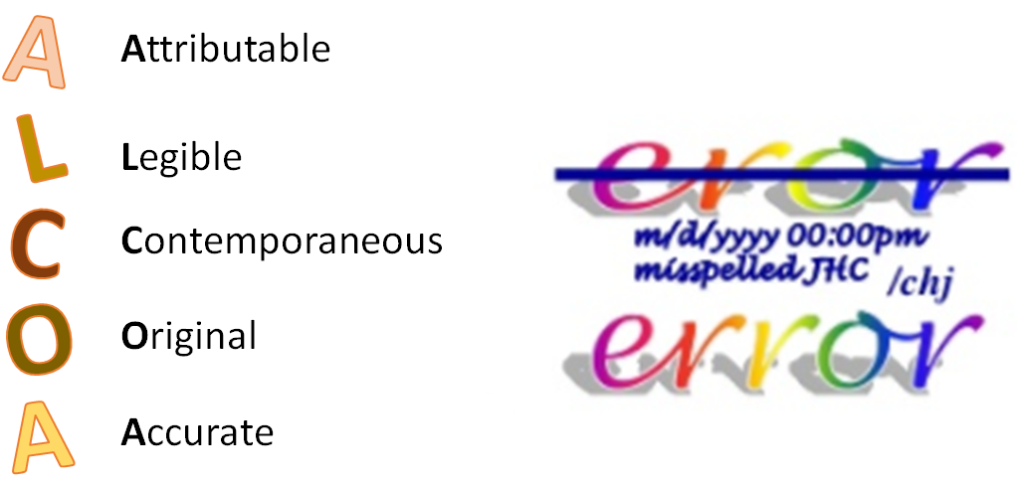
Outline

Slide 4
ALCOA Principles: Attributable
All data collected must be attributable to the person who collected it;
  Qualified person
  Delegated to perform the task
  Dated signature/initials on the source document

Slide 5
ALCOA Principles: Legible
Records are critical for study outcome and patients' safety
Should be read easily
If corrections necessary, a single line drawn through errors, initialed and dated

Slide 6
ALCOA Principles: Contemporaneous
Data assumed credible, only if recorded at the time of a measurement
Documents should clearly reflect data was recorded at the time it was obtained

Slide 7
ALCOA Principles: Original
The first-time data recorded, medium becomes source document
Transcribing data presents possibility of data entry or typing errors
Certified copies/Shadow Copies may be acceptable

Slide 8
ALCOA Principles: Accurate
Data that is true and correct
Multiple documents recording the same data,
  Need to be in agreement with each other

Slide 9
ALCOA Principles: ALCOA+
Complete
Consistent
Enduring
Available
Traceable

Slide 10
Thank You !

