Slide 1
Data Management in Clinical Trials
Dawit A. Ejigu (MD, MSc)
Associate Professor,
Department of Pharmacology
SPHMMC

Slide 2
Outline
Background on CDMS
Data Management Standards/ guidelines
Data Management Process
CRF completion
Electronic Documentation

Slide 3
Clinical Data Management (CDM)
Process of collecting, cleaning, and managing data in compliance with standards
1⁰ Objective; High-quality data
  Accurate and suitable for analysis
  Comply with protocol requirements
  Minimal/no misses
  Acceptable level of variation

Slide 4
Clinical Data Management System (CDMS)
A software platform to collect, validate, clean, and manage trial data
Commercial or free
  Commercial; ORACLE CLINICAL, CLINTRIAL, eClinical Suite, MACRO, RAVE
  Free; OpenClinica, REDCap, openCDMS, TrialDB, & PhOSCo
CDMS needs to have
  Password, Audit trail, Date and time stamp

Slide 5
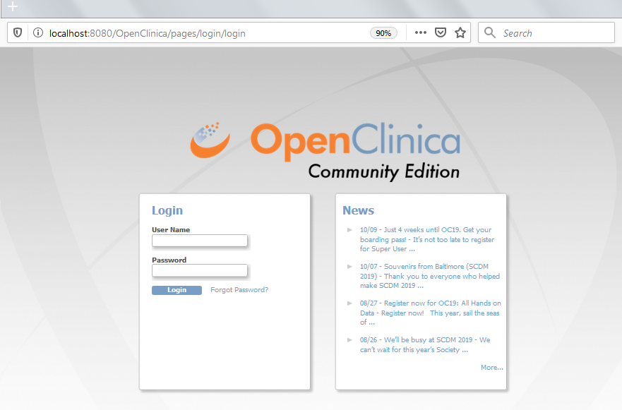
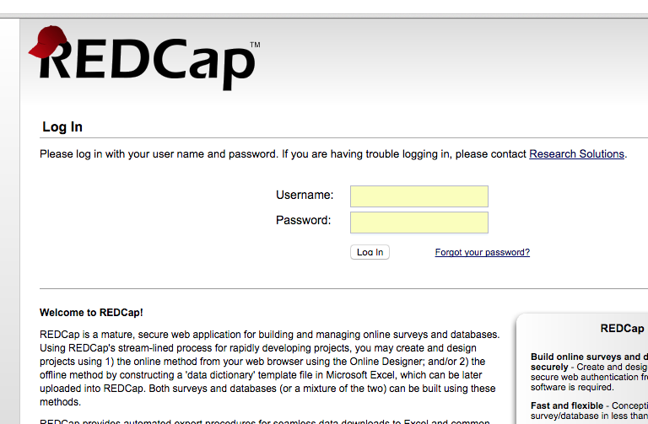
Clinical Data Management System (CDMS)…

Slide 6
Data Management Standards
Rules & formats to ensure CT data is consistent, accurate, interoperable, and compliant across studies & organizations
Help sponsors, CROs, & regulators understand & use data efficiently
  E.g. standardized names, codes, structures, and formats

Slide 7
Data Management Standards: Benefits
Cost-effective & timely product development
  RAs spend fewer resources on study data review
Streamline conduct, data transfer, analysis & submission process
↓ Time and money needed to set up a study
  E.g. similar studies conducted in the past
Comparisons of data across studies and data sharing

Slide 8
Data Management Standards: Benefits
Cost-effective & timely product development
  RAs spend fewer resources on study data review
Streamline conduct, data transfer, analysis & submission process
↓ Time and money needed to set up a study
  E.g. similar studies conducted in the past
Comparisons of data across studies and data sharing

Slide 9


Data Management Standards: Docs
CDISC: CDASH, STDM and ADaM
Controlled Terminologies: MedDRA, WHO Drug
Regulatory standards: 21 CRF Part 11
Quality & Data Integrity standards: ALCOA+ principles
Standard from societies: GCDMP

Slide 10
Data Management Process: Starting Point
Review and finalization of Study documents
  Review protocol for visits and data to be collected
  Develop Data Management Plan (DMP )
  Data Validation Plan

Slide 11
Data Management Process: CRF Design
Critical step in ensuring quality data
Primary goal: collect protocol required data
Also to ensure Protocol compliance & collect analyzable data
  Reduce queries
  Avoid ambiguity
Uses the schedule of events in the protocol
Only collect data important to answer the research question

Slide 12
Data Management Process: DB Design
Compliance with regulatory requirement
DB validation; system specification, user requirement, regulatory compliance, test & documentation
Test environment and production environment

Slide 13
Data Management Process: Data Collection
Paper vs electronic
Electronic; less errors, faster resolution of discrepancy
  eCRF
  Direct Data Entry (DDE); eSource
Source Document Agreement

Slide 14
Data Management Process: Data Entry
Single vs double entry
Double with 2nd person correction or verification with 3rd person
Paper vs Electronic Data Capture (EDC), Direct Data Entry (DDE)

Slide 15
Data Management Process: Data Validation
Testing validity with protocol specification
Using edit checks
Front-end edit checks vs Back-end edit checks
Edit checks that fail to pass a validation -> Discrepancy
  Inconsistent data, missing data, range checks, protocol deviation
In eCRF/DDE when data entered vs paper after data entered
Data Clarification Forms – Documents containing queries
  Paper studies

Slide 16
Data Management Process: Data Validation…
Validation using external tools
  Excel, access, stat software…
Manual checking

Slide 17
Data Management Process: Query Management
AKA Discrepancy Management
Reviewing discrepancy, investigating reasons, resolving them with documentation or declare them unresolvable
Dedicated location to record discrepancy within CDMS
Either flagged for investigator or self-evident corrections (SEC)

Slide 18
Data Management Process: Medical Coding
Standard terminologies for adverse events and medications
MedDRA; adverse events,
WHO DDE; drugs, Customized dictionaries
Wrong coding – masking safety issues or wrong safety concern
Accurate reporting of safety, efficient review, data sharing

Slide 19
Data Management Process: DB Locking
After final quality checks and assurance then final validation check
All DM activities finalized including discrepancies
Pre-lock checklist used
After locking DB can not change except in few conditions

Slide 20
Data Management Process: Archival
Both after completion and discontinuation
ICH GCP recommendation for 2 years, other stringent requirements
Importance
  Meet regulatory requirement
  Respond to questions raised long after trial conclusion/ discontinuation
Data archive should be retrieved within reasonable timeframe

Slide 21
Data Management Process: Important points
Source Data Agreement
PDF of eCRF screens
Training on CCGs & CRF including documentation
Review of SD/CRF for quality
Signature of PI or delegates on CRFs/ eCRFs
Source Document
eCRF/ Paper CRF

Slide 22
Data Management Process: Important points…
Avoid backlog of queries
PI signature breaks upon data correction in DB
If there is direct data entry to eCRF = eCRF will be SD
  The protocol need to list such data

Slide 23
CRF Completion
Dawit A. Ejigu (MD, MSc)
Associate Professor,
Department of Pharmacology
SPHMMC

Slide 24
Outline
Background on CDMS
Data Management Standards/ guidelines
Data Management Process
CRF completion
Electronic Documentation

Slide 25
CRF Completion
Goal of CRFs is collection consistent and accurate data
Data in a CRF could be inaccurate or unusable, or it may be lost
CRFs and associated instructions are critical in ensuring the data quality
  Instructions could be together with CRF or self contained

Slide 26
CRF Completion instructions
Diagnostic criteria
Definitions of terms used on the form
Specifications of time points for observations
Measurement methods and equipment
Units and precisions
Guidelines for handling variability, uncertainty, inconsistency, and error in source or measurements

Slide 27
Specific Instructions
Provides instructions on CRF completion for, “all practical scenarios”
  Multiple data values
  Repeated assessments
  Data collected outside the study schedule
  Data corrections
  Data resulting from unanticipated events…

Slide 28
Specific Instructions…
State on the form circumstances for skipping
Provide instructions for recording missing data
  “asked but not answered” or “not done.”
Provide necessary definitions on the form
  Next to the item to which they apply
Provide explicit guidance as to order of day and month

Slide 29
Specific Instructions…
If calculations required explain clearly
  E.g. to inform immediate site action
State the role of the individual completing the form
  E.g., physician, research staff, patient, or proxy
Location in the record from which info is to be extracted
Establish metrics for assessing CRF completion performance

Slide 30
Convention for form completion
Descriptions of the expected data formats
  Proper date format to be expected
  Documenting partial dates
  Blank for each digit of continuous measure + decimal places
  Clarifying rounding rules and abbreviations
Field definitions where field needs guidance
  Screen shots of CRFs where needed to clarify instructions

Slide 31
Convention for form completion…
Instructions to call out linked data
  AE about a drug & CRF prompts info. on concomitant medication
Completing forms; legible entry with indelible ink
Documenting any required updates
  Stroke one line, initial and date

Slide 32
Description of CRF Structure
EDC, a section devoted to clarifying eCRF dynamics
  Which eCRFs are present once subject is created
  What entry required for additional forms to populate
  Eg. eCRFs/ modules not appearing for screen failures
Ensure understanding on completing expected entries

Slide 33
Thank You !

