Slide 1
Investigational product management
Dawit A. Ejigu (MD, MSc)
Associate Professor,
Department of Pharmacology
SPHMMC

Slide 2
Outline
Background
Packaging and Labeling
Transportation & Storage
Appropriate use of IP
Return/ Disposal of IP
Drug accountability

Slide 3
Investigational Product (IP)
An active ingredient or placebo
A product with a marketing authorization and;
  Formulated or packaged in a way different from the approved form
  Used for an unapproved indication,
  Used to gain further information about an approved use.

Slide 4
Investigational Product (IP)…
Is manufactured according to GMP
CTA submissions to RAs needs confirmation on adherence to GMP (eg CoA)

Slide 5
Packaging and Labeling
Should conform to the RA requirement
If needed boxes and containers should provide the required blinding
Double blind vs Observer blind studies
There may be a need for blinded and unblinded staff and monitors
Unblinded staff/monitors caution not to unblind others

Slide 6
Packaging and Labeling…
There should be an efficient unblinding procedure as well as randomization procedure
Package should prevent contamination

Slide 7
Transportation and storage
IP transported only after the following are received
  Ethics and regulatory approval
  Signature on protocol
  Investigator/institution agreement
  Financial agreement
  CV or biography

Slide 8
Transportation and storage…
Requirements for customs clearance before initiating IP transportation
Transportation and storage of IP should be controlled and documented
  Temperature monitoring during transport and storage
  Temperature logs during storage
  There may be a need to report back condition of receipt
  Adequate IP in stock with appropriate expiry date

Slide 9
If an IP has expired in the middle of the trial what could be the most appropriate action
  Destroy IP
  Inform Product Manager
  Administer IP
  Inform ethics committee

Slide 10
If an IP has expired in the middle of the trial what could be the most appropriate action
  Destroy IP
  Inform Product Manager
  Administer IP
  Inform ethics committee

Slide 11
Appropriate use of the IP
The investigational product should be used only in accordance with the protocol
  Specific agreement
The correct use of the product should be explained to participants/staff
For trial designs without DOT, adherence issues needs to be considered
  E.g. Counting unused tablets

Slide 12
Appropriate use of the IP…
Concomitant medications/interventions interfering with trial result need to be identified
Stat analysis plan needs to consider how to deal with IP usage deviating from the protocol
  Incomplete dose
  Dosing interval
  Incorrect route
  Mixed use of active ingredient and placebo…

Slide 13
Appropriate use of the IP…
Concomitant medications/interventions interfering with trial result need to be identified
Stat analysis plan needs to consider how to deal with IP usage deviating from the protocol
  Incomplete dose
  Dosing interval
  Incorrect route
  Mixed use of active ingredient and placebo…

Slide 14
Any deviation in IP use will automatically result in the withdrawal of subject from the study.
  True
  False

Slide 15
Any deviation in IP use will automatically result in the withdrawal of subject from the study.
  True
  False

Slide 16
Return/Dispose unused IPs
IPs that can still be used may either be returned or destroyed on site
Destruction needs to be according to local regulations
Certificate of destruction may be needed
Expired/spoiled IPs, empty vials containers may also be destroyed
Destruction after drug accountability

Slide 17
Which is more appropriate about destruction of Investigational Products?
  Inform RAs before destruction
  Inform ECs before destruction
  Destruction before accountability
  Only spoiled/expired IPs are destroyed

Slide 18
Which is more appropriate about destruction of Investigational Products?
  Inform RAs before destruction
  Inform ECs before destruction
  Destruction before accountability
  Only spoiled/expired IPs are destroyed

Slide 19
Drug Accountability
Dawit A. Ejigu (MD, MSc)
Associate Professor,
Department of Pharmacology
SPHMMC

Slide 20
Drug accountability
IP should be accounted for from receipt up to return/destruction
Documentation is required in all steps
  Condition of receipt
  Condition of storage
  IP administration to participants
  IP returned by the participants
  IP remaining in stock
  IP Returned/destruction…

Slide 21
Drug accountability…
It is mandatory that all IPs shipped to the site needs to be accounted for
Accountability may need to be done at regular intervals and after IP administration is completed
Return/disposition of IP is better done after final accountability is done

Slide 22
Drug accountability…
Final accountability better done before database lock and/or analysis
  Incomplete IP administration
  Frequency/ interval between administration
  Wrong route of administration
  Mixed up administration
  Administration contrary to randomization

Slide 23
Drug accountability…
Unblinded monitor may be needed depending on the type of trial design
During vaccine accountability monitor checks the following
  IP administration log
  IP in stock
  Condition of storage/ temp. recordings
  Randomization lists
  Used vials / blisters

Slide 24
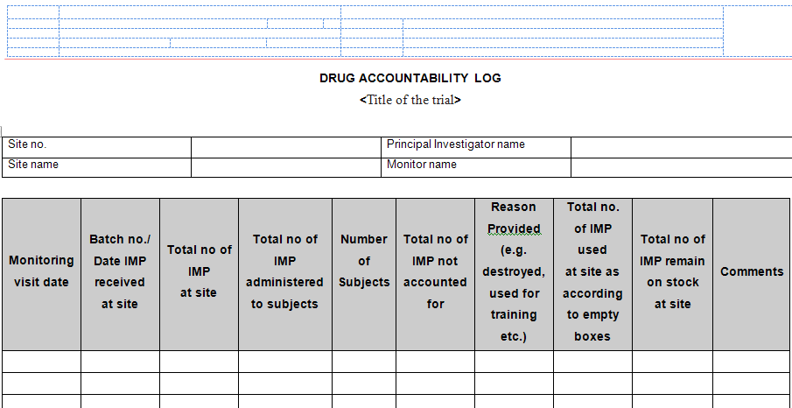
Drug accountability…

Slide 25
Thank You !

