Slide 1
Conducting a Trial p2
Dec 2025
Million Molla (MD, MPH, MBA)
National Clinical Trial Advisor-NRERB
TWG-EFDA

Slide 2
Learning Objectives
Determine the activities related to preparation, conduct, and close-out of a clinical trial
Recognize the importance of protocol compliance including investigational product (IP) management and safety reporting
Apply/Adapt best practices (strategies) in participant recruitment and retention

Slide 3
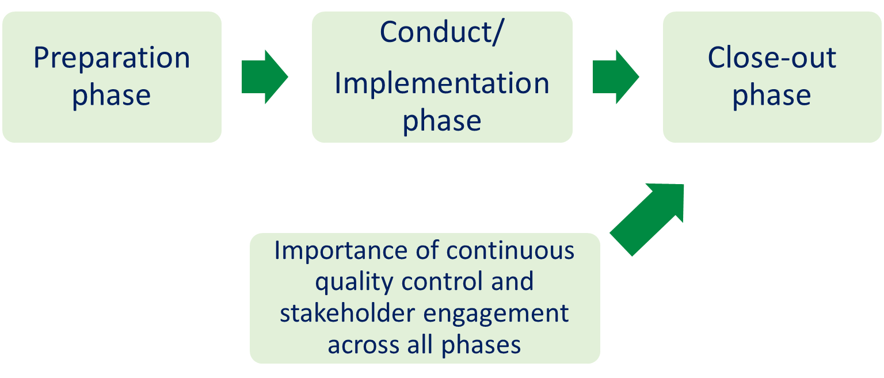
Overview of Trial Lifecycle

Slide 4
Close-Out Phase – Key Activities
Completion of participant follow-up
Data query resolution and database lock
Final monitoring visits
Return or destruction of IP and study materials
Regulatory reporting and communication with ethics committees

Slide 5
Data Management and Query Resolution
Work with monitors and data management teams to:
Resolve all outstanding queries
Document all resolutions
Ensure all data is validated, reviewed, and approved before data lock

Slide 6
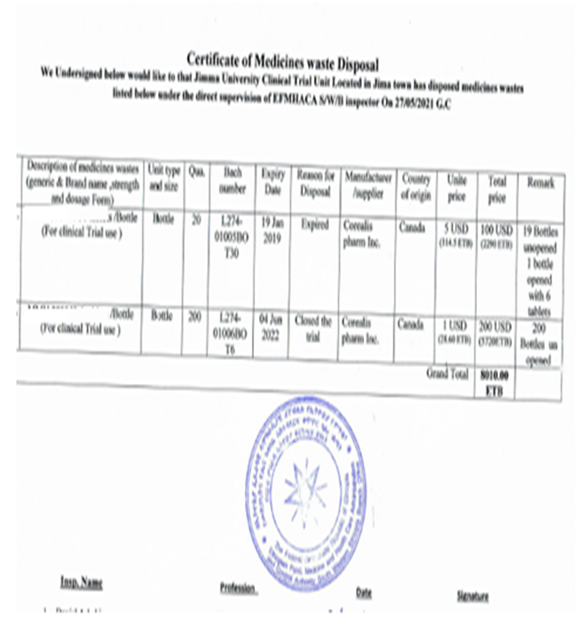
Investigational Product Management
Follow sponsor and regulatory authority guidelines
Final accountability check for IP
Arrange return or certified destruction of unused products
Maintain accurate documentation (e.g., destruction certificates)

Slide 7
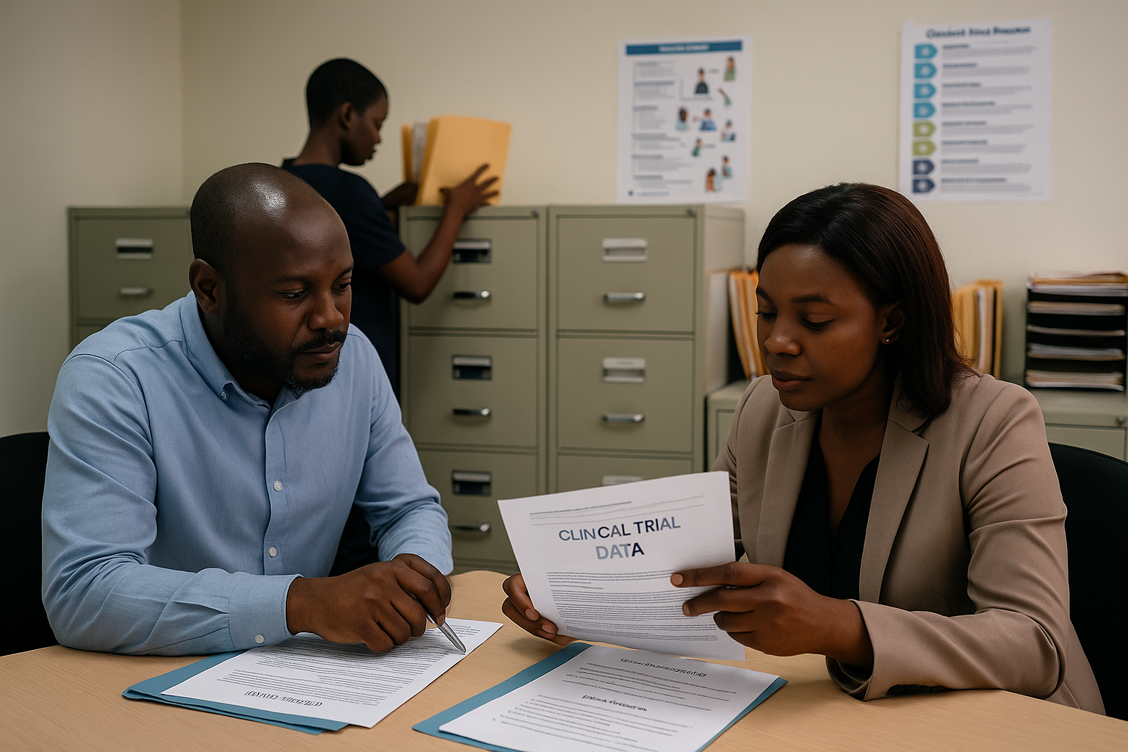
Final Monitoring Visit
Ensure:
All participants have exited the study
No pending data or safety issues
All documentation is complete
Close-out checklist is finalized

Slide 8
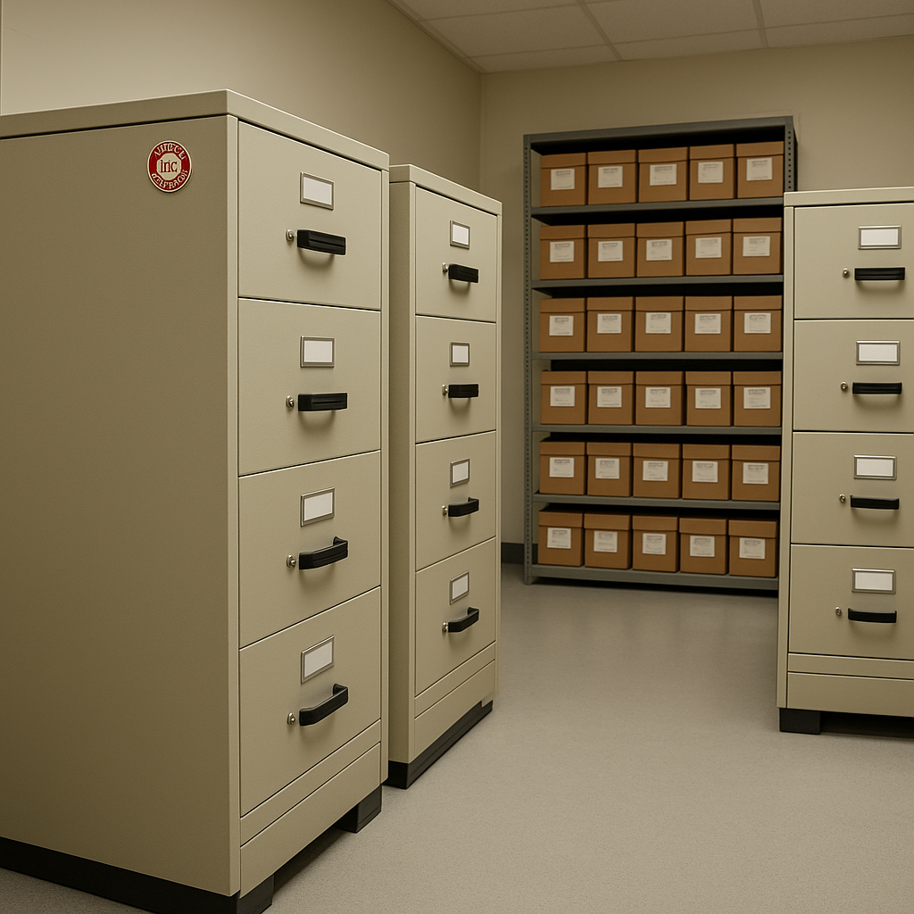
Archival of Study Documents
Follow ICH-GCP and sponsor guidance:
ICH-GCP: Store essential documents at least 2 years after last marketing approval
EU Directive: At least 5 years post-trial
Archive in secure and environmentally controlled facilities
Maintain accessibility for audits and inspections
Written approval from the sponsor prior to destroying records

Slide 9
Protocol Compliance
Protocol compliance is critical for:
Participant safety
Reliable and valid results
Regulatory and ethical integrity
Protocol adherence includes:
Timely safety reporting
Documenting deviations
Accurate execution of procedures

Slide 10
Participant Recruitment & Retention Strategies
Develop recruitment plans before budgeting
Utilize diverse sources for recruitment:
Community outreach
From health centers e.g. Family planning clinics or immunization clinics
Colleges and sports clubs
Using the advertisement (TV, radio talk show, flyers)
Referral networks

Slide 11
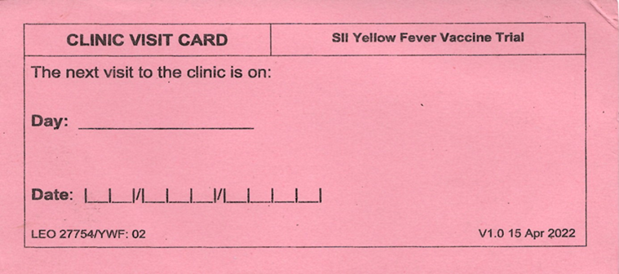
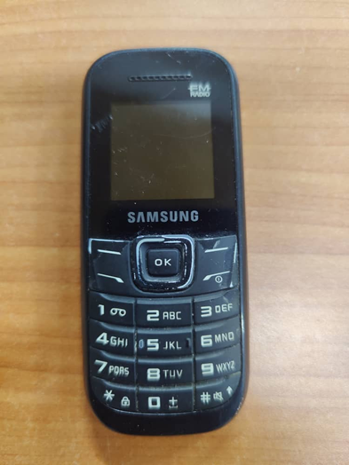
Retention Strategies
Ensure participant adherence by:
Providing reminders eg appointment card for next visit
Follow up on participants via phone calls or home visits if necessary
Addressing concerns empathetically
Offering reimbursements and support where appropriate
Monitoring for signs of non-adherence

Slide 12
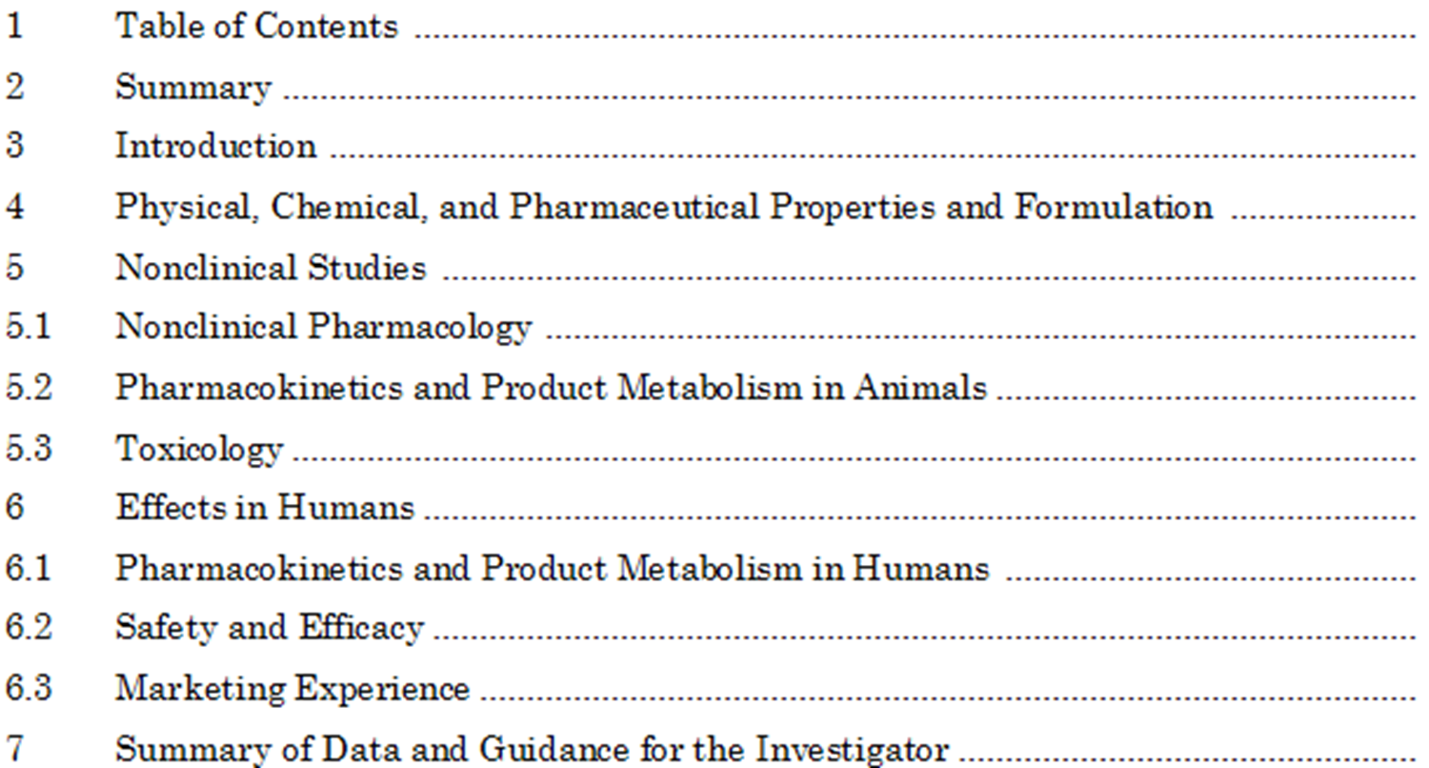
Investigator’s Brochure (IB) Overview
A comprehensive document compiling clinical and nonclinical data on the investigational product
Supports the rationale for the trial
Facilitates understanding of:
Safety profile
Dosing and administration
Clinical management of participants

Slide 13
Key Components of the IB
Summary & Introduction
Physical, chemical, and pharmaceutical properties
Nonclinical studies (e.g., pharmacology, toxicology)
Clinical experience: pharmacokinetics, efficacy, safety Risk/benefit assessment
Guidance for investigators

Slide 14
Maintenance and Use of the IB
Updated at least annually or when new data emerges
Reviewed by investigators before trial initiation
Basis for informed consent and safety monitoring

Slide 15
Summary and Key Takeaways
Close-out requires careful coordination and documentation
Protocol compliance ensures safety and data integrity
Recruitment and retention must be planned and actively managed

Slide 16
MCQ 3
With regards to administration of an investigational product (IP), which of the following is wrong?
Code breaking is allowed at any time with no need for consultation with the sponsor
Procedures for IP management need to be in place before the trial starts
We need to always ensure accountability of an IP
Obtaining a destruction certificate is mandatory if we need to do so

Slide 17
Why B, C, and D Are Correct
B. Procedures for IP management need to be in place before the trial starts → True. IP accountability, storage, dispensing, and return/destruction procedures must be documented in SOPs before initiation.
C. We need to always ensure accountability of an IP → True. Every dose must be tracked from receipt to administration or destruction to ensure compliance and safety.
D. Obtaining a destruction certificate is mandatory if we need to do so → True. When IP is destroyed, a certificate signed by authorized personnel is required for regulatory and sponsor records.

Slide 18
MCQ 3
Why A is Wrong
In blinded or randomized trials, code breaking (unblinding) is strictly controlled.
It can only occur under specific circumstances (e.g., medical emergencies affecting participant safety) and must follow documented procedures.
Consultation with the sponsor and ethics/regulatory authorities is required, and all unblinding events must be documented.
Allowing code breaking “at any time” without oversight would compromise trial integrity, bias results, and violate Good Clinical Practice (GCP).

Slide 19
Thank You!
Questions?

Slide 20


Thank you to

