Slide 1
Conducting a Trial Part 1
Dec 2025
Million Molla (MD, MPH, MBA)
National Clinical Trial Advisor-NRERB
TWG-EFDA

Slide 2
Learning Objectives
Determine the activities related to preparation, conduct, close-out, and post-trial benefits of a clinical trial.
Recognize the importance of protocol compliance including investigational product (IP) management and safety reporting.
Apply/Adapt best practices (strategies) in participant recruitment and retention.

Slide 3
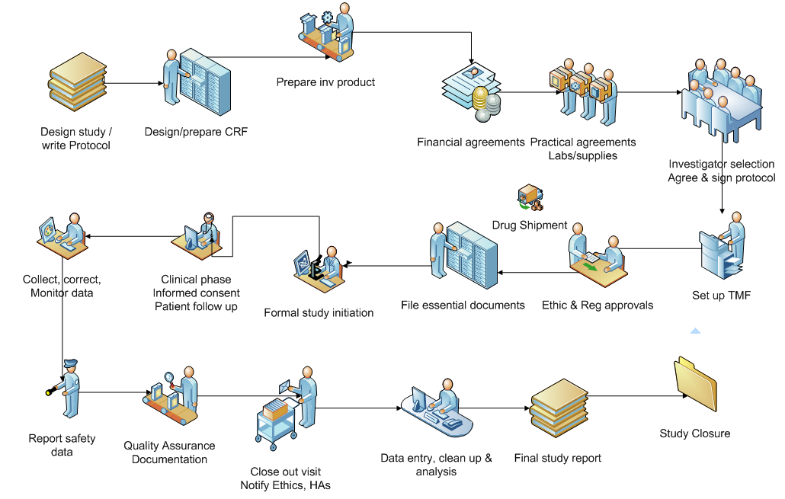
Clinical Trial Process

Slide 4
Preparation for a trial

Slide 5
Ethics and Regulatory approvals in GCP
ICH E6(R2) – Principle 2.6: “A trial should be conducted in compliance with the protocol that has received prior institutional review board (IRB)/independent ethics committee (IEC) approval/favourable opinion”
ICH E6(R3) – Draft Principle: “Clinical trials should be scientifically sound and described in a clear, detailed protocol. The trial should be conducted in accordance with the protocol, which has received prior approval/favorable opinion by an independent ethics committee/institutional review board (IEC/IRB).”

Slide 6
Why Protocol Compliance matters
Ensures ethical oversight
Protects participant safety
Maintains data credibility
Meets sponsor/regulatory expectations

Slide 7
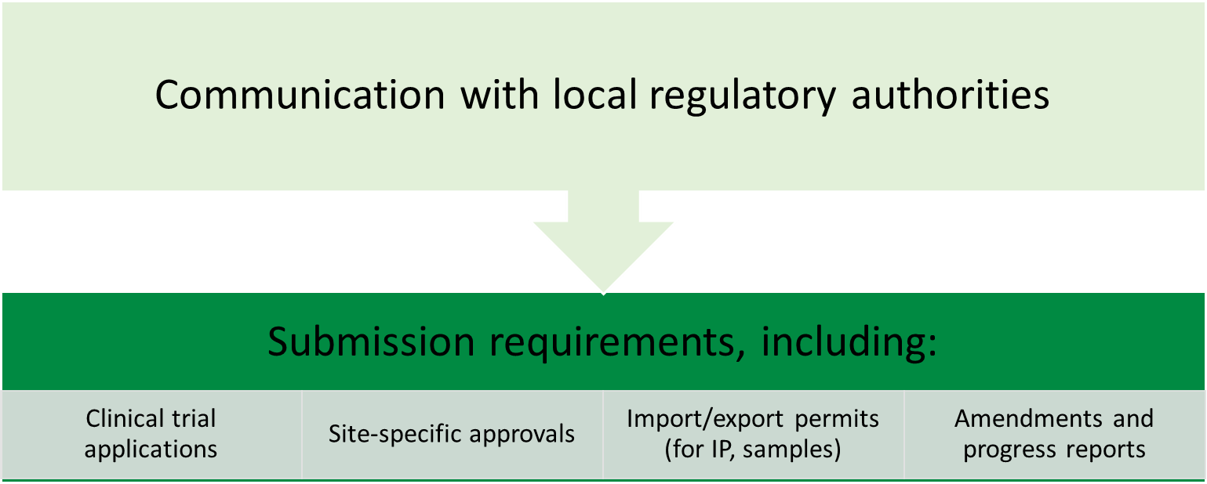
Ensure Local Regulatory Requirements Are Met

Slide 8
Why is it important to wait for both ethics and regulatory approvals before initiating any trial activities?

Slide 9
Why Ethics Approval Is Crucial
Protects participants: Ethics committees (like NRERB) ensure that risks are minimized, informed consent is clear, and vulnerable populations are safeguarded.
Ensures justice and respect: Trials must be fair, inclusive, and respectful of participants’ rights, culture, and autonomy.
Prevents exploitation: Especially in outbreak settings, ethics review guards against rushed or poorly designed studies that could harm communities
Notes:
Trials media.tghn.org.

Slide 10
Why Regulatory Approval Is Essential
Legal authorization: Regulatory bodies confirm that the trial complies with national laws and international standards.
Scientific validity: They assess whether the protocol is methodologically sound and whether the investigational product (e.g., vaccine) meets safety and quality benchmarks.
Accountability: Regulatory approval ensures that sponsors, investigators, and institutions are held accountable for trial conduct
Notes:
Trials media.tghn.org.

Slide 11
Risks of Skipping Approvals
Trial suspension or shutdown: Authorities may halt trials that begin without proper clearance.
Loss of credibility and funding: Sponsors and partners may withdraw support if ethical or regulatory breaches occur.
Harm to participants and communities: Without oversight, trials may expose people to unnecessary risks or misinformation.
Notes:
Trials media.tghn.org.

Slide 12
Special Considerations in Outbreak Settings
Rapid response must still be rigorous: Even in emergencies, ethical and regulatory reviews must not be bypassed. Streamlined processes exist to accelerate approvals without compromising standards
Global harmonization matters: For multinational trials, coordinated ethics and regulatory reviews prevent fragmentation and research waste
Notes:
Trials media.tghn.org.

Slide 13
Availability and Handling of Investigational Products
ICH-GCP 2.12 Investigational products should be manufactured, handled , and stored in accordance with applicable GMP
GMP(Good Manufacturing Practice) refers to internationally recognized standards for the production and quality control of medicines.
In clinical trials, GMP applies not only to approved drugs but also to investigational medicinal products (IMPs), biologics, and devices used in research.
It covers all aspects of manufacturing, including facilities, equipment, personnel, documentation, production, quality control, complaints, recalls, and self-inspection

Slide 14
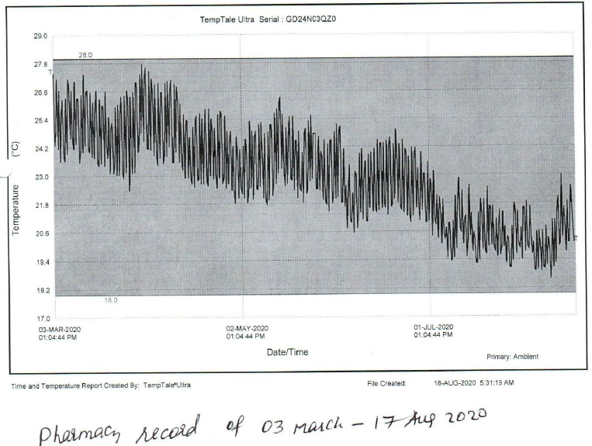
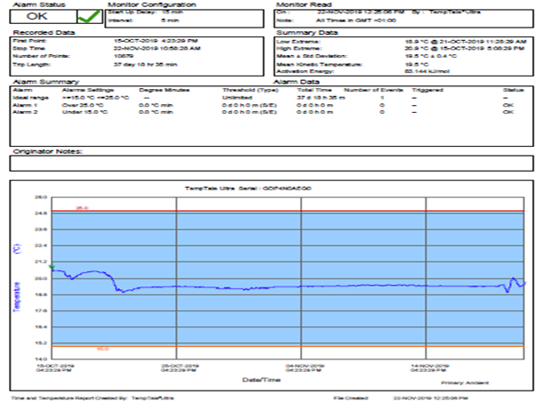
Availability and Handling of Investigational Products
IP storage Temperature log​
IP shipping Temperature log​

Slide 15
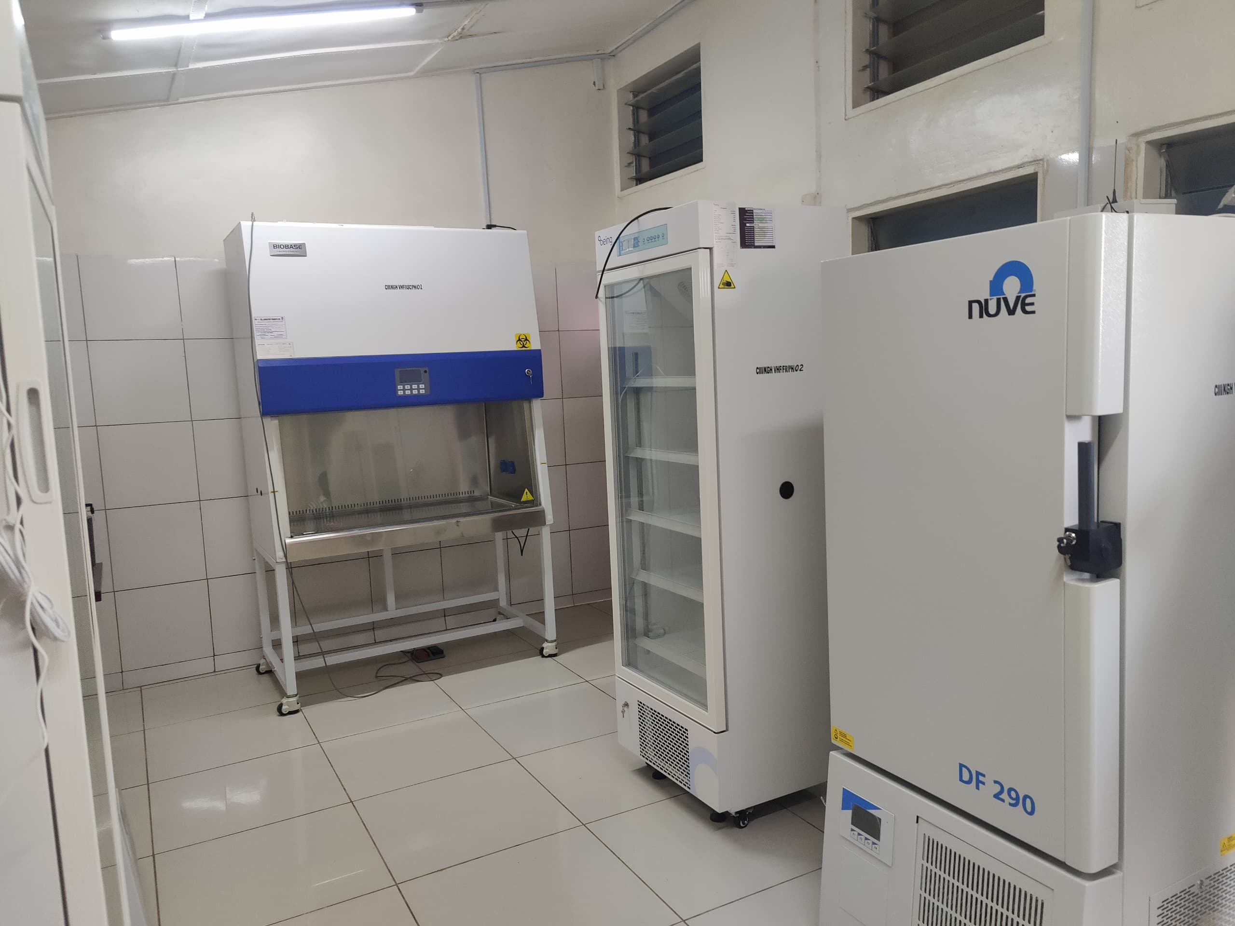
Equipment Supply, Readiness and Maintenance
Why equipment readiness matters?
Ensures accurate and reliable data collection
Supports participant safety
Satisfies GCP and protocol requirements
Prevents delays or deviations due to faulty or missing equipment

Slide 16
Equipment Supply
Confirm all required equipment is procured and delivered ahead of trial start
Use a site initiation checklist to verify essential items (e.g. centrifuges, Freezers, Thermometer)
Ensure equipment is fit-for-purpose and validated

Slide 17
Equipment Readiness for Use
Install and Calibrate equipment before use
Ensure adequate power backup for critical devices (e.g. vaccine fridges, data servers)
Train site staff on proper operation and troubleshooting

Slide 18
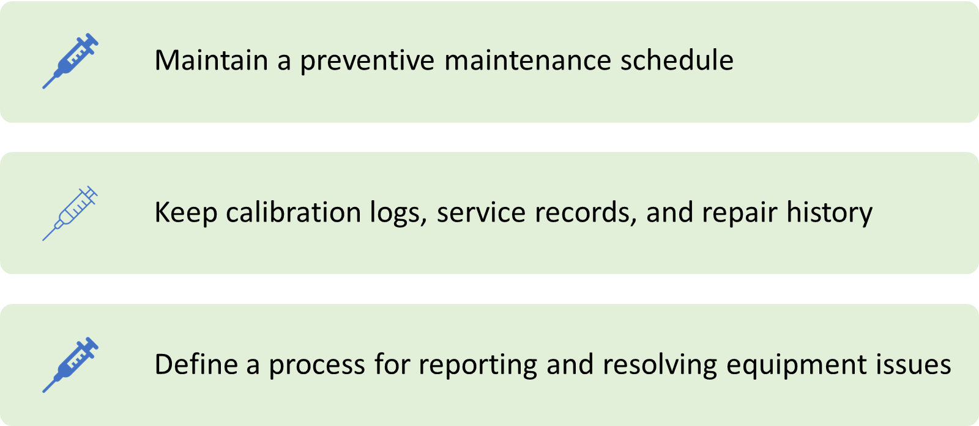
Equipment Maintenance and Monitoring

Slide 19
What are some critical equipment that you use at your clinical trial sites?

Slide 20
Clinical & Patient Care Equipment
Vital signs monitors: Blood pressure cuffs, thermometers, pulse oximeters, ECG machines for continuous monitoring MESM Number Analytics.
Phlebotomy and sample collection kits: Needles, syringes, vacutainers, centrifuges for blood and biological sample processing imperialcrs.com.
Refrigerators and freezers: For storing investigational products, vaccines, and biological samples at controlled temperatures MESM imperialcrs.com.
Emergency equipment: Defibrillators, crash carts, oxygen supply, and resuscitation kits to handle adverse events Number Analytics.

Slide 21
Laboratory & Diagnostic Equipment
Clinical laboratory analyzers: Hematology, biochemistry, and immunology analyzers for trial-related testing Number Analytics.
Imaging tools: Portable ultrasound or X-ray machines if required by protocol.
Pathology and genetic testing platforms: For advanced biomarker or immunogenicity studies.

Slide 22
Data & Trial Management Systems
Electronic Data Capture (EDC) systems: Secure platforms for recording trial data Number Analytics.
Randomization and trial management software: Ensures unbiased participant allocation and protocol adherence.
Secure servers and backup systems: Protect sensitive participant data and ensure compliance with GCP.

Slide 23
Ancillary & Support Equipment
Temperature monitoring devices: Continuous monitoring for vaccine storage and transport
Personal protective equipment (PPE): Masks, gloves, gowns for staff safety.
Calibration and validation tools: To ensure accuracy of medical devices and laboratory instruments.
Logistics supplies: Label printers, barcoding systems, and secure storage cabinets for investigational products.
Notes:
imperialcrs.com.

Slide 24
Why These Are Critical
Safety: Immediate response to adverse events.
Data integrity: Reliable equipment ensures valid and reproducible results.
Compliance: Regulatory bodies require validated, calibrated, and documented equipment use.
Operational efficiency: Proper tools reduce delays and errors in trial execution.
Notes:
imperialcrs.com.

Slide 25
Why These Are Critical
In outbreak-response vaccine trials (like the COVID-19፣ Marburg ), cold-chain equipment, rapid diagnostic tools, and emergency medical kits are especially critical.
They ensure the investigational vaccine is stored safely, participants are monitored closely, and any adverse events are managed immediately.
Notes:
imperialcrs.com.

Slide 26
Training & Qualification of CT Personnel
ICH-GCP Principle 2.8 : Each individual involved in conducting a trial should be qualified by education, training, and experience to perform his or her respective task(s).
Why Training and Qualification Matter?
Ensures staff are competent to perform trial-specific duties
Reduces protocol deviations and participant risk
Required by GCP, sponsors, and regulatory bodies
Notes:
imperialcrs.com.

Slide 27
Key Qualification Domains
Education
Academic background relevant to the role (e.g.
medicine, pharmacy, nursing,
laboratory science)
Training
Good Clinical Practice (GCP)
Study protocol
Standard Operating Procedures (SOPs)
Role-specific training (e.g. life support for staff)
Experience
Prior involvement in clinical research
Proven competency in role-specific tasks (e.g.
consenting, data entry, sample handling)
Notes:
imperialcrs.com.

Slide 28
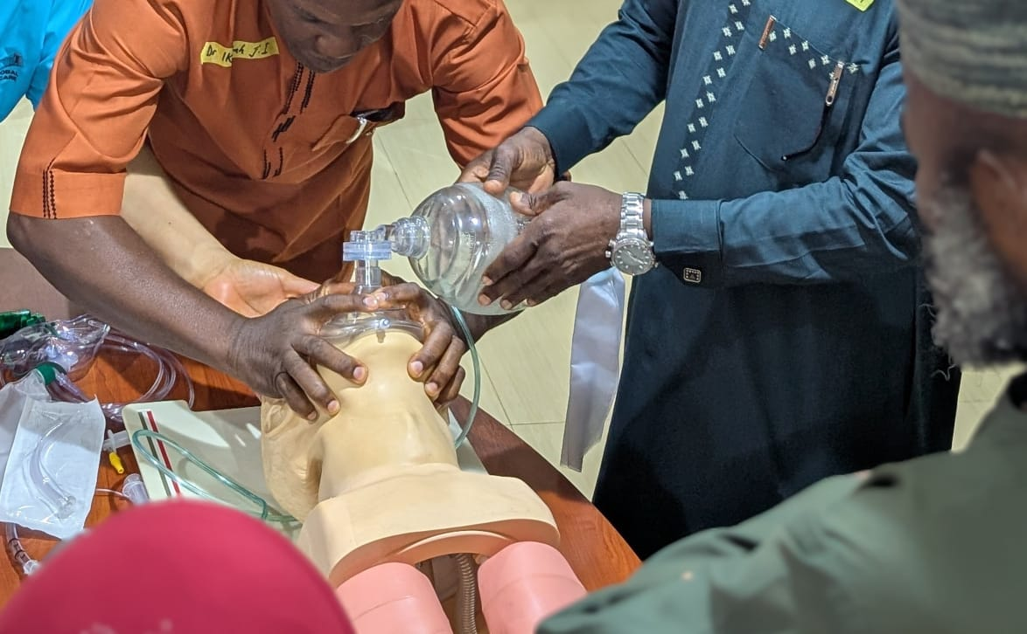
Key Qualification Domains
Maintain updated training logs, signed CVs, and GCP certificates in the Investigator Site File(ISF).
Staff should be re-trained on protocol amendments.
Notes:
imperialcrs.com.

Slide 29
Documentation in Clinical Trials
ICH-GCP Principle 2.10 : All clinical trial information should be recorded, handled, and stored in a way that allows its accurate reporting, interpretation, and verification.
Key Documentation considerations
Maintain records before, during, and after the trial
Use appropriate source documentation (e.g., clinic notes, lab reports)
Essential documents must be stored in the Investigator Site File (ISF) or referenced from it
Maintain version control and audit trails for documents
Provide direct access to monitors, auditors, and inspectors
Notes:
imperialcrs.com.

Slide 30
What Is the ISF?
The Investigator Site File (ISF) is the collection of essential documents maintained at each trial site.
It demonstrates that the site is conducting the study in compliance with Good Clinical Practice (GCP), regulatory requirements, and the approved protocol.
Think of it as the trial’s “paper trail” at the site level.

Slide 31
What Is the ISF?
Contents of the ISF
Typical documents include:
Regulatory approvals: Ethics committee approval letters, protocol, informed consent forms.
Investigator documents: CVs, medical licenses, training records.
Trial management: Delegation logs, screening/enrollment logs, monitoring visit reports.
Safety documents: SAE (serious adverse event) reports, safety updates.
Correspondence: Letters between sponsor, CRO, and site.
Drug accountability: IMP receipt, storage, dispensing, and return records.

Slide 32
What Is the ISF?
Importance of ISF
Ensures compliance with GCP and regulatory standards.
Facilitates monitoring and auditing by sponsors, CROs, and regulators.
Supports data integrity by documenting every step of trial conduct.
Protects patients by ensuring ethical and safe trial management.

Slide 33
What Is the ISF?
Common Issues with ISF
Missing or outdated documents.
Poor organization (hard for monitors/auditors to navigate).
Incomplete delegation logs or training records.
Lack of timely updates (e.g., amended protocols not filed).

Slide 34
What Is the ISF?
Scenario:
"During a monitoring visit, the auditor finds that the site has not filed the latest ethics committee approval letter in the ISF. What are the implications?" Encourage students to discuss compliance risks, patient safety, and trial validity.

Slide 35
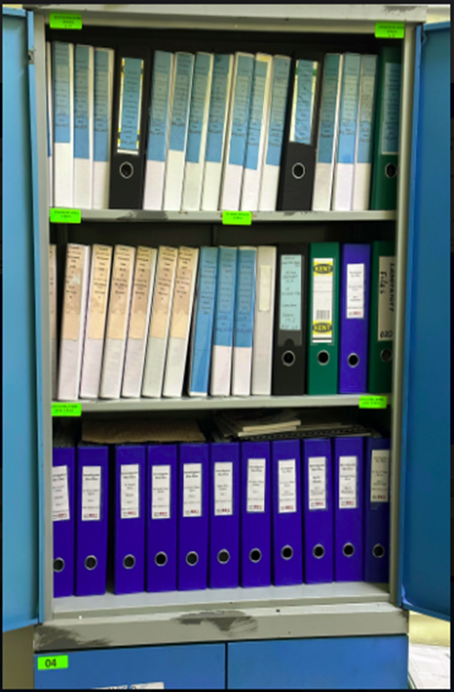
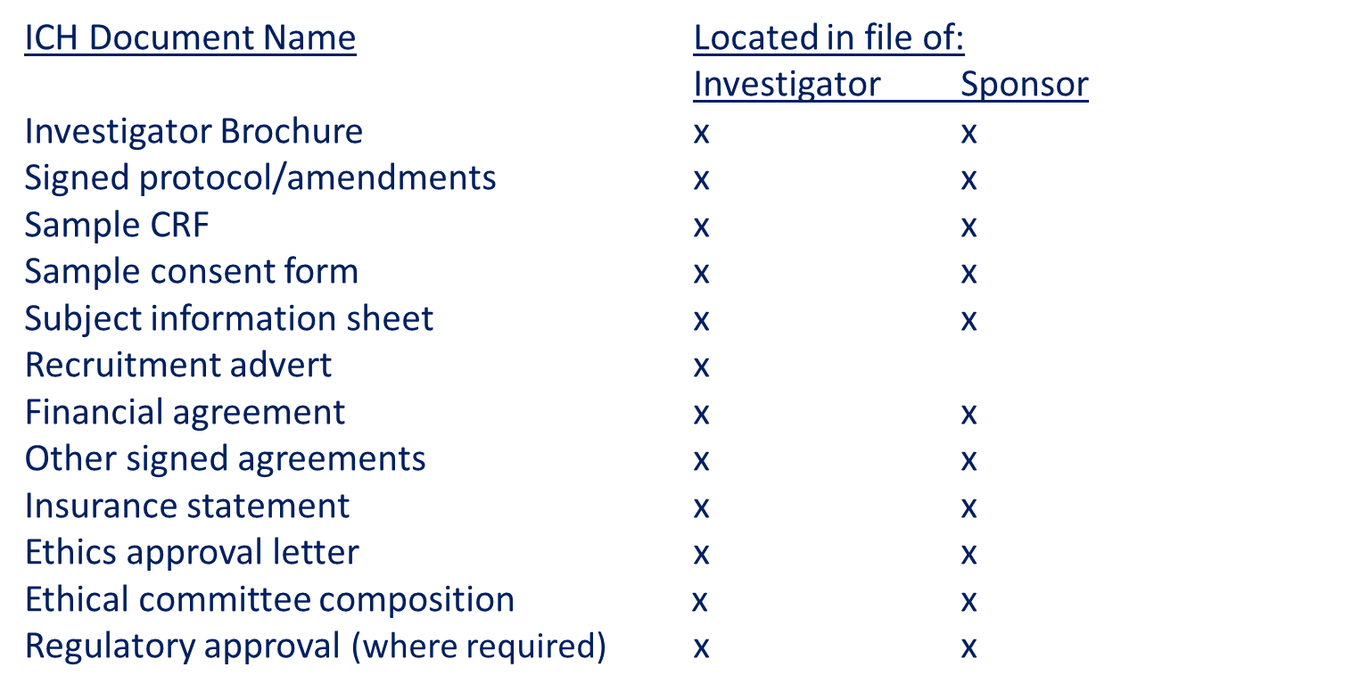
Documentation in-Investigator Site File/ISF.

Slide 36
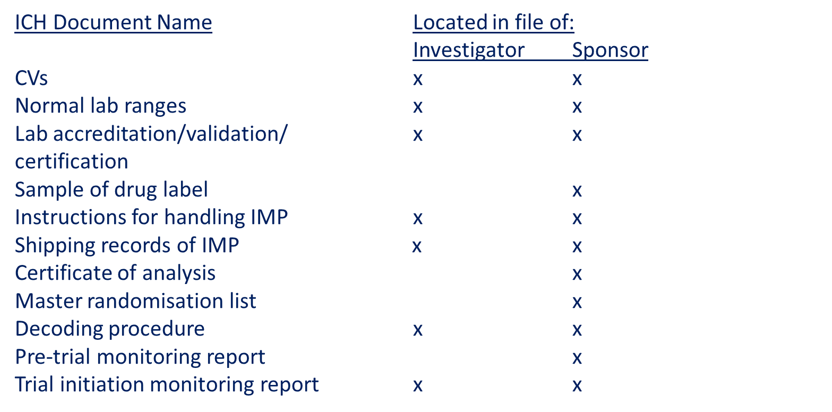
Documentation in ISF
Ensure your ISF is always inspection-ready. Organize documents by section, update regularly, and restrict access to authorized staff only

Slide 37
Site Initiation Visit (SIV) and Monitoring
ICH-GCP Principle 2.13 : Quality assurance systems and procedures should be implemented to ensure trial integrity.
Monitoring is a principal quality control activity in clinical trials
A Site Initiation Visit (SIV) checks site readiness before participant enrolment

Slide 38
The monitor verifies:
Staff training on protocol and GCP
Availability and calibration of required equipment
Proper storage and accountability of Investigational Product (IP)
Setup of the Investigator Site File (ISF)
Completion of regulatory and ethics approvals

Slide 39
Multiple Choice Question 1
Which one of the following is true?
We can obtain the ethics committee approval after we started the study
Following local laws doesn’t matter as long as we implement international laws and regulation when conducting a trial
There is a need to obtain ethics committee approval before implementing a significant amendment of the clinical trial
There is no need for backup for our lab and electricity as we plan to conduct a trial

Slide 40
Multiple Choice Question 1
A. We can obtain the ethics committee approval after we started the study ❌ False. Ethics committee (IRB/REC) approval must be obtained before initiating any clinical trial. Starting without approval violates GCP and is unethical.
B. Following local laws doesn’t matter as long as we implement international laws and regulation when conducting a trial ❌ False. Both local laws/regulations and international standards (ICH-GCP, Declaration of Helsinki) must be followed. Ignoring local laws can invalidate the trial and lead to legal consequences.

Slide 41
Multiple Choice Question 1
C. There is a need to obtain ethics committee approval before implementing a significant amendment of the clinical trial ✅ True. Any substantial amendment (e.g., protocol changes, consent form updates, safety procedures) requires prior ethics committee approval before implementation.
D. There is no need for backup for our lab and electricity as we plan to conduct a trial ❌ False. Reliable infrastructure (electricity, lab backup, data storage) is critical for trial integrity and patient safety. Lack of backup risks data loss and protocol violations.

Slide 42
Amendement
Substantial vs. Non-Substantial Amendments
Substantial amendment:
Any change that impacts patient safety, scientific validity, or ethical acceptability of the trial.
Examples: Protocol changes affecting inclusion/exclusion criteria, dosage, informed consent wording, safety monitoring procedures.
Requires prior ethics committee approval before implementation.
Adding a new patient population (e.g., children instead of adults) → must seek ethics approval.

Slide 43
Amendement
Substantial vs. Non-Substantial Amendments
Non-substantial amendment:
Minor administrative or logistical changes that do not affect patient safety or trial integrity.
Examples:
Updating contact details of investigators or sponsor staff.
Correcting typographical errors in documents;
Changing the order of case report form (CRF) questions without altering content; Updating site staff training logs.

Slide 44
Amendment
Substantial vs. Non-Substantial Amendments
Non-substantial amendment:
Correcting a typo in the protocol (e.g., “10mg” mistakenly written as “100mg” but clarified in text as 10mg consistently elsewhere) → document correction, no ethics approval needed.
Does not require ethics committee approval.
Instead, these are usually notified to the sponsor and documented in the Investigator Site File (ISF) for transparency.

Slide 45
Conducting a trial

Slide 46

Informed Consent in Clinical Trials
Consent should be freely given Informed obtained from every subject prior to clinical trial participation.
Informed consent is an integral ethical requirement in the conduct of clinical trials
Consent must be obtained before any study-specific procedures are initiated

Slide 47
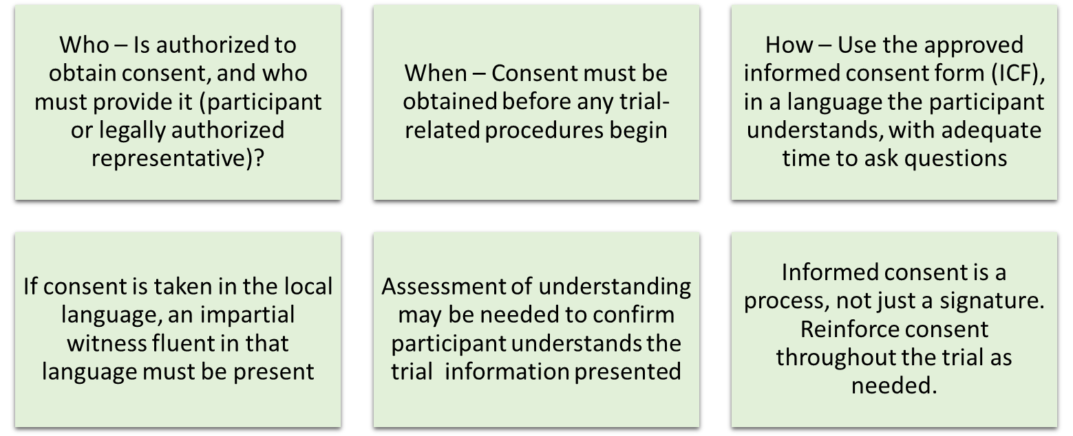
Points to consider

Slide 48
Screening and Selection of Participants
Purpose of Screening
To determine if a potential participant meets the defined eligibility criteria to take part in the clinical trial.
Key Steps in the Screening Process
Verify participant identity and basic eligibility (age, residence, medical history)
Obtain informed consent before performing any screening procedures
Conduct screening assessments as defined in the protocol (e.g., physical exams, lab tests, rapid diagnostics)
Document all findings in the screening log and CRFs

Slide 49
Eligibility Criteria
Inclusion criteria: Characteristics that must be present for a participant to enroll (e.g., age range, diagnosis, clinical stability)
Exclusion criteria: Conditions that prevent a participant from joining (e.g., allergies, comorbidities, concurrent treatments)
Ensure that all inclusion and exclusion criteria are strictly applied and that eligibility decisions are reviewed and confirmed by the PI or designee.

Slide 50
Eligibility Criteria
Inclusion criteria: Characteristics that must be present for a participant to enroll (e.g., age range, diagnosis, clinical stability)
Exclusion criteria: Conditions that prevent a participant from joining (e.g., allergies, comorbidities, concurrent treatments)
Ensure that all inclusion and exclusion criteria are strictly applied and that eligibility decisions are reviewed and confirmed by the PI or designee.

Slide 51
Administration of Investigational Product (IP)
ICH-GCP Principle 4.6.5 : The investigator should ensure that the investigational product(s) are used only in accordance with the approved protocol.
Key Points on IP Administration
Written procedures for IP administration must be established before the trial begins
IP must only be administered by trained and authorized staff, as per protocol
Maintain secure storage with restricted access to authorized personnel
Ensure up-to-date and real time accountability documentation for dispensed, returned, or destroyed IP
For blinded studies, any code breaking must be well-documented and justified

Slide 52
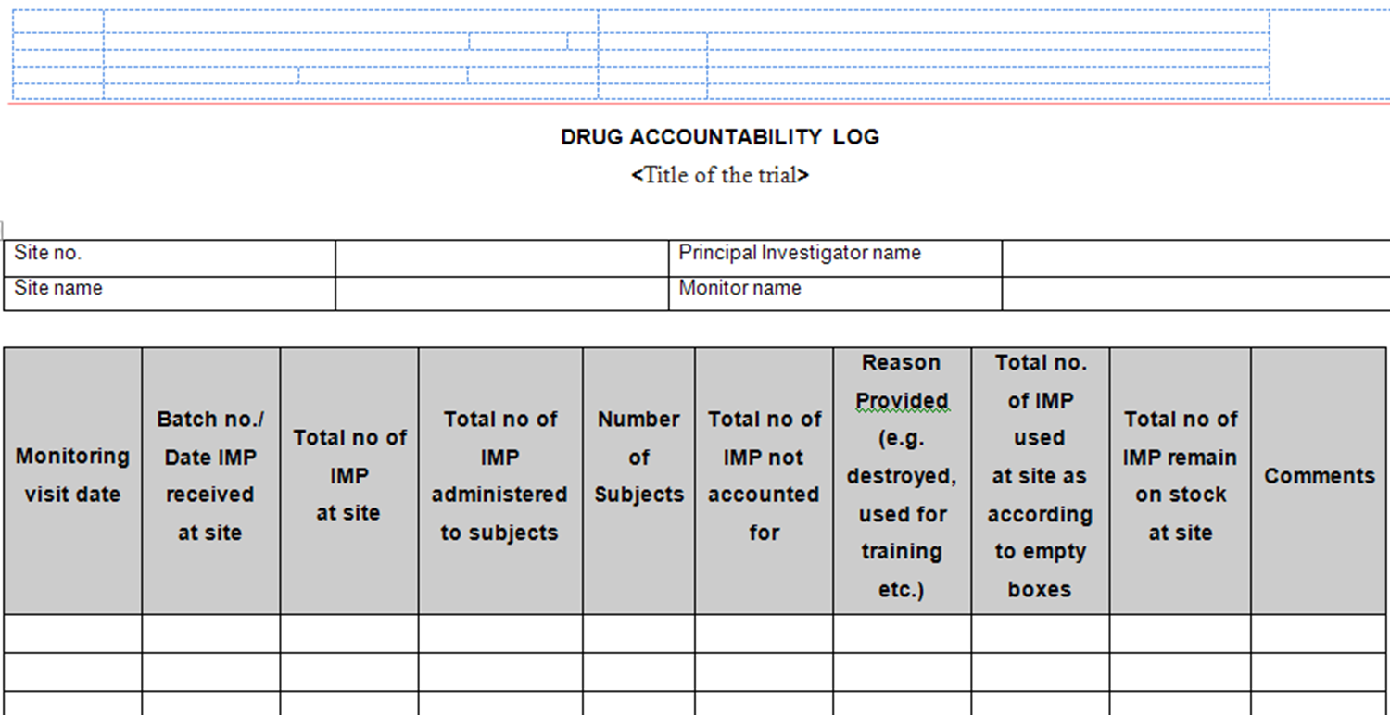
IP Accountability

Slide 53
Participant Follow-Up: Ensuring Safety and Efficacy
ICH-GCP Principle 2.7 :The medical care given to, and medical decisions made on behalf of, subjects should always be the responsibility of a qualified physician.
All follow-up visits and safety assessments must be documented. Missed visits should be followed up and explained.

Slide 54
Key considerations for participant follow up
Ensure adequate time and capacity to conduct follow-up visits per protocol
Provide access to appropriate facilities for safety monitoring and efficacy assessments
Maintain confidentiality and ensure access to medical care, laboratory services, and proper data archiving
Have sufficient qualified staff available for clinical oversight and data collection
Provide the standard of care to all participants throughout the trial
Establish systems for timely safety data recording, management, and reporting

Slide 55
Monitoring During Trial Conduct
The sponsor determines the extent and nature of trial monitoring. On-site monitoring is typically conducted before, during, and after the trial.
Purpose of Monitoring Visits
Ensure compliance with the protocol, GCP, SOPs, and applicable regulations
Verify that trial conduct supports participant rights, safety, and data integrity
Detect and address deviations and issues early

Slide 56
Key Monitoring Activities
Review enrolment and consent documentation
Assess informed consent process for each participant
Verify source documents and CRFs (Source Data Verification)
Review IP storage, handling, and accountability
Monitor recruitment and retention performance
Evaluate safety reporting and AE/SAE documentation

Slide 57
Multiple Choice Question 2
Select the true statement.
The principal investigator doesn’t need to have the time to conduct the trial since activities can be delegated
Medical care given to subjects should always be the responsibility of a qualified physician
Providing a standard of care isn’t the responsibility of the trial as participants need to cover their own cost
Only the PI and critical investigators need to have the qualification (education, training and experience)

Slide 58
A. Wrong → The Principal Investigator (PI) must have sufficient time and commitment to conduct the trial. While tasks can be delegated, responsibility cannot be delegated.
C. Wrong → Trials must ensure participants receive appropriate standard of care. Costs cannot simply be shifted to participants; sponsors and investigators must safeguard participant welfare.
D. Wrong → All investigators and staff involved in the trial must be qualified by education, training, and experience—not just the PI and “critical” investigators.

Slide 59
B
Why B is Correct
According to ICH-GCP (International Council for Harmonisation – Good Clinical Practice), medical care and decisions related to trial participants must always be under the supervision of a qualified physician (or dentist, where appropriate).
This ensures participant safety, ethical conduct, and compliance with international standards.

Slide 60
Thank You!
Questions?

Slide 61


Thank you to

