Slide 1
Randomization & Blinding
Dawit A. Ejigu (MD, MSc)
Associate Professor,
Department of Pharmacology
SPHMMC

Slide 2
Outline
Background
Blinding
Randomization

Slide 3
Background
Important techniques in avoiding bias
Features of most clinical trials
Especially for trials included in marketing application
In blinded trials where
IPs pre-packed in accordance with a randomization schedule, and supplied to the trial center(s)
Rxs may be labelled only with codes
No one aware of the specific treatment allocation

Slide 4
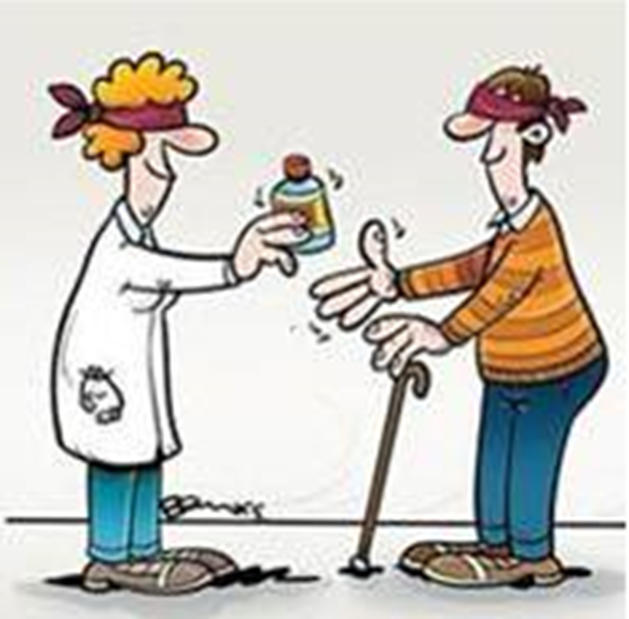
Blinding

Slide 5
Blinding
Limits the occurrence of bias in the conduct and interpretation of a trial
Knowledge of Rx influence important activities of trials
Recruitment and allocation of subjects
Subsequent care
Attitudes of subjects to the treatments
Assessment of end-points
Handling of withdrawals
Exclusion of data from analysis

Slide 6
Blinding
Aim to prevent rx identification till opportunities for bias have passed
Double blind; optimal approach
Rx not distinguished either before or during administration
Patient, investigator or sponsor not aware of Rx allocation
All activities with a potential for bias needs to be blinded
Challenge; physical difference b/n rxs or effect induced by the IP
Minimize information to ones with functions

Slide 7
Blinding
Knowledge of the next treatment shouldn’t influence next recruitment
Medical assessment should be done one who is blind to treatment
Make the primary endpoints as objective as possible
Data management needs also to be blinded

Slide 8
Blinding
Unbliding need to be planned for
Emergency unblinding when necessary for managing patients
All intentional/ unintentional unblinding needs to be reported/documented

Slide 9
Blinding: Practical Issues
IP and control may have different physical characteristics
Color, smell, appearance, texture…
could easily be identified challenge for blinding
Try to address during formulation
Eg adding chemicals to make IPs smell the same
Mask the syringes with opaque plasters
Blinded and Unblinded staff and/or monitors

Slide 10
Blinding: documentation
Document planned and unplanned unblinding & report
Effort to minimize number of site staff Unblinded
Separate documentation for documents with unblinding potential
Separate CRFs and DBs with data that could unblind staff

Slide 11
Randomization..
Introducing element of chance assigning rxs to subjects
Provides sound statistical basis for the quantitative evaluation
Ensures similar distribution of prognostic factors in the arms
Together with blinding avoids bias in subject selection/allocations
Randomization schedule documents random allocation of subjects

Slide 12
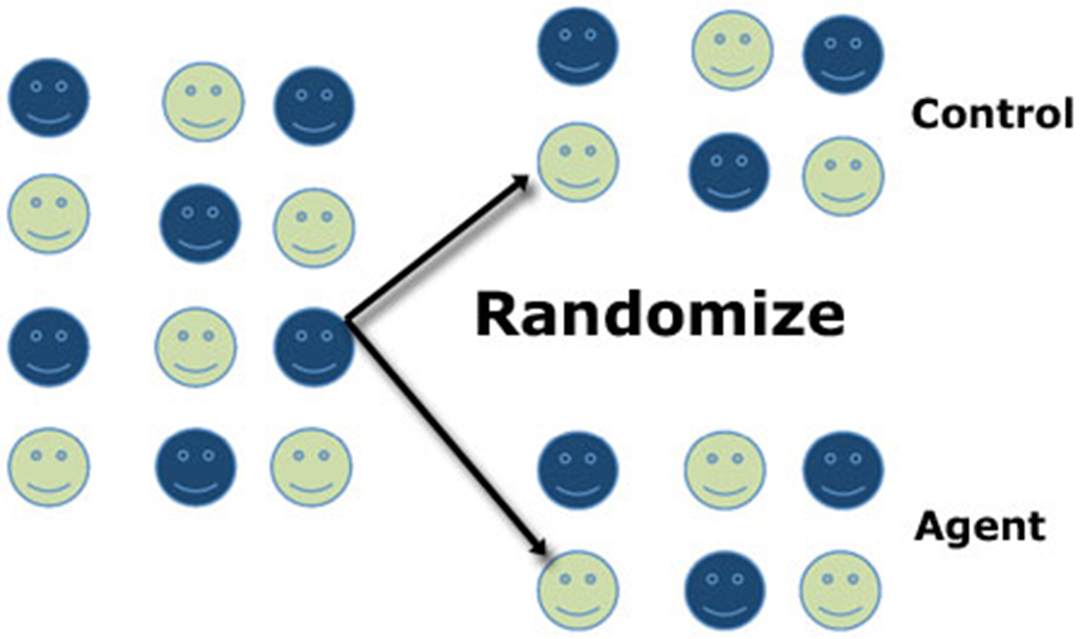
Randomization…

Slide 13
Randomization: sequence generation
Assignment based on chance (random) process characterized by unpredictability
Use computerized random number generator
Allocation proportion needs to be specified

Slide 14
Randomization: restrictions to randomizations
Three types of randomization
Simple randomization
Block randomization
Stratified randomization

Slide 15
Simple Randomization
New rx allocation without regard to those already made
When the next subject is assigned, previous allocations are not considered
Best to avoid prediction
May result in unequal size if trial prematurely terminated

Slide 16
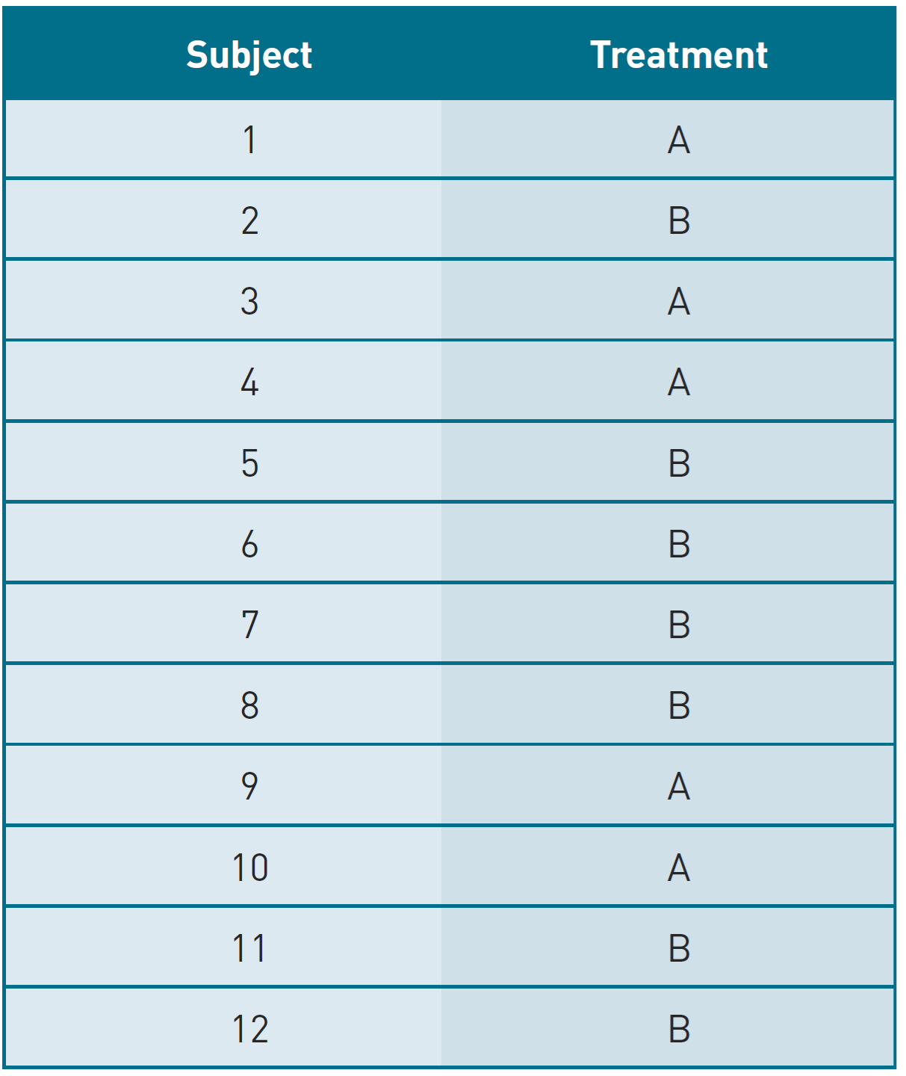
Simple Randomization…

Slide 17
Block Randomization
To balance groups periodically
Block size could differ to avoid prediction
Small block size could be predictable
Avoid mentioning block size in protocols

Slide 18
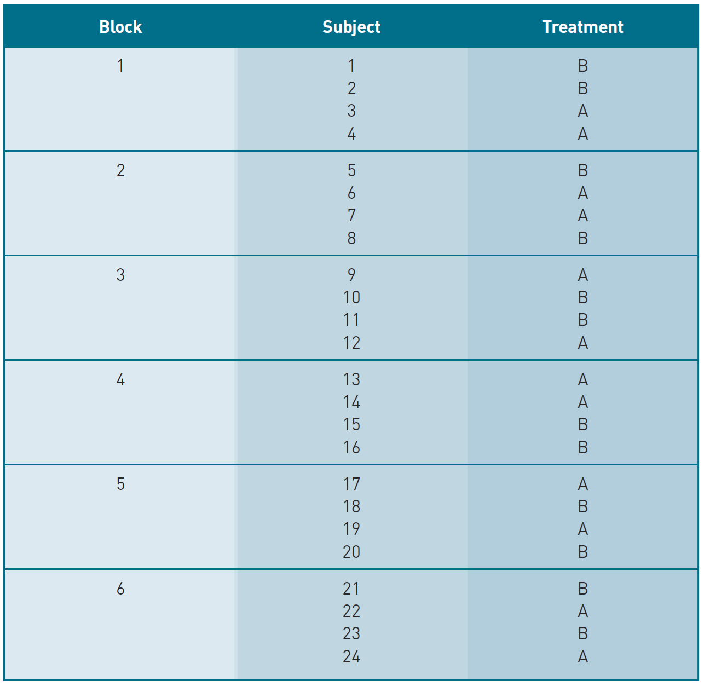
Block Randomization…

Slide 19
Stratified Randomization
In addition to balance in number periodically,
balance is also constantly maintained for a set of prognostic factors
E.g. age, gender, diabetes, severity of illness, or geography
Unevenly distributed between treatment groups could be cause for concern

Slide 20
Block Randomization…

Slide 21
Concealing randomization sequence
Generated sequence needs to be implemented with allocation concealment
Different from blinding
Prevents foreknowledge of treatment assignment
Shields those who enroll participants
Use of sequentially numbered opaque sealed envelops, IVRS, TWRS
Involvement of pharmacist

Slide 22
Randomization Implementation
Need to separate roles of generation and concealment from assignment role
While assigning participants the trialist could be aware of treatment allocation & could bias enrolment
Ensure that the assignment schedule is unpredictable and locked away
Strict sequence followed while recruiting participants

Slide 23
Thank You !

