Slide 1
Hypothesis Testing in RCTs
Dawit A. Ejigu (MD, MSc)
Associate Professor,
Department of Pharmacology
SPHMMC

Slide 2
Outline
Hypothesis testing
Choice of analysis method
Sensitivity analysis

Slide 3
Hypothesis
Null & alternative hypotheses when testing hypothesis
Ho = No difference between the groups
H1= There is difference between the two groups
After doing analysis we may
Reject Ho; there is statistically significant difference
OR
Accept Ho; there is no statistically significant difference

Slide 4
Hypothesis Testing
Most trials compare treatments (Phase IIb or III)
Superiority trials
More common-consistent with hypothesis testing logic
Demonstrates a Rx is superior to a second Rx
Test depends on type of data
Continuous; comparison of means (e.g. t-test)
Categorical data; comparison of proportions (e.g. Chi-Square test)
Time to event; (e.g. Cox regression )

Slide 5
Hypothesis Testing Logic
Hypothesis tests assume two groups are equal
Demonstrate that the data is EXTREME
Either
The assumption is false OR
Extreme data was observed by chance

Slide 6
Hypothesis Testing Logic…
Statistical theory sets a threshold to define extreme result as rare
Threshold set based on willingness to draw a false conclusion
Level of Significance; α usually 0.05
Modern statistics reports exact a p-value
If p< α, meaning p< 0.05, conclude the assumption is false

Slide 7
Hypothesis Testing Logic…
If the assumption is false, the two groups are not equal
But still there is a 5% chance this conclusion is incorrect (1 in 20)
If p>0.05 then there is a lack of evidence of a difference
Determination of association uses a distribution curves
Normal, binomial, Poisson, chi, Weibull distribution….
The curves may have different shapes

Slide 8
Hypothesis Testing Logic…
Final goal to demonstrate if the result obtained is very rare
Whether located at the extreme end of the tail
Where the probability is less than 0.05

Slide 9
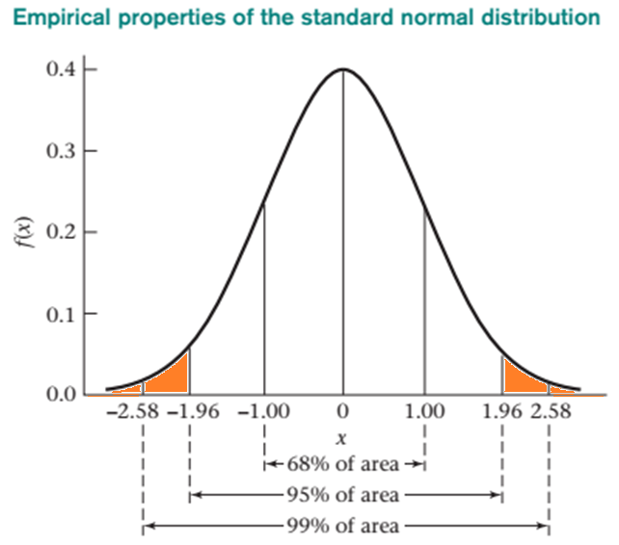
Normal Standard Distribution (SND) N(0,1)
Rejection region
Z calc > Ztab
Or
The reverse for negative values

Slide 10
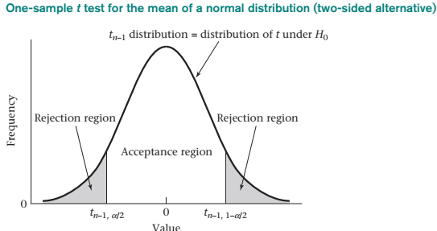
SND vs t-distribution

Slide 11
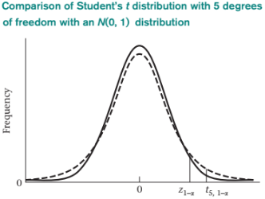
Other Distributions

Slide 12
Other Distributions…

Slide 13
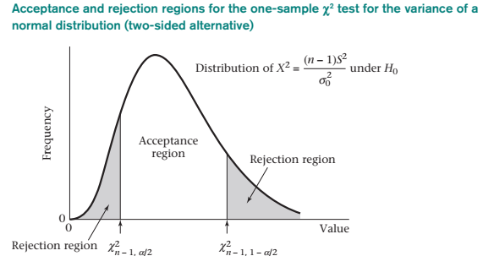
Other Distributions…

Slide 14
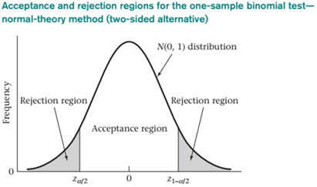
Other Distributions…

Slide 15
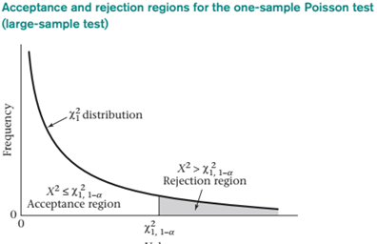
Other Distributions…

Slide 16
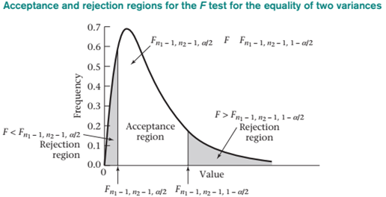
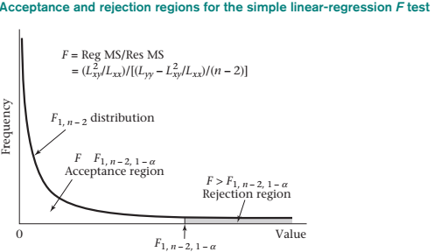
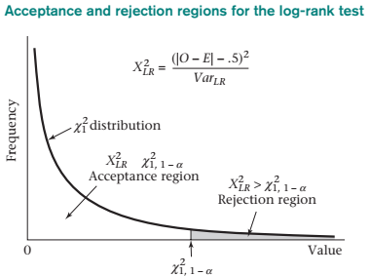
Other Distributions…

Slide 17
Choice of analysis method
Type of data; continuous, categorical, time to event
Underlying distributions
Previous publications
International recommendations
Parametric vs nonparametric tests

Slide 18
Sensitivity analysis; To check data robustness
Outliers
Noncompliance/protocol violation
Missing data
Definitions of outcomes
Distributional assumptions
Baseline imbalance

Slide 19
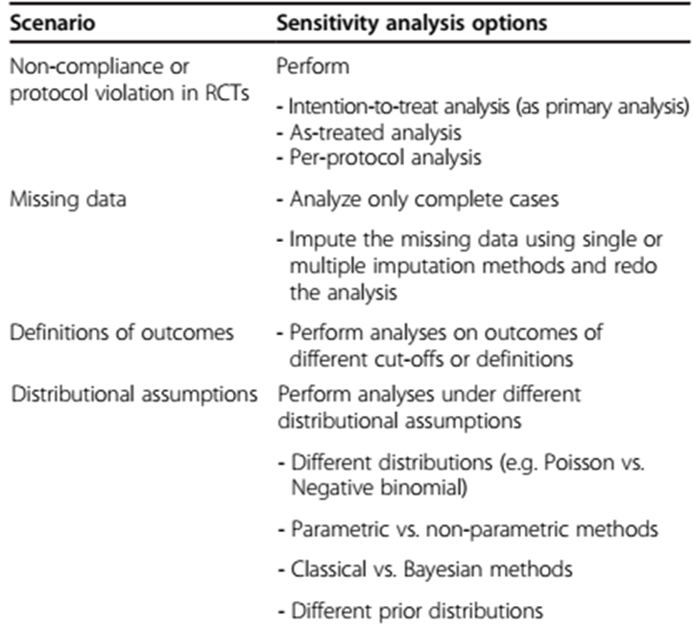

Slide 20
Confidence Intervals
Dawit A. Ejigu (MD, MSc)
Associate Professor,
Department of Pharmacology
SPHMMC

Slide 21
What we cover
Background
What is CI
Interpretation of 95% CI
Additional Issues
Calculation Considerations

Slide 22
Background
Effect size could be expressed in two ways
Point estimate with p-value
Interval estimate with 95% confidence
The effect size could be
Difference = Mean difference, Absolute Risk Difference (ARD)
Ratio = Risk Ratio, Odds Ratio, Hazard Ratio
Regulations require CT results presented in CI

Slide 23
What is CI
We use sample parameters to estimate population parameters
Inference about the effect size in a population from our sample
CI is a range of effect sizes to estimate the true intervention effect in the population
Based on the data collected from the sample (trial participants)
E.g. 95% CI; means if we repeated the trial many times, what range would the true effect fall into 95% of the time

Slide 24
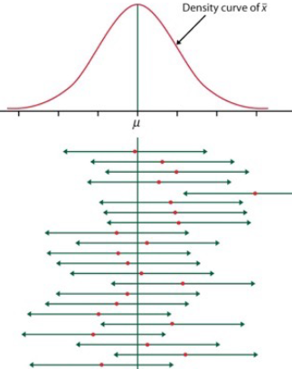
Interpretation of 95% CI
Suppose we repeatedly draw samples of size n from the population
For each sample we compute the corresponding 95% CI
95% of these CI’s will contain the true population mean μ
5% of these will be wrong, they will not include population mean μ

Slide 25
Additional issues about CI
With larger sample size the CI will be narrow,
E.g. (2, 8) vs (4,6)
For differences if CI includes 0, the results is not significant
For ratio if the CI includes 1 the result is not significant

Slide 26
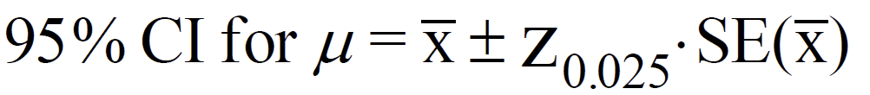
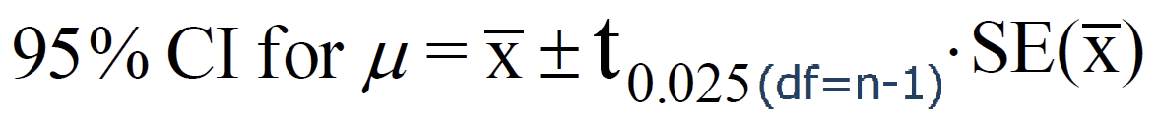
Calculation Considerations
For standard normal distribution
For t-distribution
…

Slide 27
Thank You !

