Slide 1
Study designs in RCTs
Dawit A. Ejigu (MD, MSc)
Associate Professor,
Department of Pharmacology
SPHMMC

Slide 2
Outline
Parallel
Cross-over
Factorial
Cluster randomized
Superiority
Equivalence
Non-inferiority

Slide 3
Types of study design
By configuration
Parallel Group
Crossover
Factorial
Cluster-randomized
Experimental vs. control/ placebo arm
Treatments in sequence
>1 treatment-comparison groups
Randomization according to group/block

Slide 4
Types of study design…
By comparison
Superiority
Equivalence
Non-inferiority
Better effecticacy of a treatment
Similarity of outcomes, clinical benefits; 2 drugs; new formulations; generics
New treatment not weaker than current treatment

Slide 5
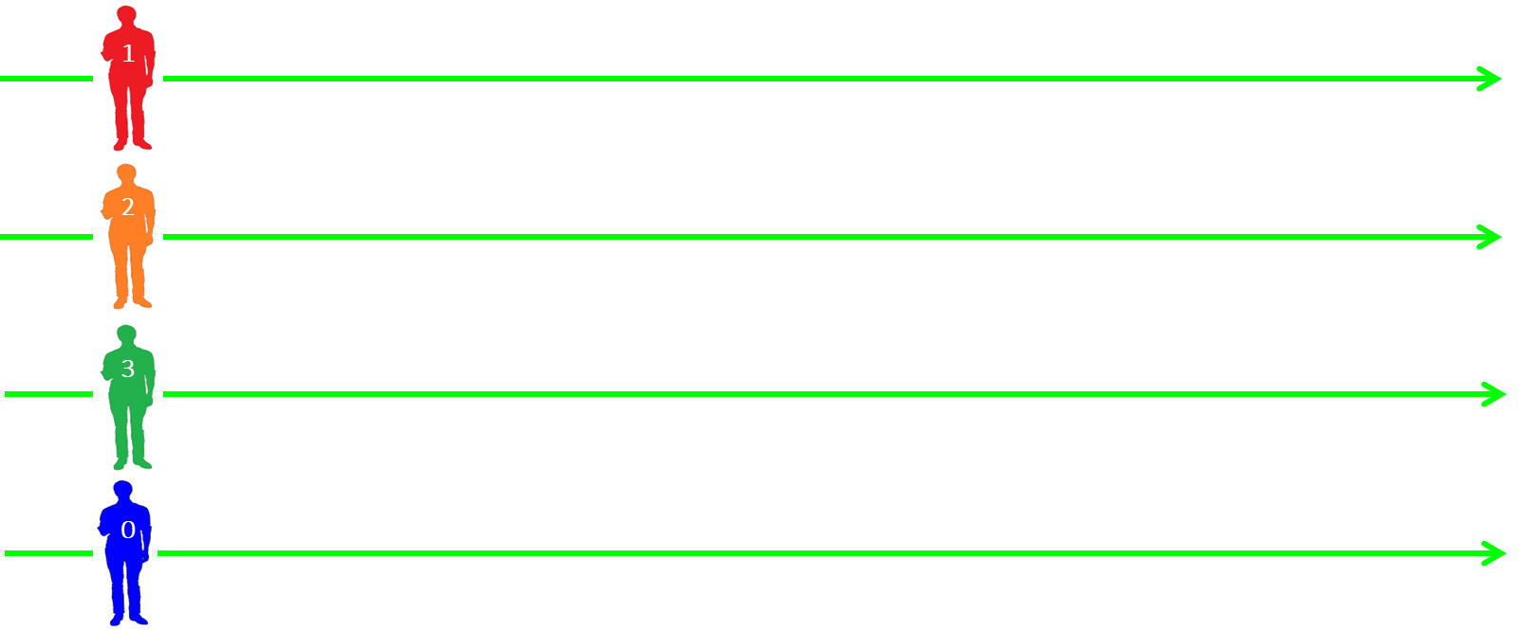
Parallel

Slide 6
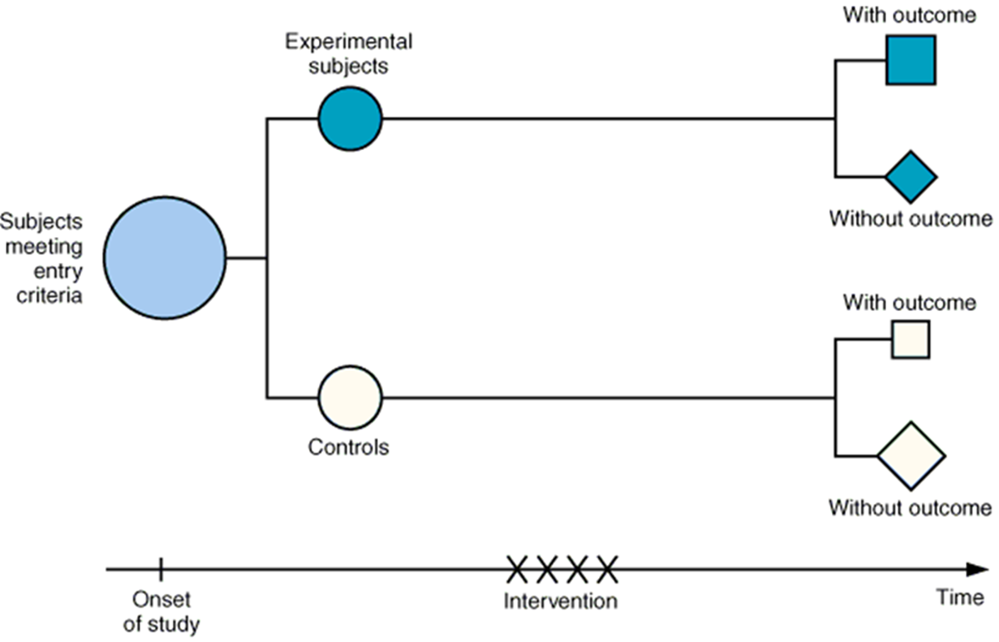
Parallel…

Slide 7
Parallel…
Most common design
Randomized to one of two or more arms
Arms could receive IP, placebo or active comparator
Less complicated design
But other aspects may complicate the design
  Repeated measure overtime
  Interaction between factors

Slide 8





Crossover
1
3
4

Slide 9
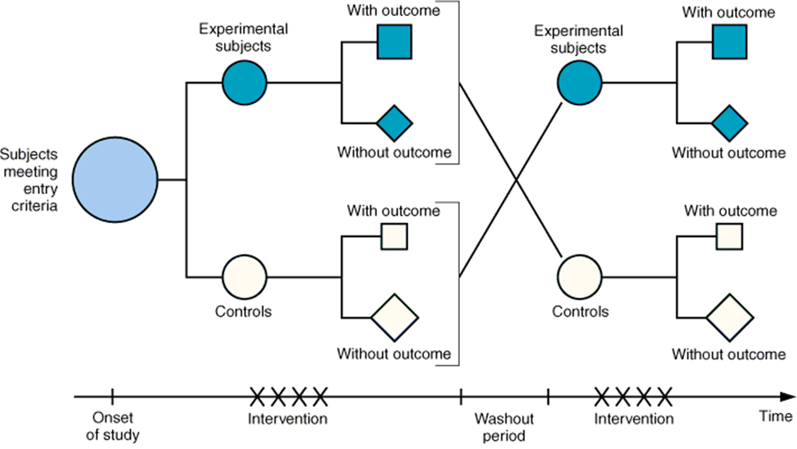
Crossover

Slide 10
Crossover…
Use each patient as own control
Must eliminate carryover effects by wash out
Time for wash out? How much time?
Assumption of no carryover effect is difficult to test
Difficult to determine the appropriate length of washout period to avoid carryover effects

Slide 11
Crossover…
Crossover design provides more information than simple parallel design
There may be “period” effects in addition to carryover effects
[Progression of disease, Dropouts]

Slide 12
Crossover…
Randomized to a sequence of two/more rxs
A wash out period needed
For chronic stable disease
Medication whose effects developed within treatment period
Washout period long enough for reversibility of drugs effect
E.g. Bioequivalence studies, interventions for chronic pain

Slide 13
Crossover…
Advantages
  Less bias; subject is his own control
  Reduced number of subjects/assessment
Disadvantages
  Carryover effects
  Complication of analysis when patients are lost to follow up
  Assignments of AEs which occur in later rx period

Slide 14
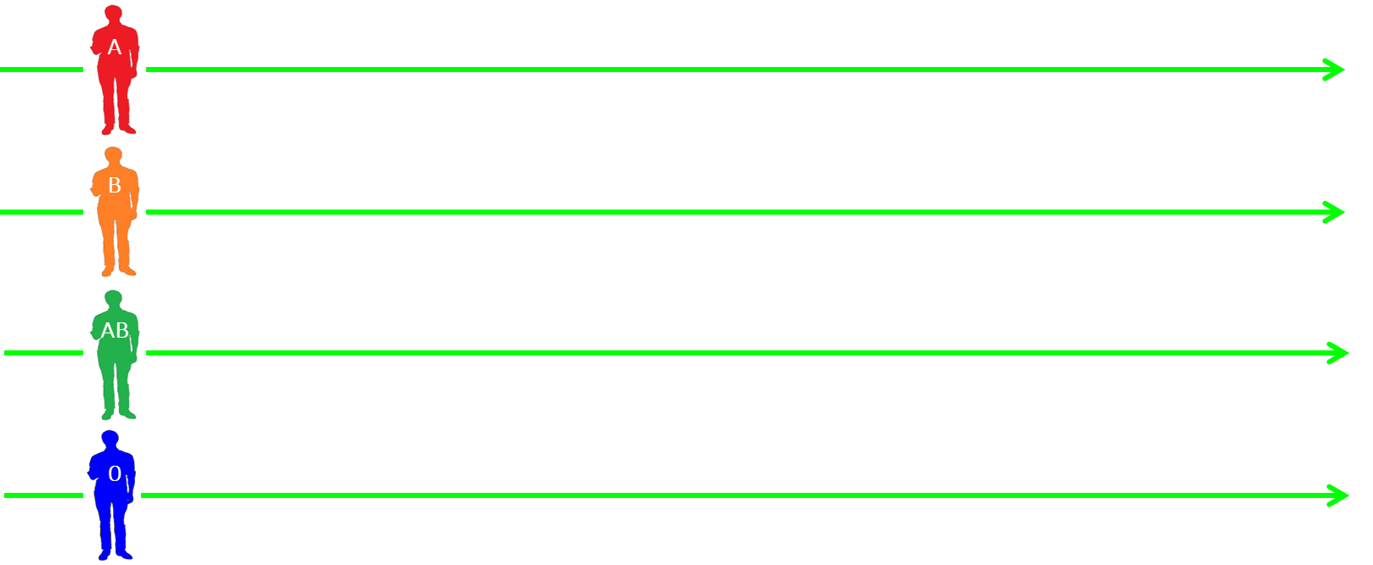
Factorial

Slide 15
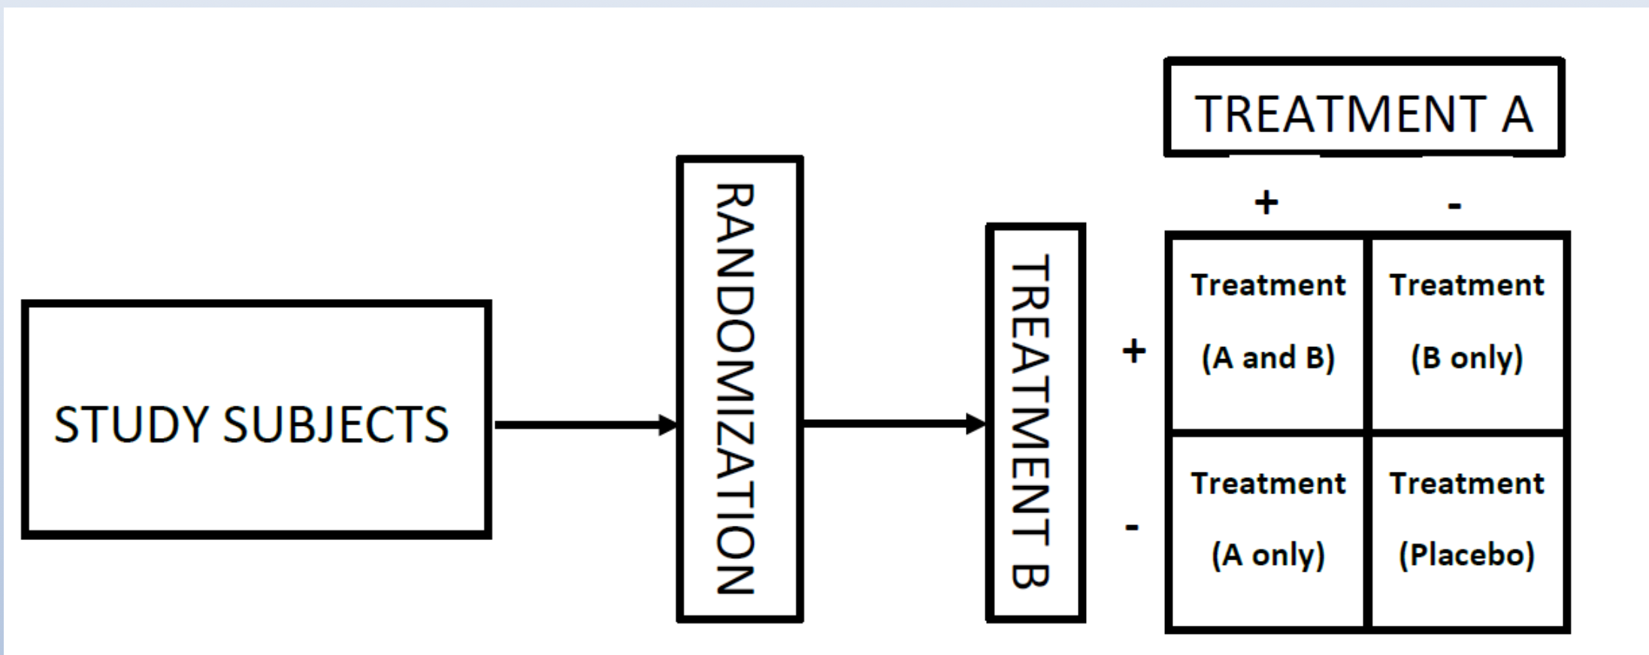
Factorial…

Slide 16
Factorial…
Evaluates two interventions simultaneously (including a combination of the two)
Each level of a factor (treatment or condition) occurs with every level of every other factor
4-arm/2x2/ study ?
Power for the interaction ?

Slide 17
Factorial…
Four possible treatment combinations, when two interventions are employed
Efficient approach in some circumstances
Potentially more informative approach
Increases proportion getting active treatment
Major concern: interaction of interventions

Slide 18
Factorial…
Two or more rxs evaluated in various combos
Rxs A&B
  A alone, B alone, A and B, neither (placebo)
  To examine joint effects of A and B when to be used together
Also to establish dose-response characteristics of two or more rxs
  n doses of X including zero dose (placebo) and m doses of Y

Slide 19
Cluster randomized
Unit of randomization is not an individual
Pros of cluster design
  For health intervention studies susceptible to “contamination”
  E.g. stop smoking strategies, healthy eating programs
  May also be logistical reasons to randomize clusters
Cons of cluster design
  Outcomes within clusters are correlated with one another
  Sample size usually large
  Analysis must take into account cluster design, complex

Slide 20
Types of study design
By comparison
Superiority
Equivalence
Non-inferiority
Better efficacy of a treatment
Similarity of outcomes, clinical benefits; 2 drugs; new formulations; generics
New treatment not weaker than current treatment

Slide 21
Superiority
To show the response to IP is superior to a comparator (active or placebo control)
  E.g. To determine the efficacy of a new drug compared to placebo in improving quality of life for arthritis patients
Efficacy outcome is quality of life score
Higher score=better QOL
Testing:
  mean(treatment) – mean(control) ≠ 0
  mean(treatment) / mean(control) ≠ 1

Slide 22
Superiority…
Superiority
NOT superiority
- CI goes below 0
- exp may be worse
NOT superiority
- CI entirely below 0
- exp worse
0
95% CI
control better than exp
exp better than control
Notes:
22
22

Slide 23
Equivalence
To demonstrate therapeutic equivalence with an active comparator
E.g. if a generic drug is bioequivalent to the original drug
Equivalent bioavailability = rate and extent of availability
Need to set margins within which drugs considered to be equivalent
  Both upper and lower margin

Slide 24
Equivalence…
Equivalence
NOT equivalence
- CI entirely above margin
- exp better
NOT equivalence
- CI goes below margin
- exp may be worse
NOT equivalence
- CI above & below margin
95% CI
0
acceptable
margin
control better than exp
exp better than control
Notes:
24
24

Slide 25
Non-inferiority
To demonstrate a Rx is not worse than an existing one by more than a pre-specified amount
Can think of as a one-sided version of an equivalence trial
New drug may have better safety profile
As for equivalence, need to set a margin, this time one-sided non-inferiority margin

Slide 26
Non-inferiority…
Hypothesis; One treatment is non-inferior to another
Example Objective:
  To determine whether a new drug is non-inferior to standard treatment in improving quality of life for arthritis patients
Outcome is quality of life score
Higher score=better QOL
Testing: mean(treatment) – mean(control) > -d

Slide 27
Non-inferiority…
Non-inferiority
NOT non-inferiority
- CI goes below margin
- exp may be worse
NOT non-inferiority
- CI goes below margin
- exp may be worse
95% CI
0
acceptable
margin
control better than exp
exp better than control
Notes:
27
27

Slide 28
Adaptive Clinical Trials
A clinical trial design that allows for prospectively planned modifications to one or more aspects of the design based on accumulating data from subjects in the trial

Slide 29
Adaptive Clinical Trials
Statistical efficiency
Ethical considerations
Improved understanding of drug effects
Acceptability to stakeholders

Slide 30
Adaptive Trial Designs
Chance of erroneous conclusions
Should be controlled
Estimation of treatment effect
Should be sufficiently reliable
Design details
Trial integrity
Restricted access to interim results
Should be pre-specified

Slide 31
Adaptive Trial Designs: Drawbacks
Require more complex analysis
Higher maximum sample size
Logistical challenges
Challenges in interpretability of results

Slide 32
Decentralized Clinical Trials (DCTs)
Remotely
implemented
Uses e-health and tele-medicine platforms
Remote data collection systems / applications
Digital technology and devices (E.g. smart phones, wearables, sensors)
Remote monitoring
Patients not needing to be in a Hospital trial site
Implemented at patient homes or in nearby local health facility

Slide 33
DCTs advantages
Logistically cost-effective
Well adapted to pandemic situations
Recruitment of diverse patient populations
Improves access to investigational products

Slide 34
DCTs: Resources Needed
An adapted regulatory framework
Infrastructure to support GCP
Infrastructure for data capture and reporting
Infrastructure for follow-up, including lab tests
Networking facilities (pharmacy, labs, clinics, etc.)

Slide 35
DCTs: Ethical Challenges
Lack of guidelines and regulatory mechanisms
Assessment of risks and AEs
Confidentiality, data security
Compromises on fairness and equity (e.g., IT illiterates)

Slide 36
Thank You !

