Slide 1
Phases of Clinical Trial and Clinical Trial Authorization
Dec 2025
Million Molla (MD, MPH, MBA)
National Clinical Trial Advisor-NRERB
TWG-EFDA

Slide 2
Overview
Phases of Clinical Trial
Clinical Trial Authorization
GCP Inspection
Common Regulatory Findings

Slide 3
Definition of Clinical Trial
A study which involves human participants designed to develop new better interventions

Slide 4
Phases of Clinical Trials
Premarketing Phases
Phase 0
Phase I
Phase II
Phase III
Post Marketing Phase (Phase IV)

Slide 5
Phase 0 (Pre-phase I) Clinical Trials
Employ very small dose not harmful to humans
Done in small no.(10-15) of healthy people
Increase success of new drug trials
usually conducted in specialized clinical research units within hospitals, often linked to academic research institutes.

Slide 6
Objectives of Phase 0 Clinical Trials
Check drug behaves as expected in humans
Gather preliminary PK/PD data
Rank candidate compounds & select those to progress to Phase I

Slide 7
Phase I (First in human) Clinical Trials
Study in healthy volunteers (15-100)
PO in a single dose (2%) of min dose in animals
Success rate about 70%

Slide 8
Objectives of Phase I Clinical Trials
Monitor Safety
Conduct Kinetic Studies

Slide 9
Types of Phase I Clinical Trials
Phase Ia (with single dose)
Phase Ib (with multiple doses)

Slide 10
Limitations of Phase I Clinical Trials
Impossible to demonstrate all effects
Difficult to Establish therapeutic response
Expose participants to ADRs

Slide 11
Phase II (Exploratory) Clinical Trial
Performed in patients (50–300)
Success rate about 33%

Slide 12
Objectives of Phase II Clinical Trials
Establish therapeutic Response
Monitor safety in patients
Determine dosage schedule

Slide 13
Types of Phase II Clinical Trials
Phase IIa (Pilot trials)
Demonstrates efficacy using Phase I PK/PD data
Explores doses
Phase IIb
Determines optimal dose
Provides specific safety and efficacy data

Slide 14
Limitation of Phase II Clinical Trials
Small sample size

Slide 15
Phase III (Confirmatory) Clinical Trials
Involves 300- 3000 participants
Randomized controlled
Involves > one arm
Most expensive & time-consuming
Success rate 25 - 30%

Slide 16
Objectives of Phase III Clinical trials
Formally assess therapeutic merits of the new compound compared with standard drug and/or placebo

Slide 17
Types of Phase III Clinical trials
Phase IIIa (Expanded Clinical Trial)
Involves > one arm
Phase IIIb (Large Scale Clinical Trial)
Involves larger & specific population
Only test group (one arm)
Relaxed entry criteria

Slide 18
Why Phase I Has Higher Success Rates
Purpose of Phase I:
Focuses mainly on safety, tolerability, and pharmacokinetics.
Conducted in small groups (20–100 healthy volunteers or patients).
Endpoints are relatively straightforward (e.g., “Is the drug safe at this dose?”).
Result:
Most investigational products can demonstrate basic safety and tolerability.
Hence, ~70% of drugs move successfully from Phase I to Phase II.

Slide 19
Why Phase II Success Drops to ~33%
Purpose of Phase II:
Tests efficacy in patients with the target disease, while continuing to monitor safety.
Larger sample sizes (50–300 participants).
Endpoints are more complex (clinical outcomes, biomarkers, dose–response).
Challenges:
Many drugs that are safe fail to show meaningful efficacy.
Biological mechanisms may not translate from lab/animal models to humans.
Variability in patient populations makes efficacy harder to prove.
Dose optimization and therapeutic window may not be clear.
Result:
Only about one‑third of drugs demonstrate both safety and efficacy strong enough to advance to Phase III.

Slide 20
Summary
A funnel of attrition:
Phase I (Safety) → Most drugs pass.
Phase II (Efficacy + Safety) → Many fail because proving benefit is harder than proving safety.
Phase III (Confirmatory trials) → Even fewer succeed, as large‑scale trials expose weaknesses.

Slide 21
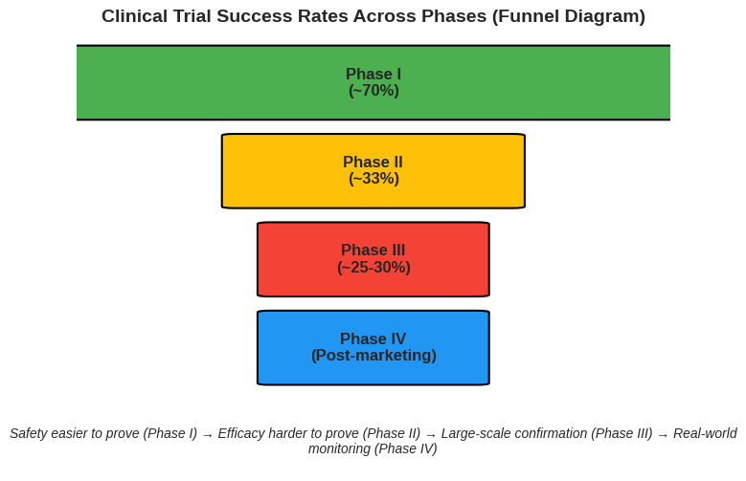
Summary

Slide 22
Tip
Many drugs are safe (Phase I).
Fewer show efficacy (Phase II).
Even fewer survive large‑scale testing (Phase III).
Only the strongest reach real‑world use (Phase IV).

Slide 23
Summary
Please note that:
Phase I success (~70%) → easier to show safety.
Phase II success (~33%) → harder to prove efficacy in real patients.
Key message: Safety is necessary, but efficacy is the true hurdle.

Slide 24
Release to Market
Appropriate dosage formulation
Approval by NMRA
Release to market

Slide 25
Limitations of Premarketing Clinical Trials
Cannot detect long term ADRs
Limited number of participants involved
May not consider genetic and age differences
Hence, need for next phase

Slide 26
Phase IV (Post Approval) Clinical Trials)
Assessment over long term use in large no. of participants after marketing the drug

Slide 27
Objectives of Phase IV Clinical Trials
Detect long term ADRs
Determine drug efficacy over long term use
Assess drug interaction if any
Apply the drug for new indication

Slide 28
New guidelines which contribute for Good Clinical Trials
Guidance for Good Randomized Clinical Trials, Developed by the Good Clinical Trials Collaborative, November 2023 v1.1
Guidance for best practices for clinical trials, WHO, 2024

Slide 29
Good Randomized Clinical Trials by GCTC
GCTC stands for the Good Clinical Trials Collaborative.
It is a global initiative that develops guidance to promote and enable high‑quality randomized controlled trials (RCTs).
Global Community Initiative → Brings together researchers, regulators, funders, and healthcare leaders.
Mission → To make it easier to design and conduct good randomized clinical trials that produce reliable evidence for healthcare decisions.
Guidance → Developed the Guidance for Good Randomized Clinical Trials, which sets out universally relevant, flexible, and quality‑focused principles.
Focus → Grounded in scientific and ethical principles, ensuring trials are informative, efficient, and equitable.

Slide 30
Good Randomized Clinical Trials by GCTC
Produce scientifically sound answers
Appropriate trial population
Robust intervention allocation
Adequate size
Adherence to allocated intervention
Follow up completion
Relevant outcome measures
Efficient & reliable data capture
Statistical analysis
Monitoring Benefits and Harm

Slide 31
Good Randomized Clinical Trials by GCTC
Respect the rights and well-being of participants
Appropriate participants communication
Relevant consent
Changing consent
Implication of changing consent
Managing of safety of participants
Communication of new information relevant to the intervention
Collaborate and be transparent
Has to be feasible
Manage quality effectively and efficiently

Slide 32
Clinical Trial Authorization (CTA)
Permission for CTs on IPs from National Medicine Regulatory Authority
Required for CT on IPs
CTA submission legal requirement for CTs
Parallel submission to N M R A & ethics committee
Ethics approval prerequisite for CTA

Slide 33
Duties of Medicine Regulatory Authority
Permitting IP importation
Examine reliable information on IP proved to be safe in animals/ phase I CTs
GCP Inspection
Conduct review of documents, facilities, records, etc

Slide 34
Objectives of GCP Inspection
Minimize health hazard associated with IP
Assess level of compliance with CT Regulation
Request corrective action
Take enforcement action

Slide 35
Responsibilities in CTs
Inspect appropriate documentation
Approved protocols/ethical & regulatory approvals
Signed ICF
IP documents and Investigator Brochure
DSMB minutes/investigators signature & CVs

Slide 36
Responsibilities in CTs…
Inspect onsite trial
As per approved protocol
Efficacy & safety issues
Trained/qualified/experienced personnel
Facilities

Slide 37
Challenges of Clinical Trial implementation
Poor trial design
Not registering clinical trials
Lack of reporting trials
shortage of trial participants to represent different populations
Lack of community engagement in trial design
Significant gaps in trial infrastructure and capabilities
National inefficiencies in clinical trial approval process

Slide 38
Common Regulatory Finding
No training given to staff
Training given but log never created
Staff delegated/doing tasks that they are not qualified to perform
Tasks added to entry at a later date, once staff receive new training
Staff missing from delegation log
Missed delegation log
Expired clinical licenses

Slide 39
Principles of Clinical Trials
Ethiopian Context:
Same principles in the National Research Ethics Review Technical Guideline (NRERTG).
It emphasize Ethiopia’s requirement for ethical clearance before trial authorization.
Highlight the National Medicine Regulatory Authority (NMRA) role in Clinical Trial Authorization (CTA).

Slide 40
Principles of Clinical Trials
International Context:
WHO’s Guidance for Best Practices in Clinical Trials (2024): stresses scientific validity and participant protection.
CIOMS: ethical principles for biomedical research involving human subjects.
SIDCER(Strategic Initiative for Developing Capacity in Ethical Review) capacity building for ethics committees globally.

Slide 41
Relevance to St. Paul Institute HR
Ethiopian Context:
Showcase how RCTs support national health priorities (maternal health, SRHR).
Good Laboratory Practice guideline: ensures data integrity in local labs supporting RCTs.

Slide 42
Relevance to St. Paul Institute HR
International Context:
WHO and CIOMS: emphasize collaboration and transparency in multi-country trials.
SIDCER: strengthens ethics review capacity, relevant for St. Paul’s collaborations.

Slide 43
RCTs in Ethiopia and Beyond
Ethiopian NRERTG, GCP, GLP, Bioequivalence guidelines → ensure local compliance and participant safety.
WHO, CIOMS, SIDCER → provide global ethical and scientific frameworks.
Together → build credibility, protect participants, and generate evidence that informs both national policy and global health practice.

Slide 44
Thank You!
Questions?

Slide 45


Thank you to

