Slide 1
Data Extraction and Synthesis
Addis Ababa, Ethiopia
Nov 19-21 ,2025
Notes:
SLIDE EXPLANATION:
REFERENCES:
EXAMPLES:
DISCUSSION POINTS AND QUESTIONS FOR THE CLASS:

Slide 2
Learning Objectives
To provide brief overview of data extraction
Introduction
Data extraction tools and contents
Quantitative data measurements
To have basic understanding on data synthesis
Qualitative synthesis
Quantitative synthesis (Meta-Analysis)

Slide 3
Data Extraction/ General approach and principles
Use Standardized data extraction tools (paper or electronic form), which include
Title of review and Initial (ID) of data extractor
Revision date or version number for data collection form
Dummy table- Raw with study ID and column (study variables)
Data collection forms should be adaptable across reviews
Design based on the research question
Cover the main components of study variable (e.g PICO)
The data extraction tool should be appended in the protocol

Slide 4
Data Extraction/ General approach and principles
Extract all relevant and similar information from all included studies
Any unpublished information –re-coded in the format of published article
Contact study authors for clarification or additional information
(e.g., Missing or Unclear raw data)
Ensure data security and adherence to ethical guidelines (Sensitive data)
Independent Dual Extraction – that should be Reproducibility
Resolve discrepancies through discussion or a third reviewer
Follow phase-based Data extraction technique

Slide 5
Data Extraction/ Relevant information
Phase 1: Extraction of study characteristics
Citation
Study design and method
Setting/Context
Population characteristics
Intervention/Comparator/Condition/Exposure/Tests

Slide 6
Data Extraction/ Relevant information
Phase 2: Extraction of Additional Parameters / Comparison
Data related to methodological quality
Randomization
Blinding
Attrition rates
Information for Subgroup Analysis
Any relevant Covariates for meta-regression
Study duration and time variable
Baseline characteristics

Slide 7
Data Extraction/ Relevant information
Phase 3: Extraction of main measurements
Details of the Intervention/Exposure
Description of the intervention and comparison group (PICO)
Description of exposure/case and control group (PEO/CoCoPop).
Sample sizes and observed events for each group
Outcome Measures:
Primary and secondary outcomes as defined in the study.
Method and length of measurement (CS or longitudinal
Scale of measurement and related estimates
Effect estimates such OR, RR, mean difference, hazard ratio).
Measures of variability (SD, SE, CI).

Slide 8
Outcome Measures/Effect estimate

Slide 9
Outcome Measures/Effect estimate
Primary Study can have the following quantitative outcome measurement
Categorical
Dichotomous
Ordinal
Multinomial
Continuous
Scales, or interval
Ratio data

Slide 10
Categorical /Binomial Outcome Measures
Estimates of Categorical data
Absolute effect estimates
Odds of exposure
Risk of outcome
Risk difference (RD)
Relative effect estimates
Odds Ratio (OR) ➔ Case control
Relative Risk (RR) ➔ Cohort / Experimental
2x2 Table facilitate estimation of appropriate effect size
Exposure/ Intervention | Outcome
 | YES | NO | Total
Yes | a | b | a + b
No | c | d | c + d
Total | a + c | b + d | a + b + c + d

Slide 11
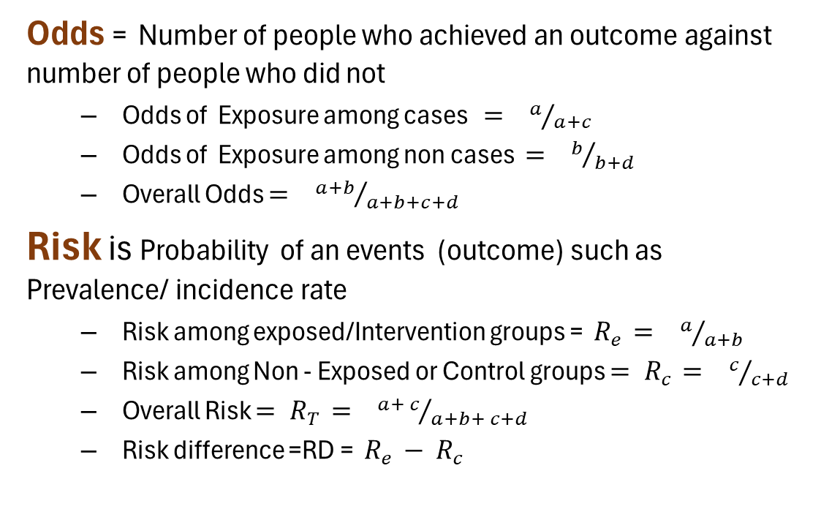
Categorical /Binomial Outcome Measures
Odds = Number of people who achieved an outcome against number of people who did not
Odds of Exposure among cases $= a/{a+c}$
Odds of Exposure among non cases $= b/{b+d}$
Overall Odds $= {a+b}/{a+b+c+d}$
Risk is Probability of an events (outcome) such as Prevalence/ incidence rate
Risk among exposed/Intervention groups = $R_{e }$ $= a/{a+b}$
Risk among Non - Exposed or Control groups ${= R}_{c }$ $= c/{c+d}$
Overall Risk ${= R}_{T }$ $= {a+ c}/{a+b+ c+d}$
Risk difference =RD = $R_{e }$ $− { R}_{c }$
Exposure/ Intervention | Outcome
 | YES | NO | Total
Yes | a | b | a + b
No | c | d | c + d
Total | a + c | b + d | a + b + c + d

Slide 12
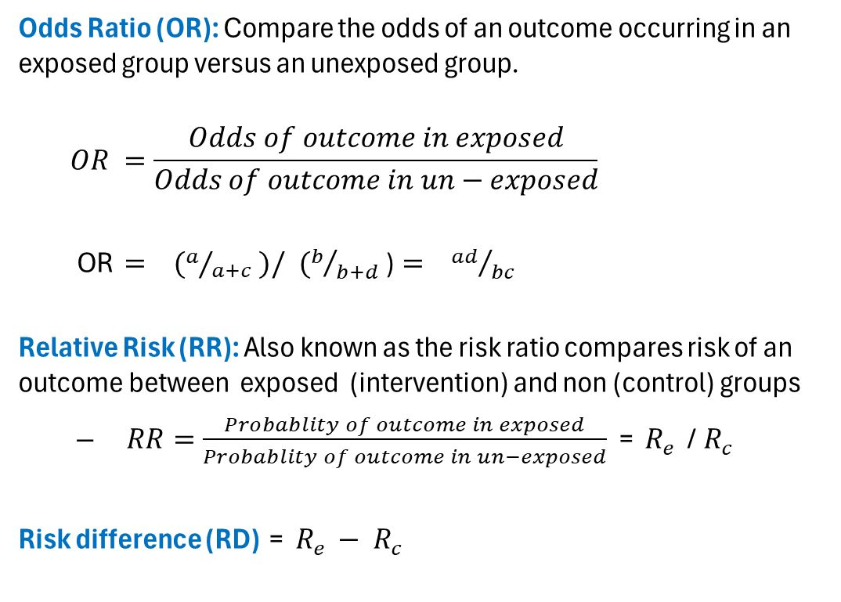
Categorical /Binomial Outcome Measures
Odds Ratio (OR): Compare the odds of an outcome occurring in an exposed group versus an unexposed group.
$$OR =\frac{Odds of outcome in exposed}{Odds of outcome in un−exposed}$$
OR $= (a/{a+c} )/ (b/{b+d}$)$= {ad}/{bc}$
Relative Risk (RR): Also known as the risk ratio compares risk of an outcome between exposed (intervention) and non (control) groups
${RR=\frac{Probablity of outcome in exposed}{Probablity of outcome in un−exposed}}_{ }$ = $R_{e }$ /${ R}_{c }$
Risk difference (RD) = $R_{e }$ $− { R}_{c }$
Exposure/ Intervention | Outcome
 | YES | NO | Total
Yes | a | b | a + b
No | c | d | c + d
Total | a + c | b + d | a + b + c + d

Slide 13
Categorical /Binomial Outcome Measures
Example 1 : Cohort study to investigate effect of smoking on lung cancer
Risk among smoker = 50/200 = 0.25
Risk among non-smoker = 10/100 = 0.1
RR = 0.25/0.1=2.5
OR = 50*90/10*150 = 3
Example 2 : Adverse reaction of two alternative CVD drugs
Risk after Drug A = 10/100 = 0.1
Risk after Drug B = 22/100 = 0.22
RR = 0.1/0.22=0.45
OR = 10*78/90*22 = 0.39
Exposure | Lung Cancer
 | YES | NO | Total
Smoker | 50 | 150 | 200
Non smoker | 10 | 90 | 100
Total | 80 | 240 | 300
Intervention | MI
 | YES | NO | Total
Drug A | 10 | 90 | 100
Drug B | 22 | 78 | 100
Total | 32 | 168 | 200

Slide 14
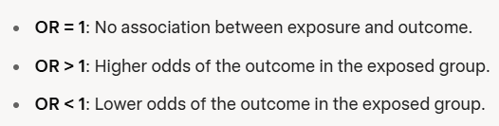
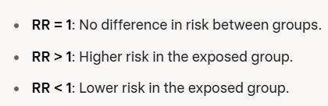
Categorical /Binomial Outcome Measures
Interpretation of OR and RR
When an event is rare, the difference between odds and risk is small
When events are common, the difference between odds and risk is large

Slide 15
Categorical /Binomial Outcome Measures
Data required for Meta- Analysis
Number of observed events from each of groups (a, b, c, d)
Total number of individuals included for both groups (n1 and n2)
Total sample sizes (N)
If the above information is not available, but (OR or RR ) has reported
Perform analysis using generic inverse variance method
Should be accompanied by SE and 95% CI or an exact P value

Slide 16
Diagnostic Accuracy Outcome Measures
Diagnostic Accuracy
Sensitivity= proportion of true positives
Sn = TP / (TP + FN)
Specificity= measures true negatives
Sp = TN / (TN + FP)
Diagnostic Odds Ratio (DOR):
Limited clinically implication
Doesn’t directly inform about Sn or SP
NB: Data Required for Meta analysis : TP , FP , TN , FN
Exposure | Disease confirmed by Reference test
 | YES | NO | Total
Test Positive | TP | FP | TP + FP
Test Negative | FN | TN | FN + TN
Total | TP + FN | FP + TN | N

Slide 17
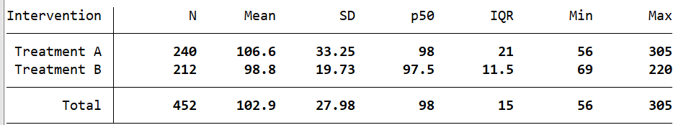
Continuous Outcome Measures
Continuous data are where an outcome is measured using scale value or range of intervals such as Weight, Length of stay, Age , Blood pressure etc
Typically measured as a mean ± standard deviation
Medians and Interquartile ranges ➔ non parametric
NB: The mean difference (or the difference in means) measures the absolute difference between the mean value of an outcome in two groups

Slide 18
Continuous Outcome Measures
Required data for Meta-analysis
Mean value of outcome measurements in each group (M_{E} & M_{C} )
Standard deviation of the outcome in each group (S_{DE} & SD_{C} )
Number of participants in each group (N_{E}& N_{C} )
Sometimes the numbers of participants, means and standard deviations may not avail-able, but an effect estimate such as a mean difference or standardized mean difference may be reported
Perform analysis using generic inverse variance method
Should be accompanied by SE and 95% CI or an exact P value

Slide 19
Data synthesis
Formulate Question
Define Inclusion & Exclusion Criteria
Locate Studies (Searching)
Select Studies
Critical Appraisal
Data Extraction
Data Synthesis
Present Results
Interpret Results/Establish Confidence in Evidence

Slide 20
Quantitative synthesis/Meta-analysis

Slide 21
Quantitative synthesis/Meta-analysis
Primary aim/objective
Synthesize available Evidence /generate Pooled effect size
Increase precision of evidences : Improve the accuracy of results.
Assess Heterogeneity: Examine variability in study results
Resolve Uncertainty: Clarify conflicting findings of individual studies.
Improve generalizability of findings: diverse populations or settings.
Identify Gaps: Highlight areas where evidence is limited, guiding future research.

Slide 22
Quantitative synthesis/Meta-analysis
Preconditions and Inputs
NB: Validity and or quality of Pooled estimates depends on doing:
Supported with well developed standard protocol
Extract the right/accurate raw data
Choose appropriate statistical method (model)
Choosing appropriate effect size (estimate)
NB: Choice of statistical model and effect size
Depend on quality and type of available Raw data
Usually consistent with estimates of the original studies
Guided by research question and review type (e.g PICO vs PEO)

Slide 23
Quantitative synthesis/Meta-analysis
Alternative Statistical model and Assumptions
Random Effects Model
Included Studies assumed to have different true effect sizes
Possible variability within and between studies
The overall effect is an average of these varying effects.
True values drawn randomly from population
Fixed Effects Model
All studies expected to evaluate the same (one) true effect size,
Differences in results are due only to sampling error (random chance).
No inherent variation in source population
NB: Studies are highly similar with low risk of heterogeneity ( I² < 25%).

Slide 24
Quantitative synthesis/Meta-analysis
Effect Size for Categorical outcome
Observational studies ➔ CoCoPop or PEO
Risk, Rate ( incidence or prevalence)
Comparative studies ➔ RR and OR interchangeably
RR or HR = Prospective/ Experimental studies
RR easy to interpret
OR = Retrospective, case control and or CS studies
Greater power for small size Studie
RD = intuitive for policy/clinical decisions
Diagnostic Accuracy ➔ Point estimates and CI of sensitivity and specificity
Generate forest plots, summary of ROC curves, or pooled estimates

Slide 25

Quantitative synthesis/Meta-analysis
Continuous outcomes
Required raw data : Sample size (n), mean and SD of included Studies
If SD is not reported-we can make simple transformation using SE and Sample size and or Confidence intervals of the mean value
Choice of Effect size
Weighted mean difference (WMD) if all included studies report the same outcome measure using the same instrument
The standardized mean difference (SMD) if all included studies report the same outcome measure but using different instruments

Slide 26
Quantitative synthesis/Meta-analysis
Main components of Analysis
Produce an overall pooled estimate:
Visualize individual and pooled effect sizes using forest plots
Heterogeneity Assessment:
Evaluate variability and explore sources of heterogeneity
Sensitivity Analysis:
Include/ excluding influenceable studies
Subgroup Analyses
Explore differences in effects across subgroups
Meta-Regression Analyses
Use meta-regression to examine the impact of study-level covariates.
Publication Bias Assessment:
Evaluate potential bias using funnel plots and or Egger’s test

Slide 27
Quantitative synthesis/Meta-analysis
Heterogeneity Assessment
Decide on the level of Heterogeneity based on I² - value
Zero value ➔ no worries (Homogeneity)
0 < 25% = Some concern
25% - 50% ➔ Some concern
50% - 75% ➔ major concern
75% - 100% ➔ substantial heterogeneity
Look for possible Reasons of Heterogeneity
Clinical ➔ Differences in the characteristics of study populations, interventions and outcomes
Methodological ➔ Difference in study designs and quality
Statistical ➔ It may be due to clinical heterogeneity or methodological heterogeneity or chance
(Murad et al, 2015)

Slide 28
Quantitative synthesis/Meta-analysis
Sensitivity analysis
Perform repeated analysis under different assumptions
Using two of alternative models
Changing alternative estimates (e.g RR Vs OR)
With and without the inclusion of small sample size studies
With and without the inclusion of a mega-trial
If findings remain consistent across analyses, we can be more confident in the result

Slide 29
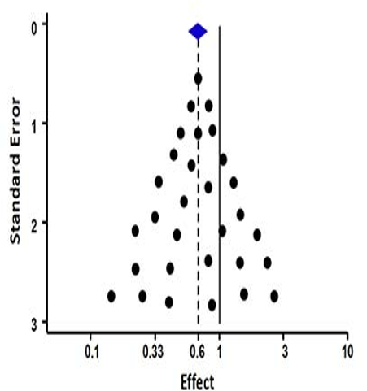
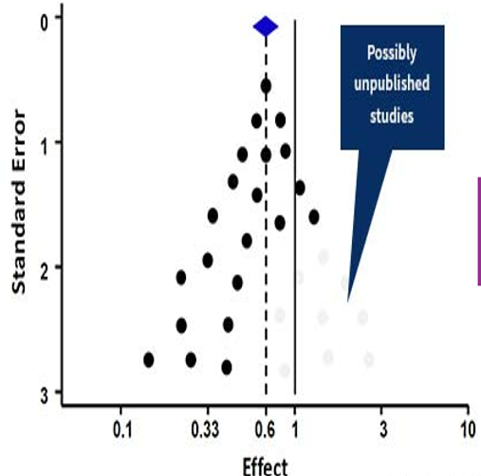
Quantitative synthesis/Meta-analysis
Assessing Publication Bias
Large studies are likely to be published while small size studies and moderate effects likely to be unpublished
Assessment using funnel plot
ES of smaller studies often scattered widely at the bottom
Absence of bias ➔ symmetrical inverted funnel
Publication of bias ➔ Asymmetrical inverted funnel
Test using Egger’s or Begg’s test

Slide 30
Quantitative synthesis/Meta-analysis
Reporting of review study findings
Follow reporting guidelines and diagram (e.g. PRISMA)
Transparent documentation and reporting
Characteristics of individual studies
Critical appraisal and Quality assessment
Key findings of individual studies and pooled estimate
Discussion and implication supported by strong evidences
Strength and Limitation of Review
Strategies to overcome the limitation
Conclusion and other information

Slide 31
References
Popay, J., et al. (2006) Guidance on the conduct of narrative synthesis in systematic reviews. ESRC Methods Programme.
Campbell, M., et al. (2020) Synthesis without meta-analysis (SWiM) in systematic reviews: reporting guideline. BMJ, 368, l6890.
Tufanaru C, Munn Z, Stephenson M, Aromataris E. Fixed or random effects meta-analysis? Common methodological issues in systematic reviews of effectiveness, International Journal of Evidence-Based Healthcare. 2015;13(3): 196-207.
DerSimonian, R., & Laird, N. (1986) Meta-analysis in clinical trials. Control Clin Trials, 7(3), 177–188.
Hartung, J., & Knapp, G. (2001) A refined method for the meta-analysis of controlled clinical trials with binary outcome. Stat Med, 20(24), 3875–3889.
IntHout, J., et al. (2016) Pleas for routinely presenting prediction intervals in meta-analysis. BMJ Open, 6(6), e010247.

Slide 32
Quantitative synthesis/Meta-analysis
Practical session
Extract relevant information and data From studies which has low risk of bias during your critical appraisal
Sample dataset will be exported to ReVMan and STATA
Demonstrate meta-analysis and generate pooled estimate:
PICO studies with continuous outcome
PICO studies with Binary outcome
Re -run the analysis (sub-group and other procedures)
Interpret outputs

Slide 33
Thank you

