Slide 1
Critical Appraisal/Risk of bias Assessment
Addis Ababa, Ethiopia
Nov 19-21 ,2025
Notes:
SLIDE EXPLANATION:
REFERENCES:
EXAMPLES:
DISCUSSION POINTS AND QUESTIONS FOR THE CLASS:

Slide 2
Critical Appraisal/Risk of bias Assessment
Learning Objectives
To have basic understanding on Risk of bias Assessment
Source/type of bias
Methods to minimize bias
Understand and Perform Critical Appraisal of primary studies
Based on standard tools

Slide 3
Critical Appraisal/Risk of bias Assessment
What is Critical Appraisal mean?
Determines extent/risk to which study has addressed risk of bias in its design, conduct and analysis
Also referred to as Assessment of risk of bias/methodological quality
A process that assesses methodological quality of a study
Required in all systematic reviews

Slide 4
Critical Appraisal/Risk of Bias Assessment
Why is Critical Appraisal Important?
Combining results of poor-quality research may lead to biased or misleading results
Facilitates deeper knowledge of included studies
Ensures that review is credible and useful for informing
Health care policy
Clinical practice
Future research

Slide 5
Critical Appraisal/Risk of Bias Assessment
The main aim of critical appraisal
To ensure validity of included studies
Internal validity: The extent to which a study has minimized bias and effect of confounding
Is it free from risk of bias/systematic error?
Are the results likely to be ‘true’?
External validity: The extent to which results can be generalized to other groups/populations or contexts that did not participate in study
Do results apply to other populations?

Slide 6
Critical Appraisal/Risk of Bias Assessment
Other types of validity
Statistical conclusion validity
Has the study avoided a Type I or Type II error?
Type I error (false- positive)
Type II error (false-negative)
Consider whether researchers have assessed risk of making these errors and performed appropriate tests
Construct validity
Does instrument measure what it purports to measure and if it does to what extent?

Slide 7
Critical Appraisal/Risk of Bias Assessment
What is Bias?
Systematic error, or deviation from the truth, in results or inferences
(Higgins & Altman, 2008)
May lead to misleading estimates of effect
Studies may be at risk of bias due to issues with
Conceptualization
Design
Conduct or interpretation of study
There are many different types of bias that can arise in research

Slide 8
Critical Appraisal/Risk of Bias Assessment
Major sources of bias in experimental/ Trail studies :
Selection bias
Performance bias
Detection/Measurement bias
Attrition bias

Slide 9
Critical Appraisal/Risk of Bias Assessment
Selection Bias
Occurs during participant recruitment/ assignment
No equal chance of being assigned to a treatment or control group
Inadequate concealment prior to allocation from those assessing participant eligibility
Performance Bias
Refers to any systematic differences in intervention administered to participants which may arise
If either researcher, participant, or both, are aware of what treatment (or control) has been assigned

Slide 10
Critical Appraisal/Risk of Bias Assessment
Detection Bias
Known as measurement bias
Occurs if an assessor evaluates an outcome differently for patients depending on whether they are in control or treatment group
Attrition Bias
Refers to differences between control and treatment groups in terms of patients dropping out of a study, or not being followed up as diligently
Not an issue if there is no missing outcome data

Slide 11
Critical Appraisal/Risk of Bias Assessment
Methods to minimize risk of bias or systematic errors
In the design:
Randomization - Random assignment of participants to groups
Blinding
Restriction
Matching
During analysis:
Stratification/pooling/Multivariate analysis
Intention-to-treat (ITT) - RCT

Slide 12
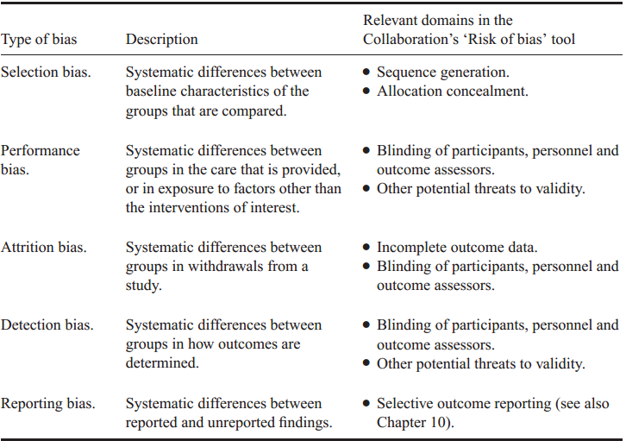
Critical Appraisal/Risk of Bias Assessment
Type of Bias and methods used to minimize risk of Bias

Slide 13
Critical Appraisal/Risk of Bias Assessment
Additional things to be considered During Appraisal
The review question
The research questions- the original study
SMART
Study arguments and coherence
Study relevance
Evidence gap

Slide 14
Critical Appraisal/Risk of Bias Assessment
Additional things to be considered During Appraisal
Should be done using the standard
There are numbers of standardized tools/instruments
JBI appraisal tools/checklists are more preferred
Numbers and contents of appraisal criteria deepened on:
The specific study design
The review question
The procedure and tools/instruments should clearly describe:
In the protocol
Final review report

Slide 15
Critical Appraisal of Experimental studies
Domains of JBI tool used for RCT studies Appraisal
Was true randomization used for assignment of participants?
Was allocation to treatment groups concealed?
Were treatment groups similar at baseline?
Were participants blind to treatment assignment?
Were those delivering treatment blind to treatment assignment?
Were outcomes assessors blind to treatment assignment?
Were treatment groups treated identically other than intervention of interest?
Was follow-up complete, and if not, strategies to address incomplete follow-up utilized?
Were participants analysed in groups to which they were randomized?
Were outcomes measured in same way for treatment groups?
Were outcomes measured in a reliable way?
Was appropriate statistical analysis used?
Was trial design appropriate for topic, and any deviations from standard RCT design and analysis?

Slide 16
Critical Appraisal of Experimental studies
Domains of JBI tool for Quasi-experimental studies
Is it clear in study what is ‘cause’ and what is ‘effect’ – is there no confusion about which comes first?
Were participants included in any comparisons similar?
Were participants included in any comparisons receiving similar treatment/care?
Was there a control group?
Were there multiple measurements of outcome both pre and post intervention/exposure?
Was follow-up complete, and if not, any strategies to deal with loss to follow-up employed?
Were outcomes of participants included in any comparisons measured in the same way?
Were outcomes measured in a reliable way?
Was appropriate statistical analysis used?

Slide 17
Critical Appraisal of Experimental studies
During Appraisal
A good understanding of research design is required in appraisers
Each criteria should be evaluated by at least two independent reviewer
Criteria scored as:
Being met/ low risk of bias
Not met/ high risk of bias
Unclear or not applicable
Document summary of the risk of bias assessments for each important outcome (across domains)
Within studies
Across studies

Slide 18
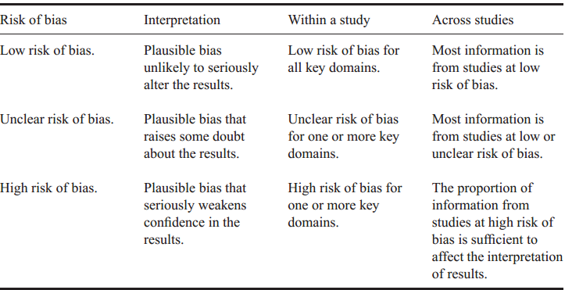
Critical Appraisal of Experimental studies
Level of the overall risk of bias assessments

Slide 19
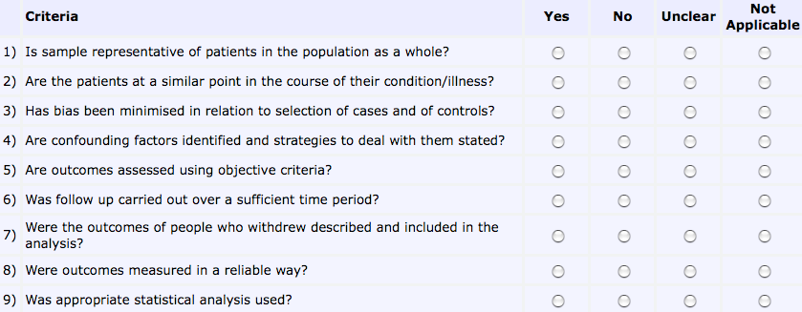
Critical Appraisal of Observational studies
Domain of JBI appraisal tool for cohort studies
Were groups similar and recruited from same population?
Were exposures measured similarly to assign people to both groups?
Was exposure measured in valid and reliable way?
Were confounding factors identified?
Were strategies to deal with confounding factors stated?
Were the groups/participants free of the outcome at the start of the study?
Were the outcomes measured in a valid and reliable way?
Was the follow up time reported and sufficient to belong enough for outcomes to occur?
Was follow-up complete, and if not, were the reasons to loss to follow-up described and explored?
Were strategies to address incomplete follow-up utilized?
Was appropriate statistical analysis used?

Slide 20
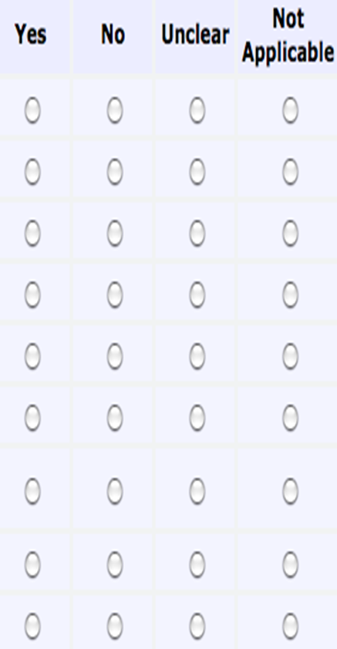
Critical Appraisal of Observational studies
Domain JBI appraisal tool for Case-control studies
Were the groups comparable other than the presence/absence of disease ?
Were cases and controls matched appropriately?
Were the same criteria used for identification of cases and controls?
Was exposure measured in a standard, valid and reliable way?
Was exposure measured in the same way for cases and controls?
Were confounding factors identified?
Were strategies to deal with confounding factors stated?
Were outcomes assessed in a standard, valid and reliable way in both groups?
Was the exposure period of interest long enough to be meaningful?
Was appropriate statistical analysis used?

Slide 21
Critical Appraisal of Observational studies
Considered:
Main types of bias
Selection bias (includes sampling and non-response bias)
Information bias (measurement, detection, recall, observation, classification, analysis and reporting bias)
Confounding
Apparent effect is not true effect
Can be important threat to validity of results
Adjustments for confounding factors
Multivariate analysis ???
Each criteria should be rated as Yes, No, Unclear and NA

Slide 22
Critical Appraisal/Risk of Bias Assessment
Description of critical Appraisal Procedures
Describe how methodological quality will be assessed
Describe how results of critical appraisal will affect decisions
Regarding study inclusion and exclusion
Describe any exclusion criteria based on quality considerations
Describe how critical appraisal results will affect data analysis
Include appropriate critical appraisal instruments in appendices

Slide 23
Critical Appraisal/Risk of Bias Assessment
Description of critical Appraisal Procedures
Narrative summary of overall methodological quality for included studies
Supplementary document for excluded studies
Supported by a table showing results of critical appraisal
Reference appropriate critical appraisal instruments in appendices
Any deviations from protocol must be reported and explained

Slide 24
Critical Appraisal of Experimental studies
Decision on Risk of Bias assessment/ Quality of study
Decision to include/exclude studies can be based on:
Meeting a predetermined proportion of all criteria
Meeting certain criteria
Whatever decision it needs to be:
Transparent
Documented at least in the protocol
Weighing criteria differently and independently
Thus, blinding of assessors considered twice as important to blinding of caregivers
Every review must set out to use an explicit appraisal process,
Use of an agreed tool is preferred

Slide 25
Critical Appraisal of Experimental studies
Group Activity/ Working in pairs,
Identify two original studies:
One Experimental
One observational
Read your designated paper and complete an appraisal using JBI tools
Report your individual risk of bias assessment result
Check if there is any discrepancies and justification
Tips for Practical Considerations
Discuss acceptable criteria for each question
Keep detailed notes/comments for each answer

Slide 26
Critical Appraisal of Observational studies
Higgins, J. P. T., et al. (2019) The Cochrane Risk of Bias Tool (RoB 2). BMJ, 366, l4898.
Sterne, J. A., et al. (2016) ROBINS-I: Risk Of Bias In Non-randomized Studies - of Interventions. BMJ, 355, i4919.
Whiting, P. F., et al. (2011) QUADAS-2: A revised tool for the quality assessment of diagnostic accuracy studies. Ann Intern Med, 155(8), 529–536.
Page, M. J., et al. (2021) The PRISMA 2020 statement: an updated guideline for reporting systematic reviews. BMJ, 372, n71.
Murad, M. H., et al. (2014) How to read a systematic review and meta-analysis and apply the results. Mayo Clin Proc, 89(6), 835–840.

Slide 27
Thank you

